Slide 1
Side Event:
Water-Energy-Food Nexus for Sustainable Development
Junguo Liu
President and Professor
North China University of Water Resources and Electric Power
Zhengzhou, Henan Province, China

Slide 2
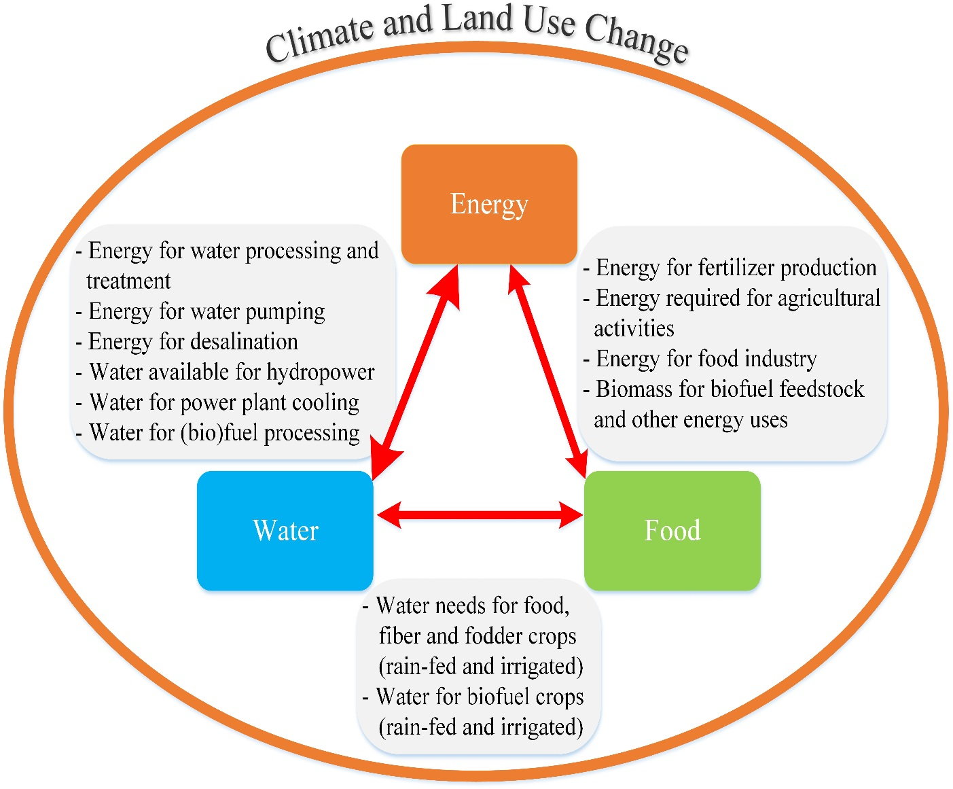
Energy production accounts for 15% of world water use
Water withdrawal, distribution & wastewater treatment account for 8% of world energy use
Food production and its supply chain account for 30% of energy use
Agriculture accounts for 70% of water use and 90% of water consumption
Liu J.*, et al.., 2017. Challenges in Operationalizing the Water-Energy-Food Nexus, Hydrological Sciences Journal 62 : 1714-1720

Slide 3
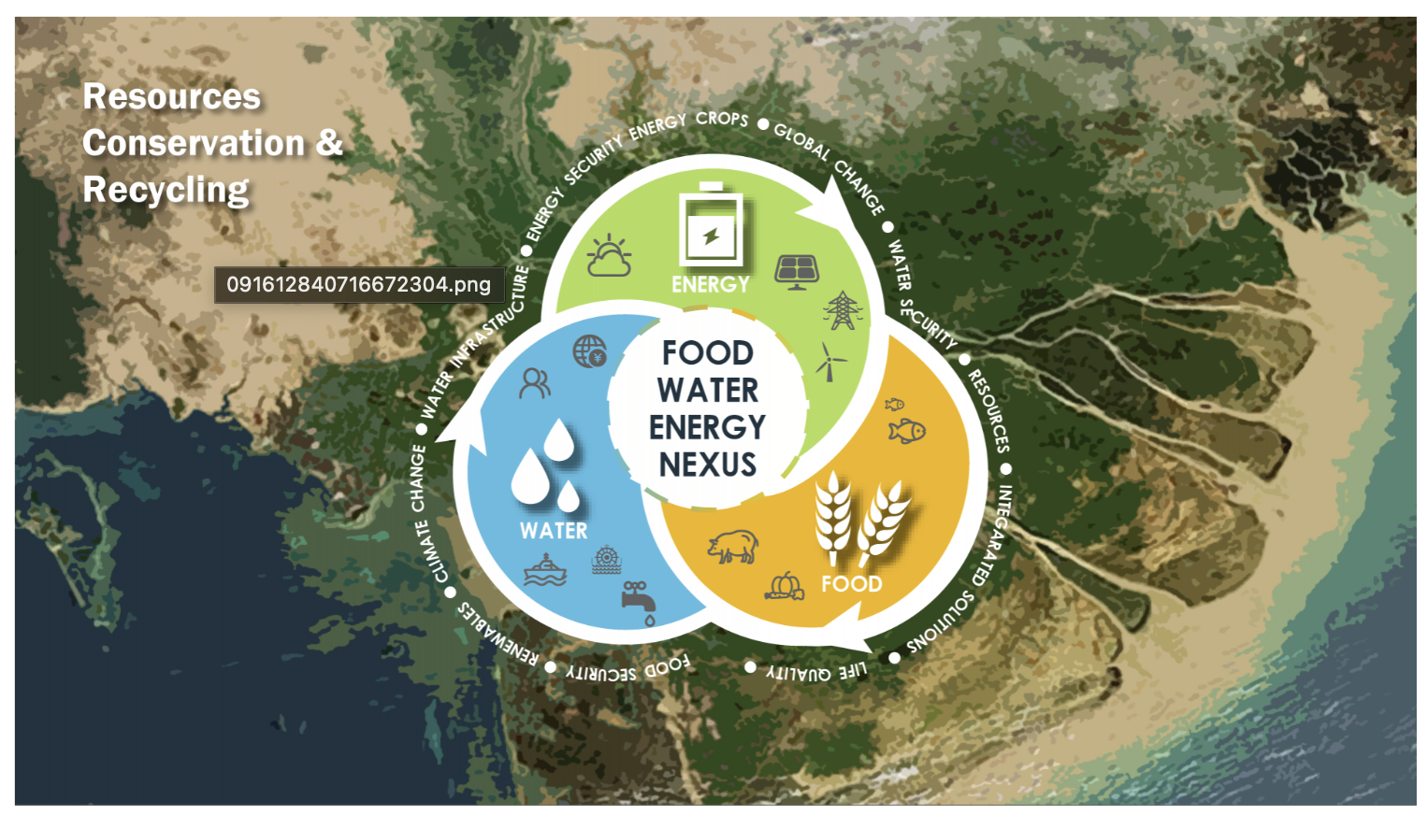
The Background of this Side Event
The interdependence of water, energy, and food is pivotal to sustainable development
As climate change intensifies, challenges such as uneven water distribution, fluctuating energy demands, and unstable agricultural production are becoming more prominent
Exploring profound impacts of climate change on the water-food-energy nexus is essential for achieving long-term sustainability

Slide 4
Topics of Side Event
Focus on the following topics:
Earth observations and advanced technologies for water and energy efficiency
Sustainable agricultural practices conserving water and increasing food security
Opportunities and challenges for reducing environmental footprints
FOR
A
B
C
Advancing the United Nations Sustainable Development Goals
Sharing knowledge of water-energy-food nexus
Promoting actionable strategies and cross-sector partnerships

Slide 5
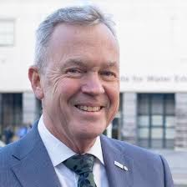
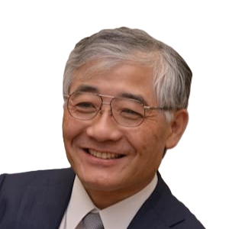
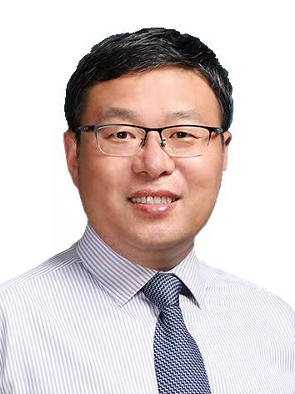
Side Event Speakers
Eddy Moors
Rector
IHE Delft Institute for Water Education
The Netherlands
Toshio Koike
Executive Director, International Centre for Water Hazard and Risk Management, Public Works Research Institute
Japan
Junguo Liu (Moderator)
President
North China University of Water Resources and Electric Power
China
Notes:
Toshio Koike, Executive Director, International Centre for Water Hazard and Risk Management, Public Works Research Institute
Junguo Liu, President / Professor, North China University of Water Resources and Electric Power

Slide 6
Side Event
1. Introduction (~5 minutes)
2. Presentations (~1 hour)
Each of the three speakers will have about 20 minutes to present.
3. Discussion (~20 minutes)
Focusing on exploring institutional collaborations among NCWU, IHE Delft, ICHARM, HUN-REN and potentially others.
The discussion will include reactions to the presentations, questions among the panelists, and space for new ideas.
The session will end with audience Q&A, moderated by the panel, followed by brief closing remarks from each speaker and a summary of key points.
4. Signing Ceremony
Eddy Moors and Junguo Liu will sign MoU on behalf of IHE Delft and NCWU
Notes:
Toshio Koike, Executive Director, International Centre for Water Hazard and Risk Management, Public Works Research Institute
Junguo Liu, President / Professor, North China University of Water Resources and Electric Power

Slide 7
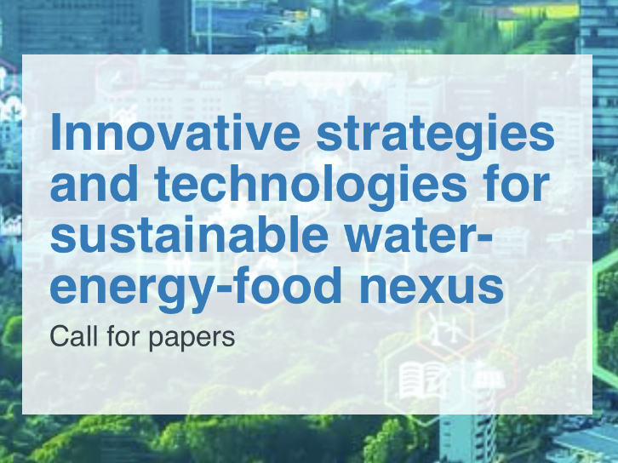
Special Issue in NEXUS
Guest editors:
Prof. Junguo Liu, President and Professor of North China University of Water Resources and Electric Power,China
Dr. Bridget Scanlon, Senior Research Scientist,University of Texas at Austin, Austin,TX, USA
Prof. Jie Zhuang,The University of Tennessee, Knoxville,TN 37996,USA
Editors:
Prof. Jerry Yan, Editor-in-Chief of Nexus,Chair Professor of the Hong Kong Polytechnic University
Prof. Michael Obersteiner, Editor of Nexus, Director and Professor of The Environmental Change Institute,The University of Oxford
Submission deadline: 31 December,2024
https://www.cell.com/nexus/special-issues/call-for-papers/sustainable-water-energy-food-nexus
7

Slide 8
Thank you!
Junguo Liu
North China University of Water Resources and Electric Power
Junguo.liu@gmail.com

