Slide 2
Ministerial roundtable I – Strengthening Trust in Science:
Promoting Effective Science-Policy-Society Nexus and Values in Science

Slide 3
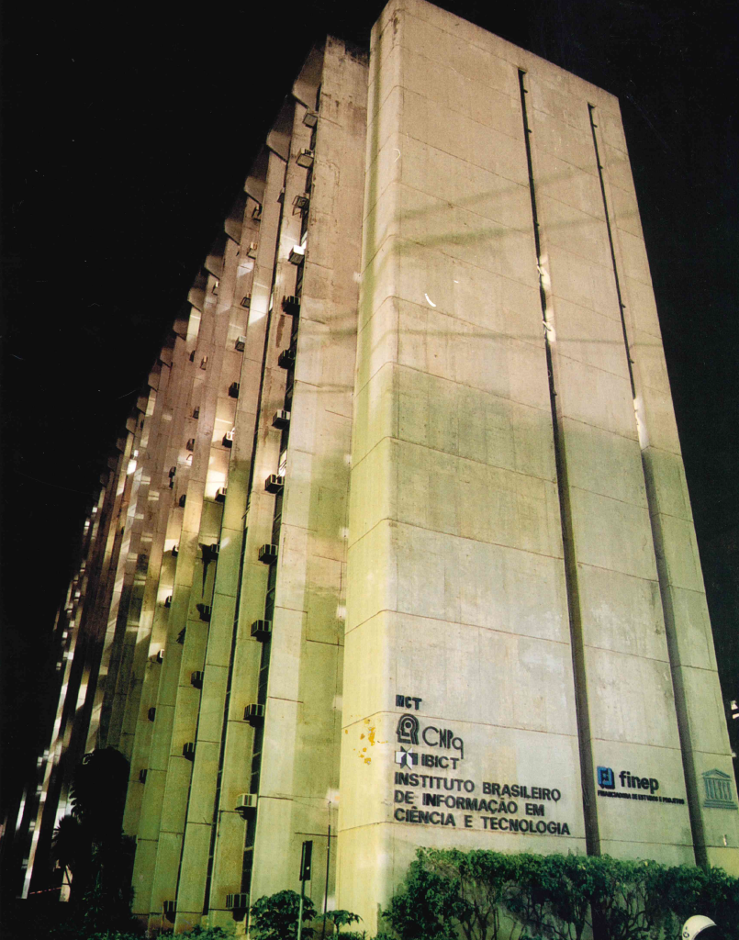
Brazilian Institute of Information in Science and Technology
Promote competence, the development of resources, and information infrastructure in science and technology for the production, socialization, and integration of scientific and technological knowledge.

Slide 4
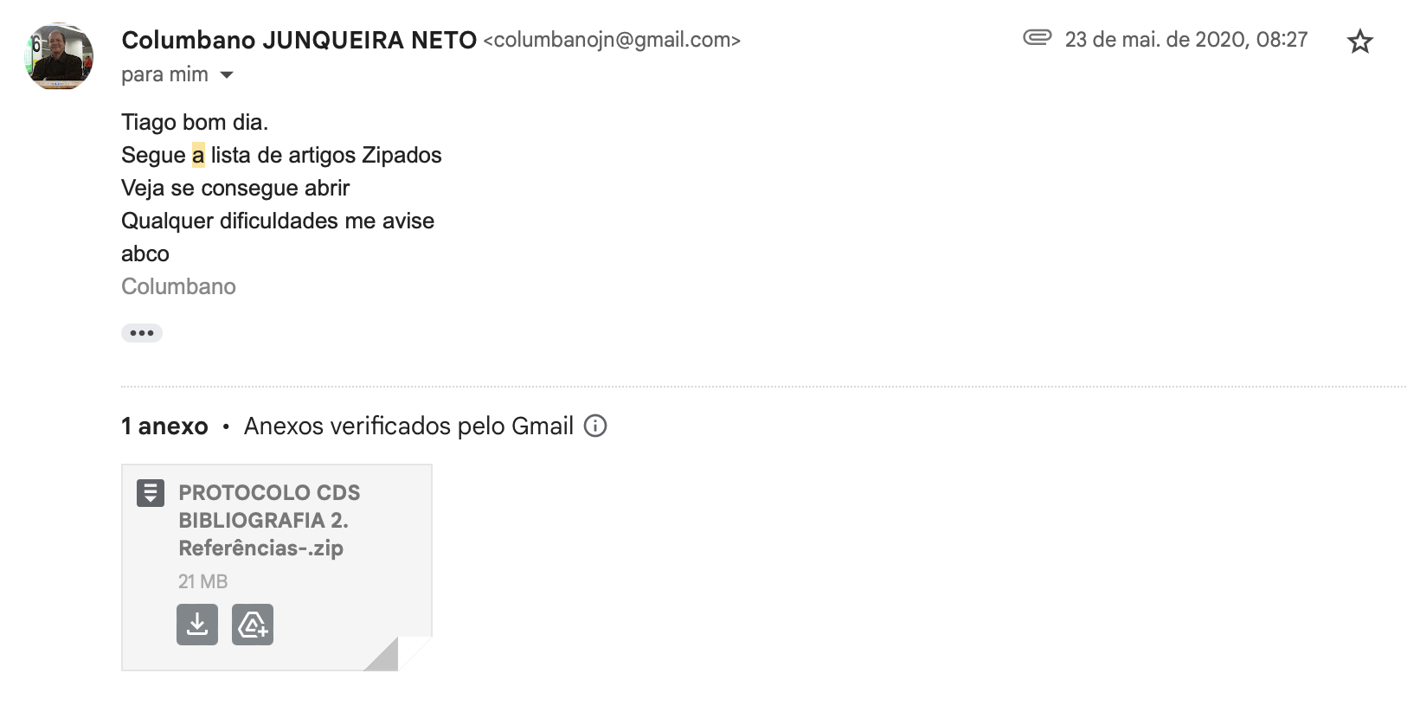

Slide 5
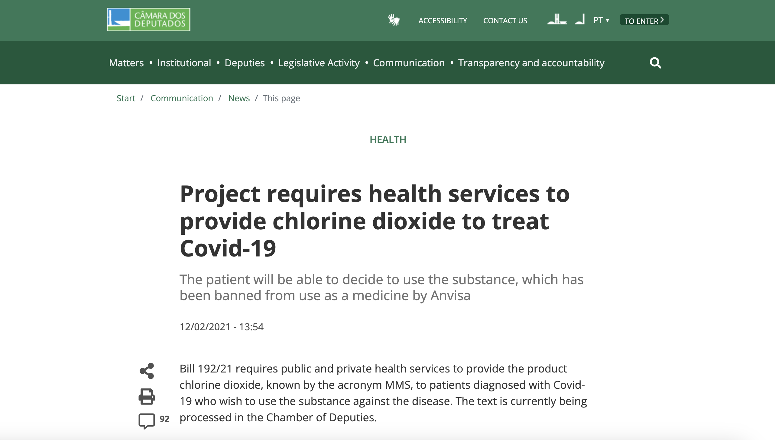

Slide 6
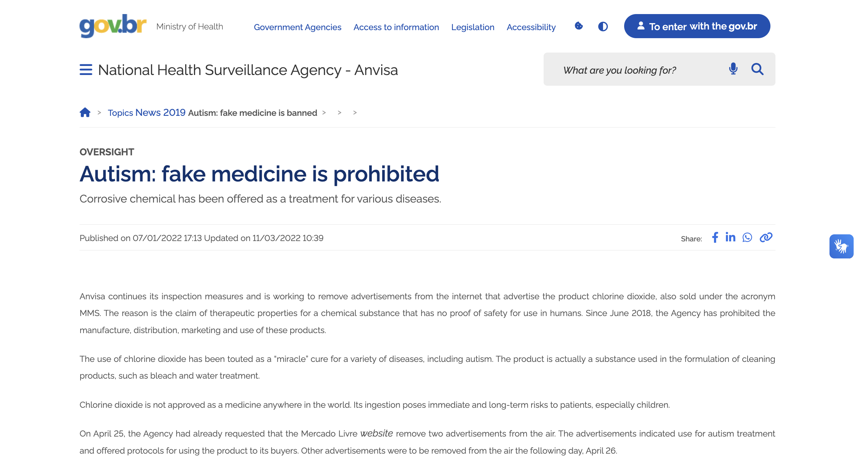

Slide 8
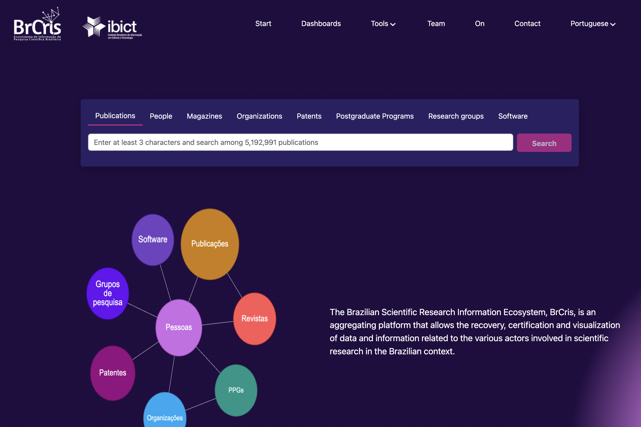
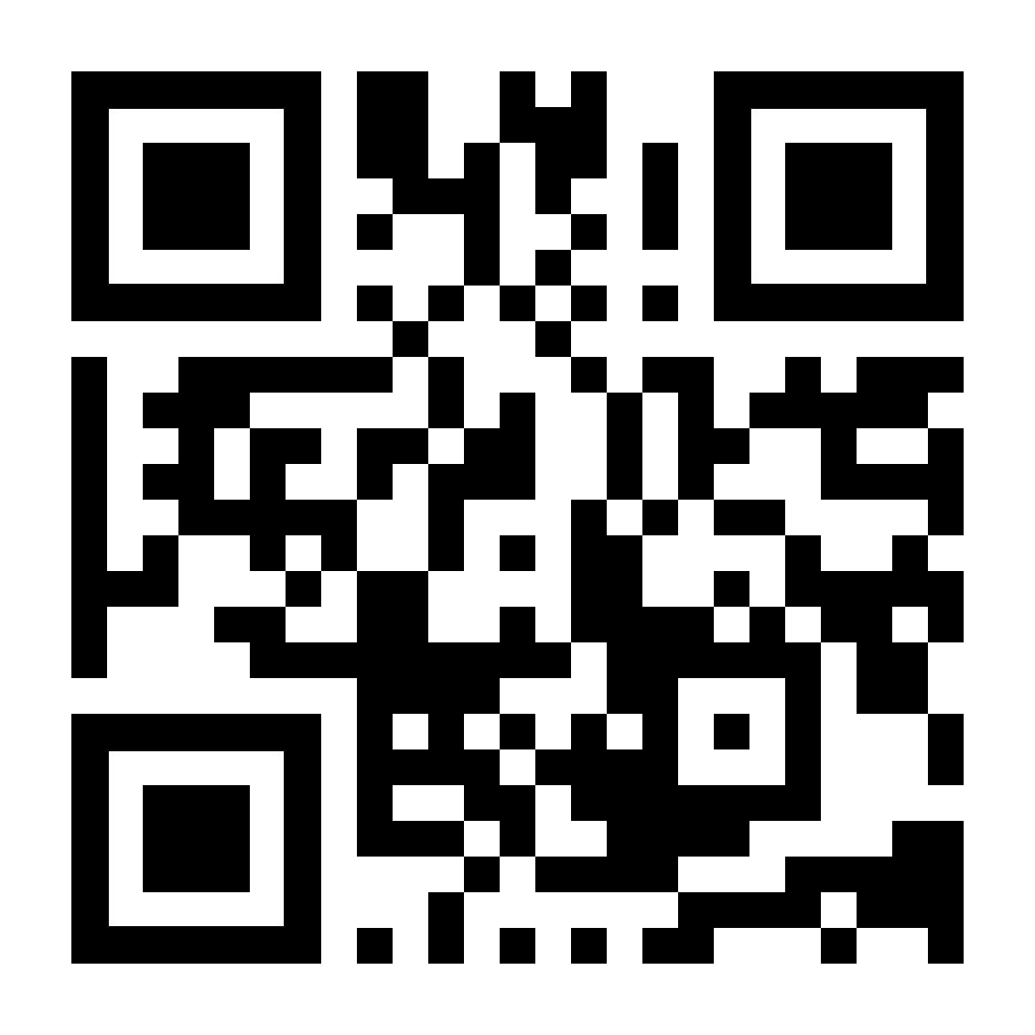

Slide 9
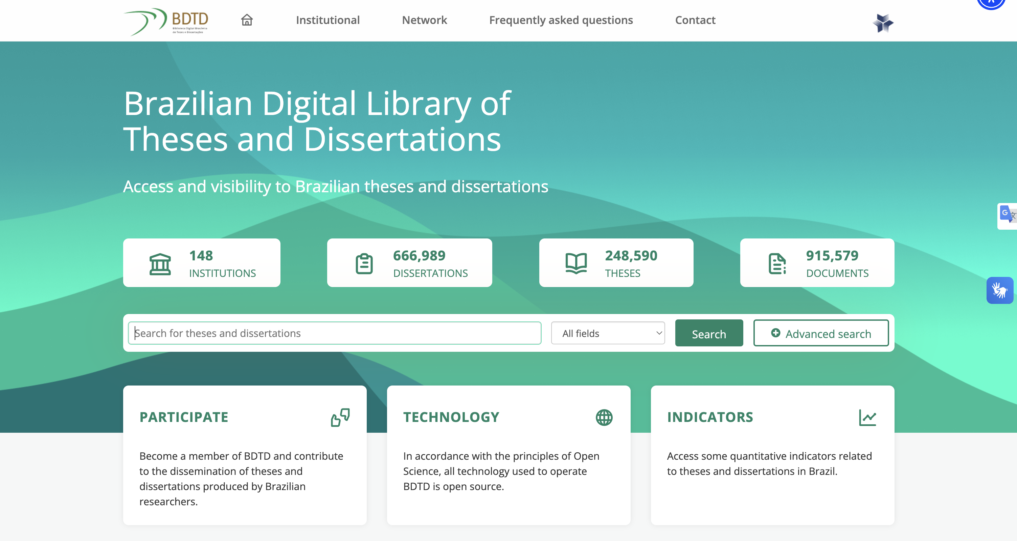
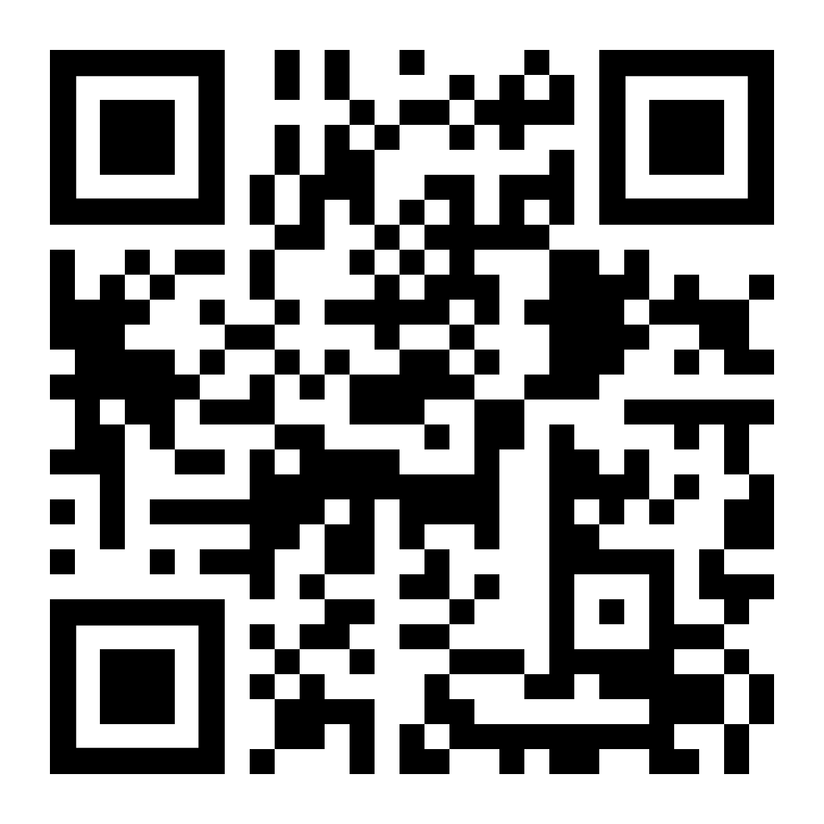

Slide 10
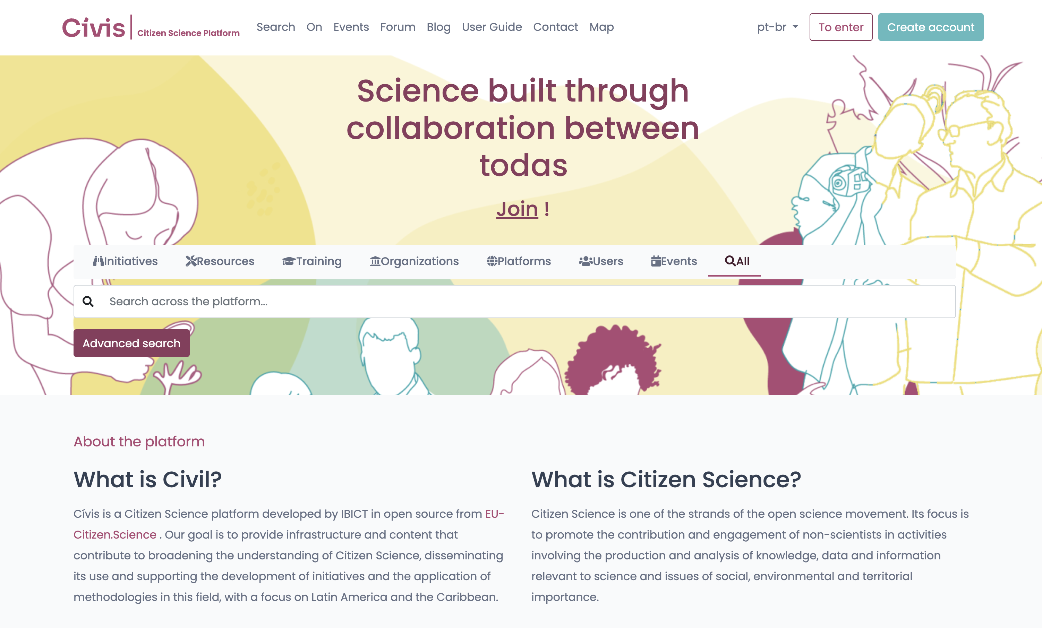
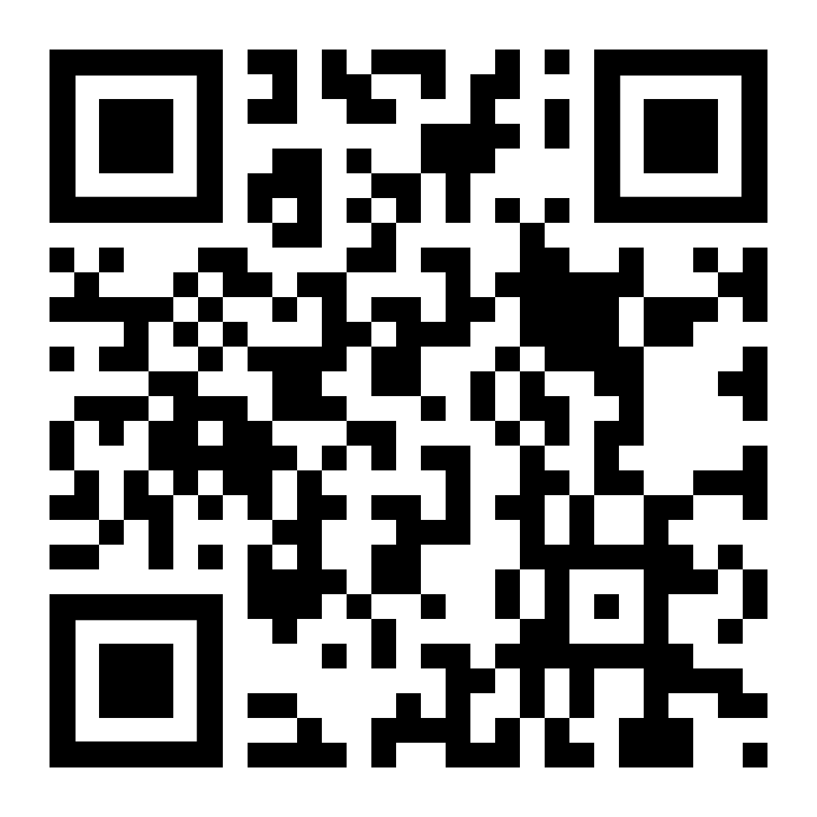

Slide 11
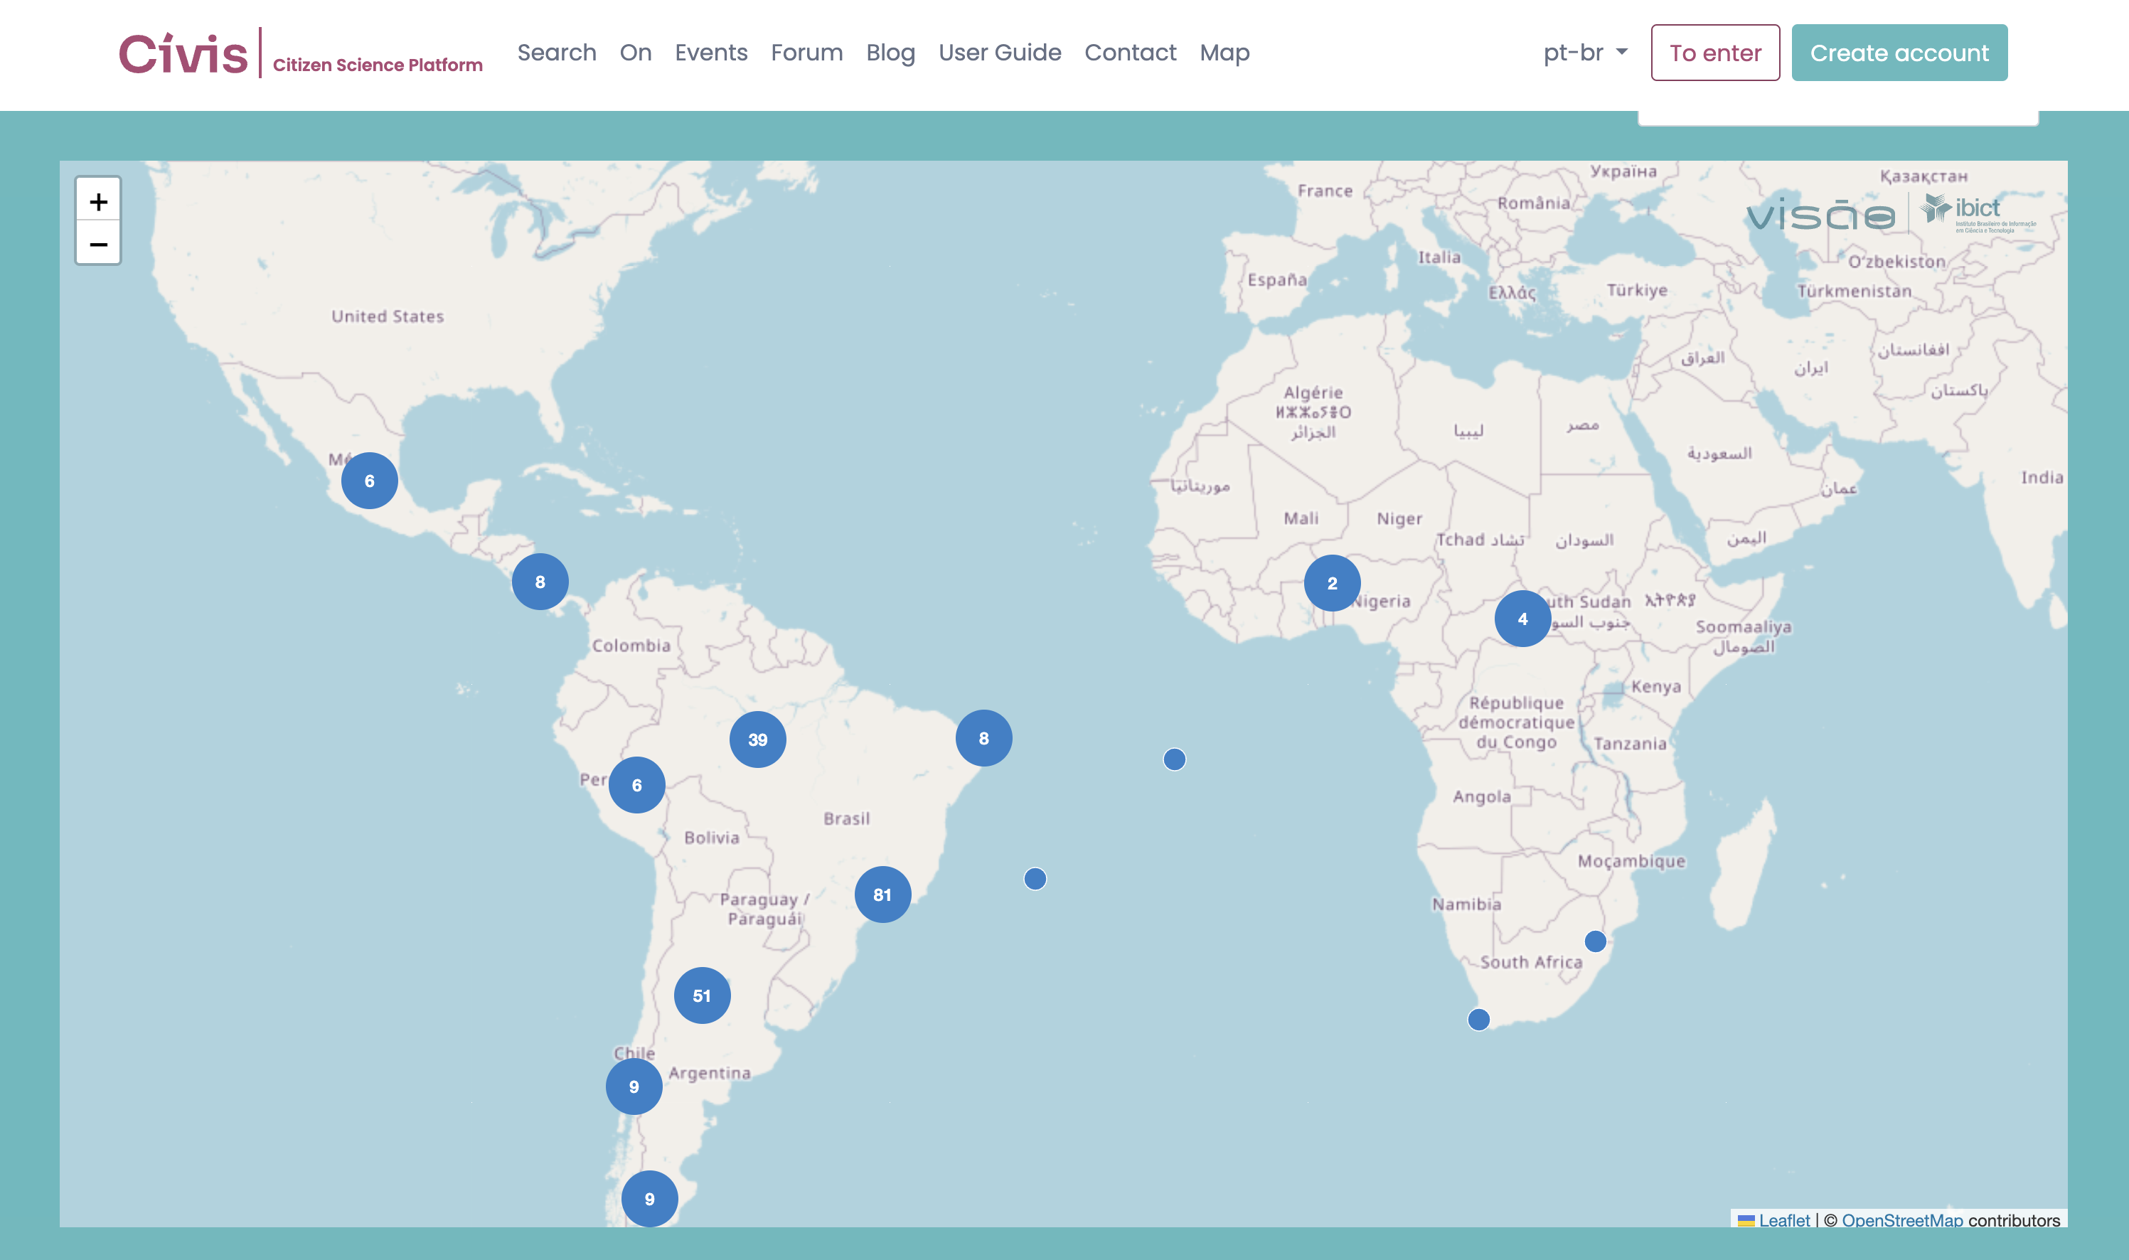

Slide 12
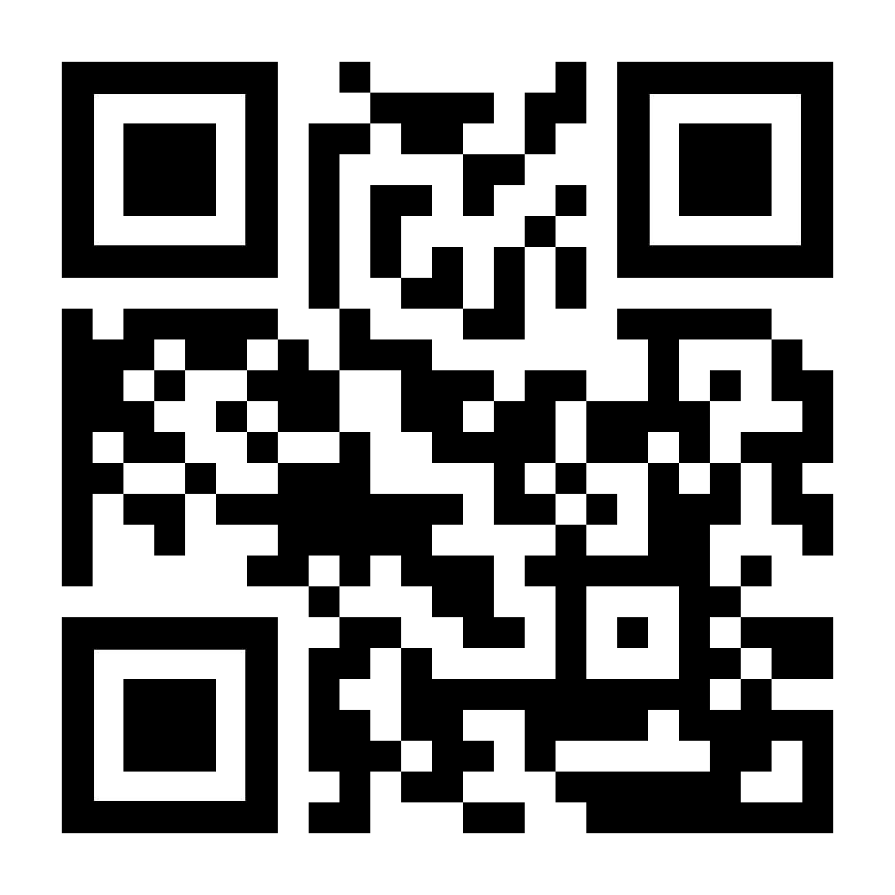

Slide 13
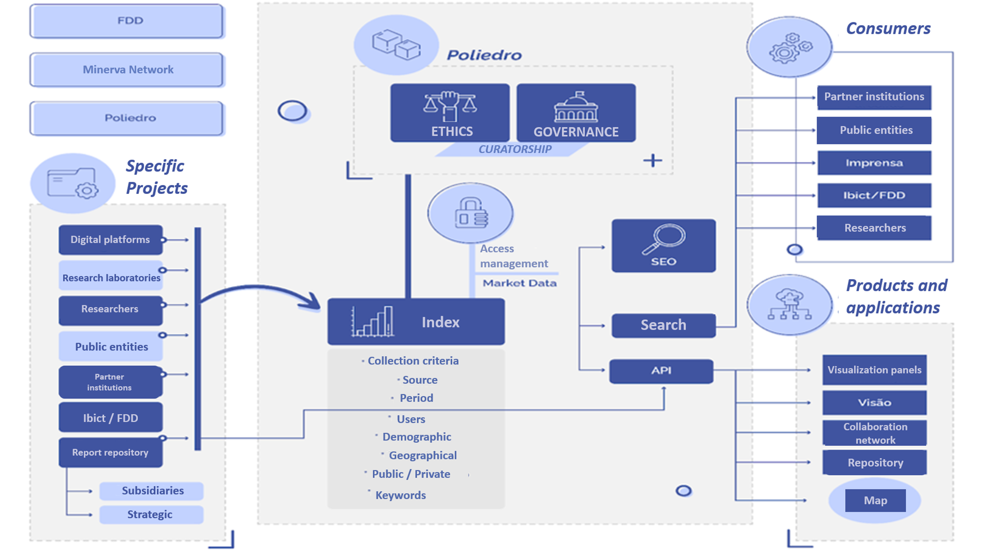

Slide 15
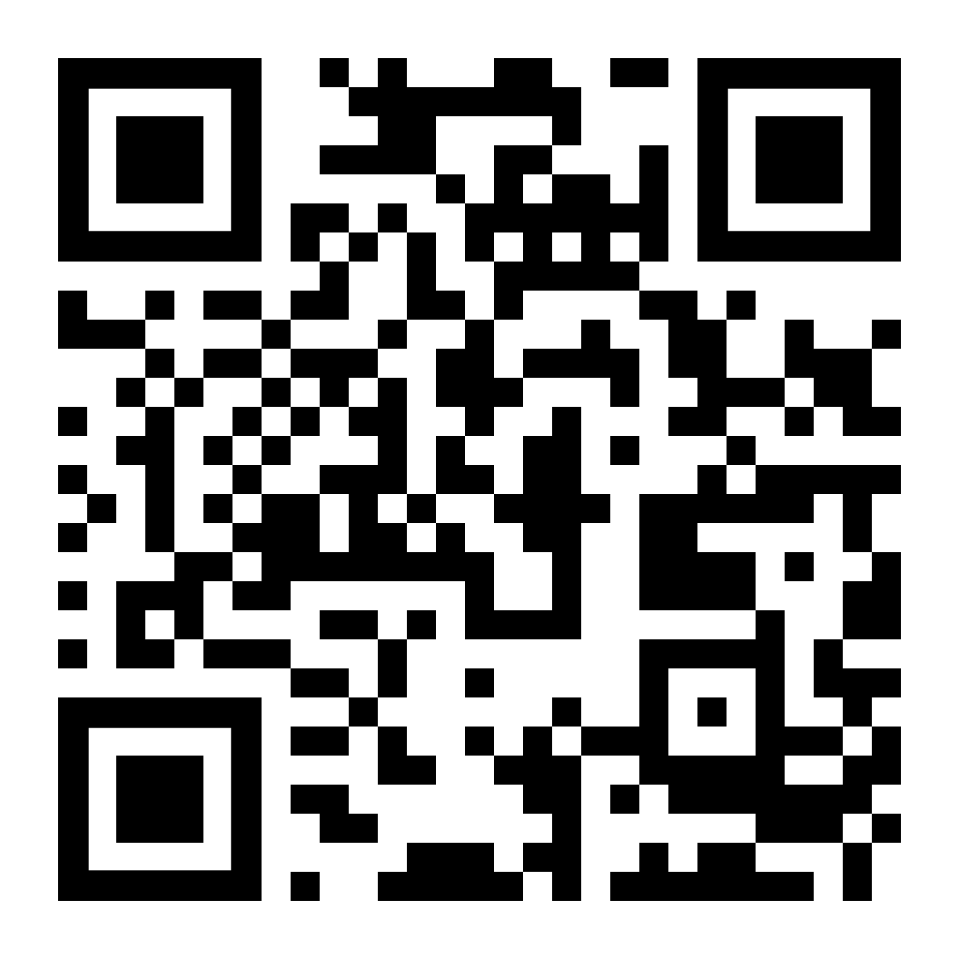
Thank you!
Tiago Braga
tiagobraga@ibict.br
Brazilian Institute of Information in Science and Technology
www.ibict.br

