Slide 1
Research Assessment:
Regional Perspectives and Unifying Actions
The World Science Forum (2024: Budapest (Hungary)
22 November 2024
Nosisa Dube
National Research Foundation South Africa
Evaluation and Impact Assessment Specialist
Director: Reviews and Evaluations
Global Research Council RRA Working Group (TFG1 Co-Lead)
RoRI Consortium (AGoRRA Co-Chairperson)
Nosisa.dube@nrf.ac.za; Nosisa.dube@gmail.com
+27 82 824 4659; +2712 481 4312; +2711 312 0208
South Africa
Notes:
My name is Nosisa Dube From the National Research Foundation of South Africa,

Slide 2
What, Why and How we Assess in the SSA Region
What we assess
Researchers’
Evaluation
01
Research Proposals/
Projects
02
Programs
Evaluation
03
Institutions’
Evaluation
04
Why (Purpose)
To benchmark Researchers against their global peers
Research Institutions use Rating of individual researchers for:
Recruitment and hiring,
Promotions & career progression,
Recognition, rewards & incentives
Access high-end funding
Review Career progression
To select research projects for funding support
To monitor the progress of ongoing projects
To evaluate performance of completed projects
To support relevant,, collaborative and impactful research.
To track programs are yielding that expected results
To inform approaches to future funding interventions
To assess research programme contributions to knowledge advancement, human capacity development and research capabilities
To account for Public investment;
To ensure continued organisational performance, relevance and sustainability
To informing decisions on organisational priorities
Magane
How
Processes: Mono, Multi, Trans disciplinary panels,
Interviews key stakeholders (beneficiaries) – comprehensive open reviews.
Principles and approaches: Subscribe to the GRC RRA Dimensions, DORA principles, GRC Merit Review Principles
Criteria: Relevance, Impact, implementation methods, team competences, Collaboration, transdisciplinary research
We Prioritize
We value research relevance, societal impact and knowledge advancement, transdisciplinary collaborative/engaged research addressing SDGS and pressing regional challenges that can be summed up to poverty alleviation, EDI, climate change expressed in national STI Policies.

Slide 3
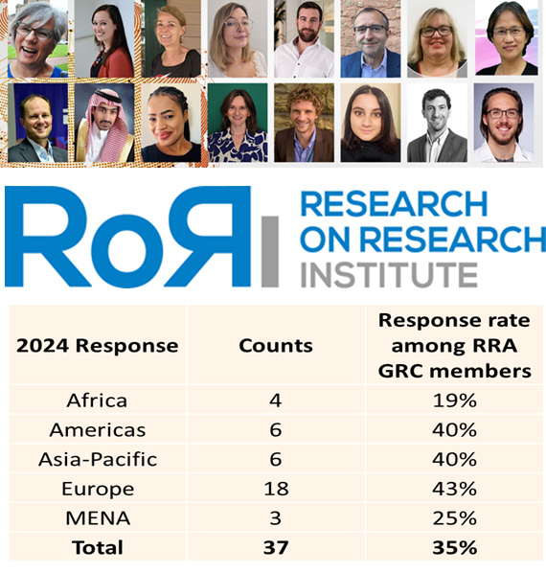
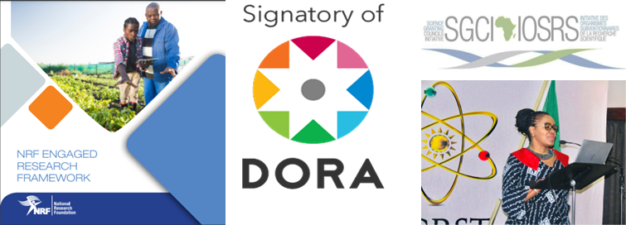
Research Assessment Reform Efforts in the SSA Region
The legislative mandate of the NRF provides the broad national intent for research that benefits society.
The frameworks outline the implementation and adoption of impact advancement and engaged research.
Using AI we track the demographics of funded researchers to honour our transformation agenda and harness EDI. We also track the number of Rated researchers to assess the strength of our science system
We raise awareness on Research Assessment Reform nationally/regionally and internationally.
Notes:
Research Assessment our context encompasses: the assessment of individual researchers, research projects, research programmes and Institutions

