Slide 2
Belgium’s SciTech Diplomacy: United in diversity
Maxim Vandekerckhove: Attaché @ Belgian Science Policy Office & Coordinator SciTech Diplomacy @ Brussels Diplomatic Academy

Slide 3
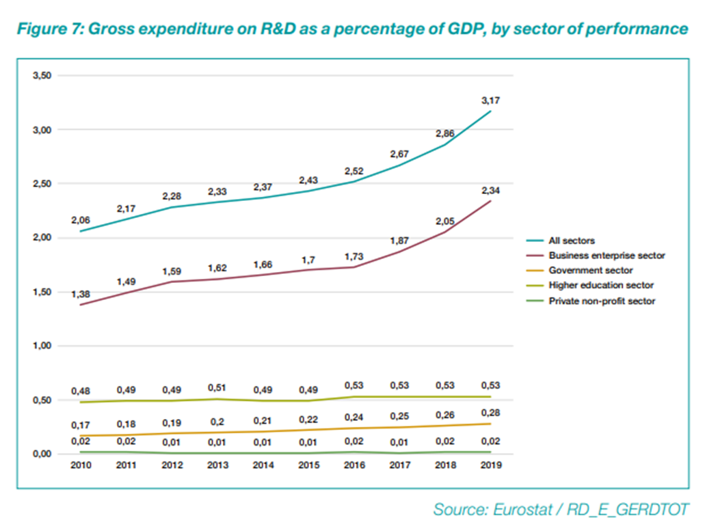
Federal Scientific Policy

Slide 4
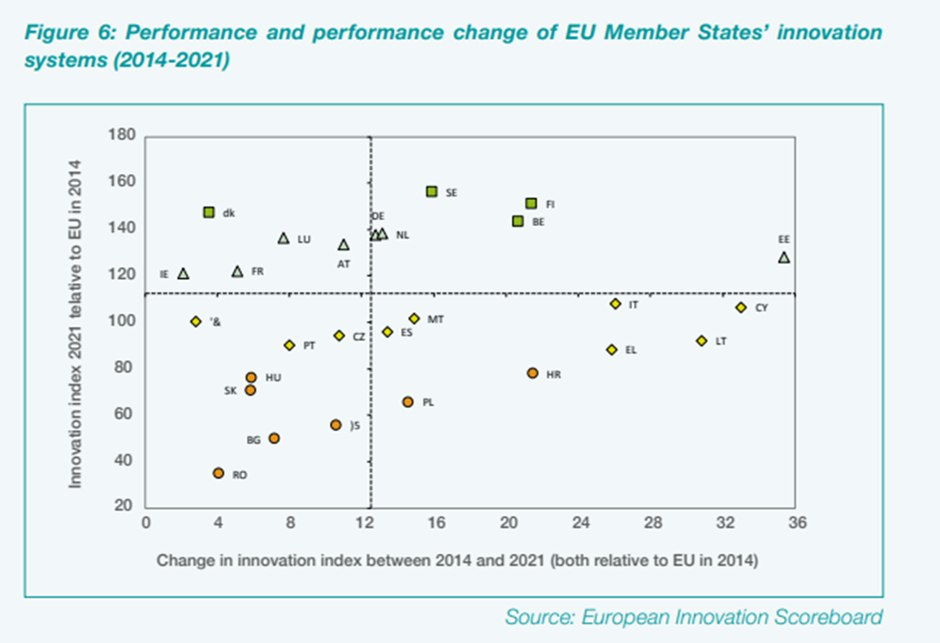
Federal Scientific Policy

Slide 5
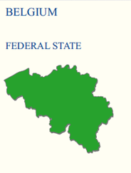
Belgium explained
Diplomatic Corps
Belspo
Diplomatic Corps
FIT
Hub.Brussels
AWEX

Slide 6
Strategies and plans
Federal level
Unofficially coordinated by Belspo
STI diplomacy is part of a “Science & Heritage” strategy
EU Science Diplomacy Agenda
SciTech strategy on federal level
No special STI councilors at National Embassies
Special Envoys
SciTech collaboration programs with India, China, Vietnam, South-Africa and Horn of Africa

Slide 8
Strategies and plans
Flemish Region
Flemish Diplomatic Corps
Flanders Investment and Trade (FIT)
STI councilors (10 councilors in 9 countries)
Commercial and economic councilors (70 offices)

Slide 11
Strategies and plans
Walloon Region
AWEX (Walloon Export and Foreign Investment Agency)
No diplomatic corps
93 commercial and economic councilors in shared and own offices
No STI councilors

Slide 13
Strategies and plans
Brussels Region
Hub.Brussels (Brussels Agency for Entrepreneurship)
No diplomatic corps
84 commercial and economic councilors in shared and own offices
No STI councilors

Slide 15
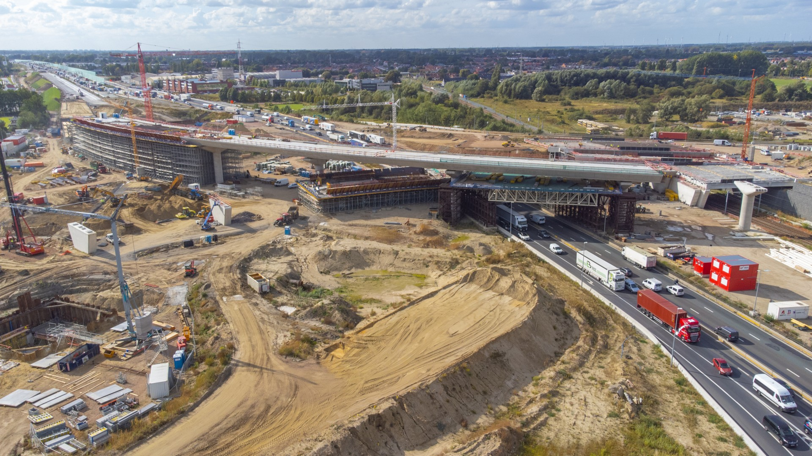
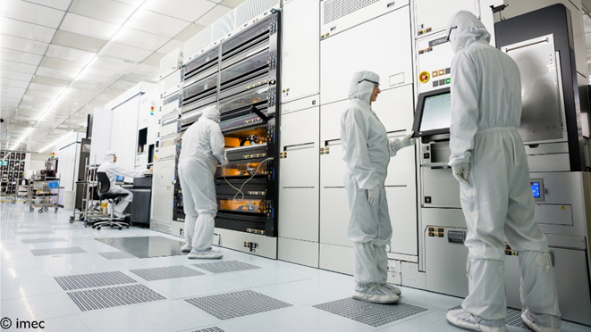
Prioritized fields of STI in Belgium
Epicenter of Tech Industry in Flanders
Chemical
Pharmaceutical
Biotech
Infrastructural
Environmental Engineering (blue cluster)
Social Sciences (SMIT program)
Nanotech (IMEC)

Slide 16
Industry defines SciTech Diplomacy
Impact of industrial players and individual employers
Agoria – Belgium’s national federation of technology companies
Business Development Clubs
Automotive
Building & Infrastructure
Energy
Sports & Entertainment
Food & Beverages
Big Science
VOKA – Flemish network of enterprises
VBO – Belgian network of enterprises

Slide 17
Belgium’s coordination mechanisms

Slide 18
Future outlook
Federal government
Synergy between STI diplomacy and cultural-heritage diplomacy
STEM (Science – Technology – Engineering – Mathematics) to STEAM (Science – Technology – Engineering – Art – Mathematics)
Strategic guidance paper based on EU Science Diplomacy Agenda

Slide 19
Future outlook
Flemish government
No new strategy since the establishment of a “STI councilor network” was the final step of the current strategy. This current strategy will mature for a while
Walloon & Brussels governments
No new strategies to be reported
EU
European Research Area (ERA) aka European Knowledge Area
Integrated approach with the European Higher Education Area

Slide 20
Belgium’s SciTech Diplomacy: united in diversity
Maxim Vandekerckhove: Attaché @ Belgian Science Policy Office & Coordinator SciTech Diplomacy @ Brussels Diplomatic Academy

