Slide 2
Science for Global Transformation: recommendations by the S20 academies
Helena B. Nader
Nov 22, 2024

Slide 3
G20 Mebers
Helena B. Nader
Nov. 22, 2024

Slide 4
UN Agenda 2030 – Leave no One Behind
In September 2015 at the United Nations General Assembly, 193 Heads of State and Government and High Representatives committed to the 2030 Agenda for Sustainable Development, emphasizing the eradication of poverty and sustainable development.
The 17 Sustainable Development Goals must ensure that the benefits of science are accessible to all.
Ethical principle of equity to support the most vulnerable populations around the world.
Helena B. Nader
Nov. 22, 2024

Slide 5
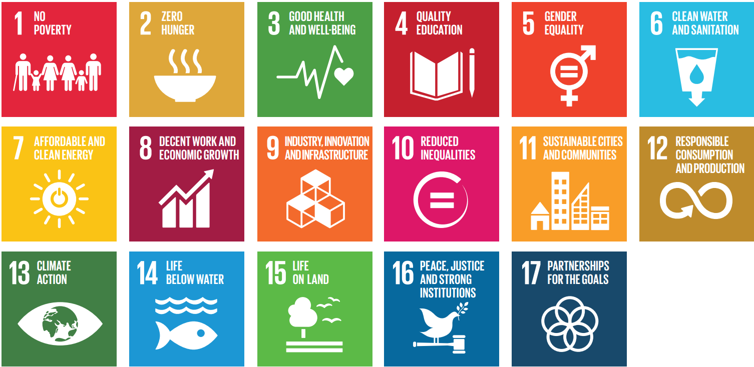
SDGs and the Challenges Facing Climate Changes in the World
Helena B. Nader
Nov. 22, 2024

Slide 6
Leave no one behind
Transformation 6
Digital revolution for
sustainable development
Transformation 1
Education, gender and
inequality
Transformation 5
Sustainable cities
and communities
Transformation 2
Health, well-being and demography
Transformation 4
Sustainable food, land, water and oceans
Transformation 3
Energy decarbonization and sustainable industry
Source: Sachs JD, Schmidt-Traub G, Mazzucato M et al. Six Transformations to achieve the Sustainable Development Goals. Nat Sustain 2, 805–814 (2019). Figure adaptaded from: TWI2050. Transformations to achieve the Sustainable Development Goals. Report prepared by The World in 2050 Initiative. (International Institute for Applied Systems Analysis, 2018).
Helena B. Nader
Nov. 22, 2024

Slide 7
S20 Brasil 2024
Science S20 Brasil aligns with the UN 2030 Agenda, focusing on five interconnected areas:
Artificial Intelligence: ethics, social impact, regulation, and knowledge sharing.
Bioeconomy: shaping the world toward a sustainable planet.
Energy Transition Process: renewable energies, social and economic considerations.
Health Challenges: quality, equity, access, and preparedness for epidemics and climate change.
Social Justice: promoting inclusion, ending poverty, and reducing inequalities.
https://bit.ly/s20documents
Helena B. Nader
Nov. 22, 2024

Slide 8
Artificial Intelligence
Artificial Intelligence (AI) is a critical driver for development, especially in healthcare, education, and tackling climate change. It may also pose risks, including the potential to widen inequalities and negatively impact the environment. To navigate these challenges effectively the S20 proposed in the Communiqué:
1. policies to assure job security and workers’ rights
2. regulations and data governance standards that benefit all countries
3. enable citizens to make informed decisions: benefits, limitations, and potential risks
4. create and share large, valuable, and well-curated scientific datasets
5. invest in data infrastructure, high-performance computing, and training to use AI
6. prioritize AI technologies for the benefits of humanity and environmental sustainability
7. fund research, develop, and effectively use of AI across various disciplines
8. establish regional academic research centers that share AI infrastructure.
9. establish intergovernmental bases to oversee AI technologies that may exceed human control
10. advocate for AI to contribute effectively to the Sustainable Development Goals
https://bit.ly/s20documents
Helena B. Nader
Nov. 22, 2024

Slide 9
Bioeconomy
S20 members understand that bioeconomy is based on the supply of goods derived from renewable biological resources (biobased products, food, feed, bioenergy, health supplies and pharmaceuticals) comprising all economic activities that depend upon these resources and their derivatives, protecting traditional knowledge and practices, and in line with the UN SDGs. To navigate these challenges effectively the S20 proposed in the Communiqué:
1. invest in research and infrastructure: to enhance innovations in biogenics feedstocks, bioenergy, medicines, and other materials from biomass, forest, plants and microorganisms from the biodiversity of different biomes.
2. integrate social justice: sustainable and inclusive bioeconomic models to enable community-driven innovations that protect and integrate traditional knowledge and culture
3. build robust international and multilateral cooperation: the G20 nations should reach a consensus on the role of the bioeconomy as one of the strategies for tackling climate change, biodiversity loss, poverty, and human and non-human health*. Formulate a framework that enables countries to implement bioeconomy programs, invest in social and technological innovations, share critical knowledge, improve quality of life and safeguard natural resources.
https://bit.ly/s20documents
*G20 Initiative on Bioeconomy (GIB) G20 High-Level Principles on Bioeconomy agreed in September by the G20 members
Helena B. Nader
Nov. 22, 2024

Slide 10
Energy Transition Process¹
The energy transition process requires continued innovation and international collaboration to achieve the UN SDGs and G20 countries must ensure just and equitable transitions. The Communiqué recommends:
1. the process should integrate clean energy sources such as solar, wind, hydropower, and geothermal, as well as mitigation and negative emissions through technological and nature-based approaches.
2. rely on the increasing use of low-emission energy sources, including nuclear and renewable energies, in a mix that varies from one country to another, and moving forward to phasing out coal.
3. carbon capture, utilization, and storage, along with market-based approaches, such as carbon pricing on a global scale, should be used for minimizing CO2 emissions
4. biofuels and sustainable hydrogen could be used for sectors as transportation and heavy industry.
https://bit.ly/s20documents
Helena B. Nader
Nov. 22, 2024

Slide 11
Energy Transition Process²
5. consider ocean energy sources, including tidal, wave, and thermal
6. batteries, complementing traditional renewable sources, for storage and energy transportation
7. energy efficiency and equitable reductions in energy demand, which are critical for mitigating climate changes
8. complete recycling processes for materials used in renewable energy systems
9. public outreach education by enhancing awareness of the principles of reduce, reuse and recycle
10. sharing of best practices among nations should be established
11. social and economic considerations include job creation, technological advancements, equitable access to energy, public engagement and environmental justice.
https://bit.ly/s20documents
Helena B. Nader
Nov. 22, 2024

Slide 12
Health Challenges¹
There is an urgent need to develop a more equitable, sustainable, and resilient health system particularly in communities with known vulnerabilities. It requires an integrated One Health approach with the interdependencies of people, animals, and ecosystems health. The Communiqué recommends:
1. global access to vaccines, medicines and diagnostic and promote production through capacity-building in research and innovation, knowledge sharing, and technology transfer
2. support global surveillance, open science, and information sharing for detection of health emergencies
3. address the challenges of antimicrobial resistance by urgent development of new antimicrobials and rational use of antibiotics in people and animals worldwide.
4. develop policies to promote healthy lifestyles, including physical activity and quality nutrition, to face obesity, tobacco, alcohol, substance abuse, ultra-processed food among others.
https://bit.ly/s20documents
Helena B. Nader
Nov. 22, 2024

Slide 13
Health Challenges²
5. effective communication strategies for disseminating health information, countering disinformation, and conducting health campaigns
6. digital health and technological transformations are crucial for supporting strong and resilient universal health systems.
7. prioritize mental health care, especially for the youth and groups with known vulnerabilities
8. develop long-term support for the management of the health of older people.
9. integrate climate change issues across all Health Working Group priority areas
10. address climate and environmental changes impact on communicable and non-communicable diseases by research and environmental management and improved surveillance.
11. leverage global resources focused on the health impacts of environmental and climate changes especially for groups with known vulnerabilities, such as those exposed to extreme weather events. Enhance climate-resilient health systems to better prepare for climate-related crises.
https://bit.ly/s20documents
Helena B. Nader
Nov. 22, 2024

Slide 14
Social Justice¹
Social justice requires ending poverty, reducing inequalities, and promoting inclusion so that no one is left behind. Harnessing the power of science is not only a pathway but a responsibility in this quest. Societies can create a more equitable and sustainable future through technological innovation, data-driven policymaking, and advancements in various scientific fields. Science should be seen inherently as a social practice requiring ethical considerations and awareness of its consequences. The Communiqué recommends:
1. construct a perspective of rights and guarantees that considers the value of developing institutions to promote social inclusion and cultural diversity
2. generate knowledge that enhance social, environmental, and human well-being; pursue scientific advances with ethical considerations and awareness of consequences.
3. combine social, natural, and life sciences to decrease discriminatory practices and promote social justice; apply scientific insights into human behavior to develop interventions challenging stereotypes and biases.
https://bit.ly/s20documents
Helena B. Nader
Nov. 22, 2024

Slide 15
Social Justice²
4. emphasize the ethical imperative of reducing all types of inequalities and use social justice to eliminate discrimination, intolerance, and violence to build a more equitable society.
5. universal internet access; enhance digital literacy to ensure all segments of society benefit from digital advancements with inclusive and equitable approaches.
6. address science-related disinformation in digital media to prevent adverse societal impacts.
7. cultivate scientific literacy and awareness of science as a self-correcting process; equip societies to meet future technological challenges through better scientific understanding.
8. promote education, social equality, and fair treatment for all: focus on health and well-being for all demographic strata; transition to sustainable energy and industry practices; ensure sustainability in food production, land use, water management, and ocean health; develop sustainable, just, and resilient cities and communities; harness the digital revolution for sustainable development.
https://bit.ly/s20documents
Helena B. Nader
Nov. 22, 2024

Slide 16
Endorsing S20 Members
https://bit.ly/s20documents
Helena B. Nader
Nov. 22, 2024

Slide 17
Special thanks to

