Slide 1
Knowledge co-production between science and traditional, indigenous and local knowledge
in global science-policy fora on biodiversity (IPBES, CBD)
Molnár, Zsolt
botanist, ethno-ecologist

Slide 2
TAKE HOME MESSAGES
Science is not enough for transformative change
All knowledges of humanity are needed to manage the multi-crisis
’Western’ science + indigenous/traditional knowledge
Relevance of knowledge: global vs. local?
Added value of looking through different eyes
More complex holistic understanding of the world
More relevant messages for practitioners and decision makers
Notes:
Let’s start with the two key messages of my contribution:
science is not enough…,
it is good two see through two eyes…

Slide 3
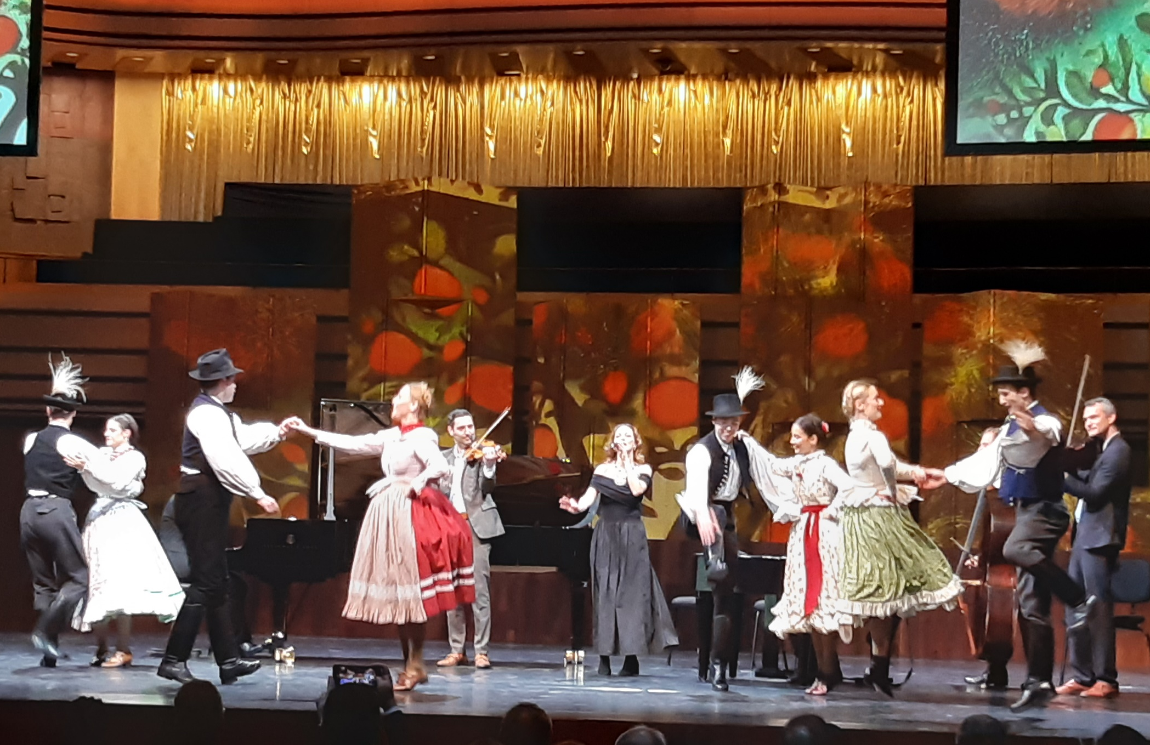
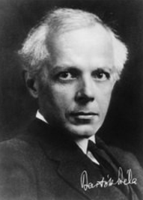
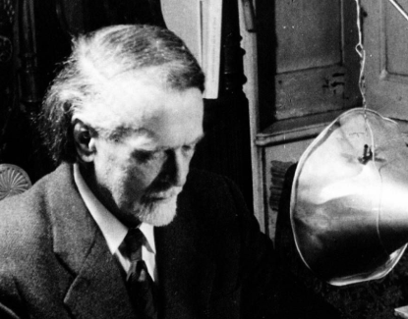
Music based on traditional folk music but merged with classical music
WSF Opening Ceremony
Béla Bartók
Zoltán Kodály

Slide 4
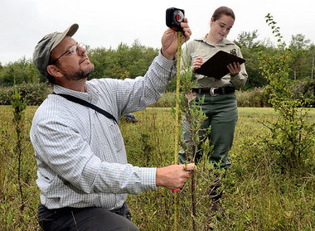
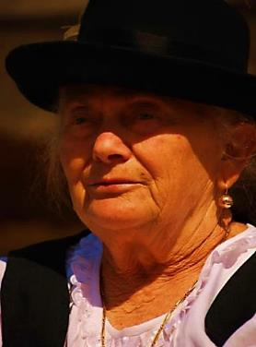
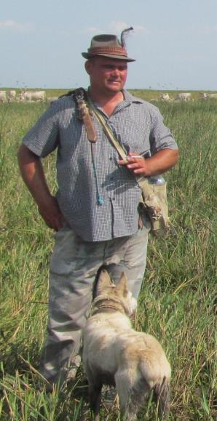
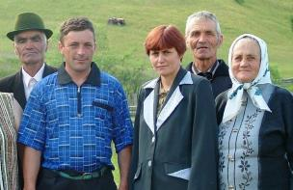
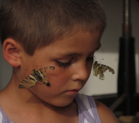
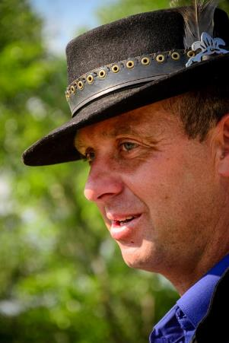
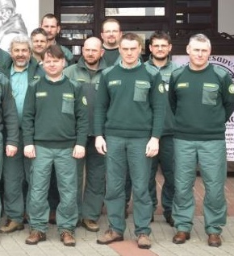
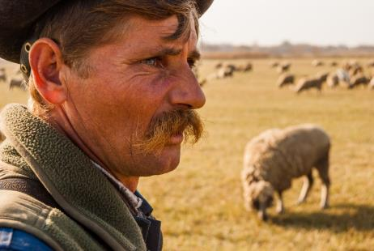
The traditional knowledge systems
Knowledgeable local land users
Often neglected, unrespected
Notes:
Experience shows that locals very often have a deep understanding of the environment, its changes and also about possible solutions.
However, this knowledge is often neglected and unrespected by scientists and decision makers.

Slide 5
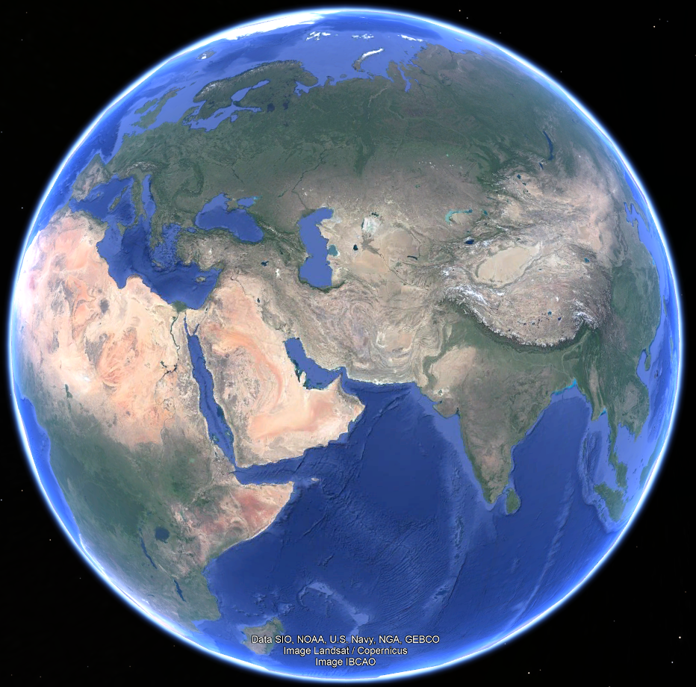
40% of the global land surface
is grazed
A key moment: turning plant biomass to meat biomass
(esp. on primary pastures not suitable for crop production)
>300 million pastoralists/herders
<50 scientific papers on this topic
knowledge gap (utilization / protection)
(videó: Budai, János)
Molnár Zs., Kelemen A., Kun R., Máté J., Sáfián, L., Biró, M. Máté A., Vadász Cs. (2020) J. Applied Ecology
Notes:
Let’s see a concrete example!

Slide 6
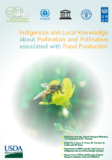
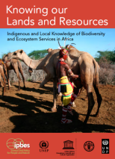
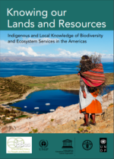
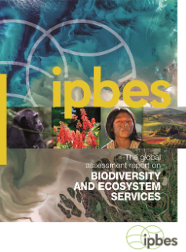
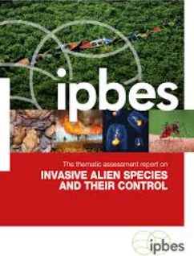
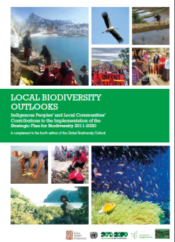
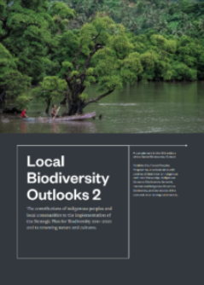
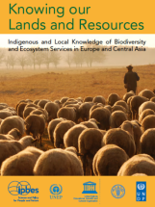
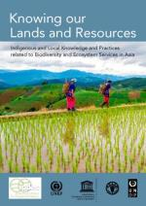
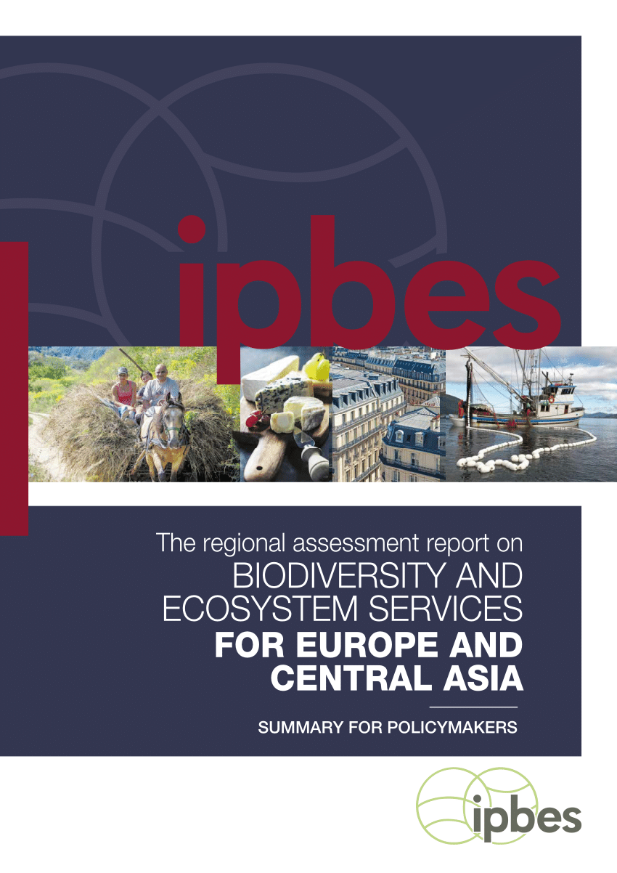
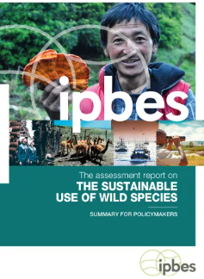
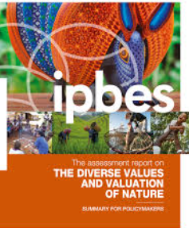
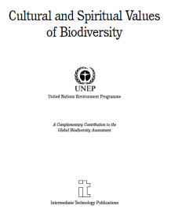
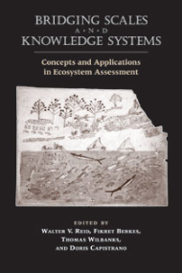
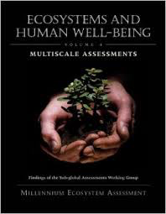
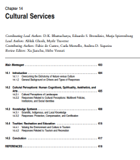
Some pre-IPBES efforts
Global-scale knowledge co-production between science and traditional knowledge
IPBES Dialogues and assessments
Convention on Biological Diversity
IPCC is late…
1999
2016
2005
2004
Notes:
There is an increasing number of reports, assessments where science worked together with indigenous and traditional knowledge at global level.
IPBES and CBD are the leading institutions in this process.

Slide 7
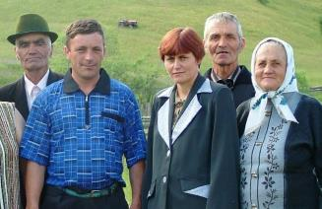
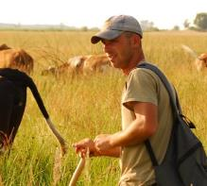
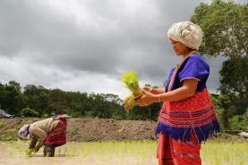
IPBES Operating Principles
Take an interdisciplinary and multidisciplinary (+ transdisciplinary) approach that incorporates all relevant disciplines
Recognize and respect the contribution of indigenous and local knowledge to the conservation and sustainable use of biodiversity and ecosystems
Challenges
Epistemological challenges (diverse worldviews)
Procedural challenges (participation of knowledge holders)
Notes:
I joined IPVES in 2014 and experienced, participated in the methodological development of how we can bring in Indigenous and traditional knwoledge into the assessments.
There is a huge progress, but approaches are still improving.
Dedicated work is needed because of the challenges these collaborations face.

Slide 8
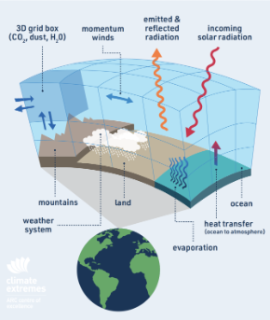
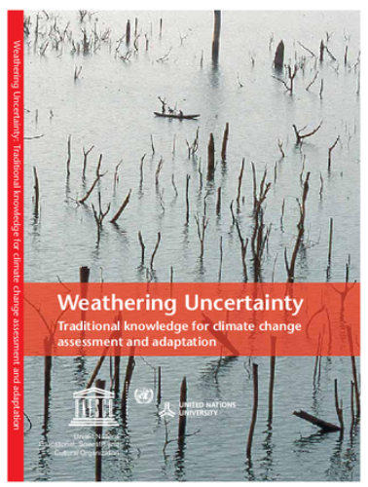
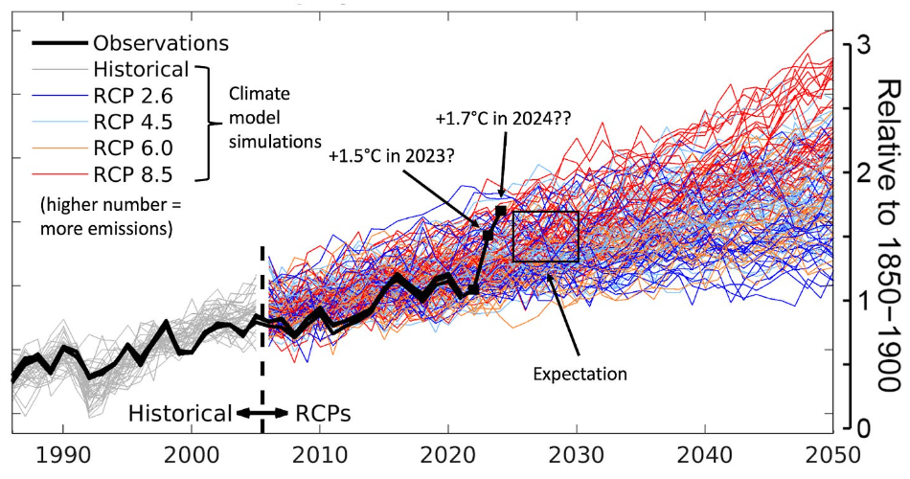
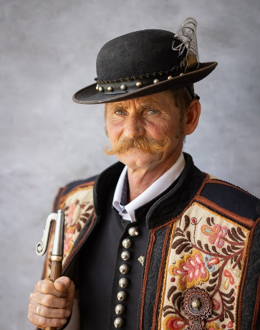
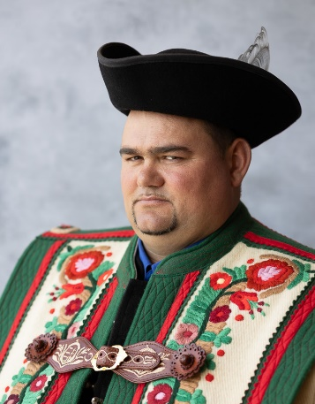
Global climate models vs. local adaptations
2012
Sáfián László
Barta Sándor
Notes:
Why do we need knowledge co-production?
Because science is able to work globally, but is unable to understand all local situations.
The two knowledge systems are different.

Slide 9
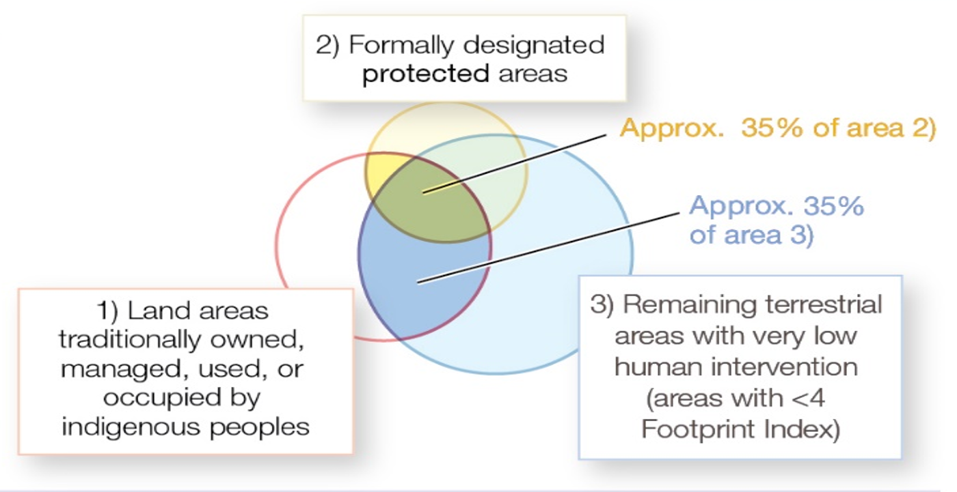
35-40% of nature protected areas and remaining ’natural’ areas are on Indigenous Peoples’ lands
We need human rights-based
approaches
Nature is degrading less rapidly
on IP lands
Garnett et al. (2018) Nature Sustainability
Notes:
Nearly 40% of protected areas and remainin natural land is on the lands of IP. So they are partners.
We know that nature is degrading less rapidly on their lands.

Slide 10
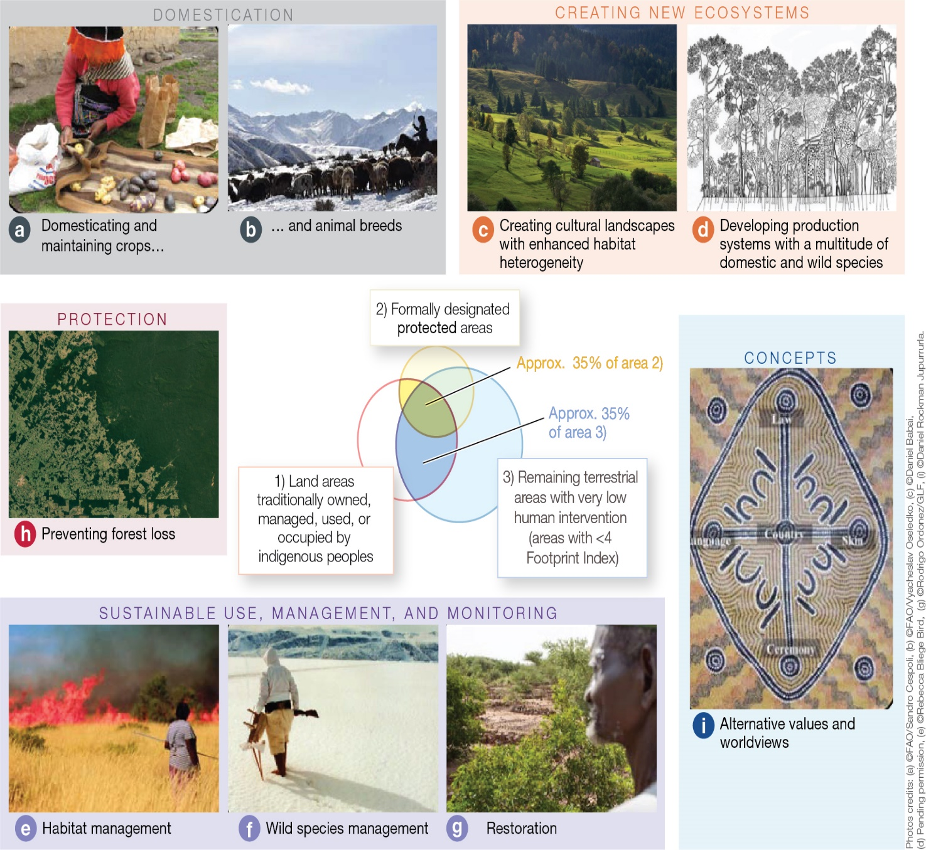
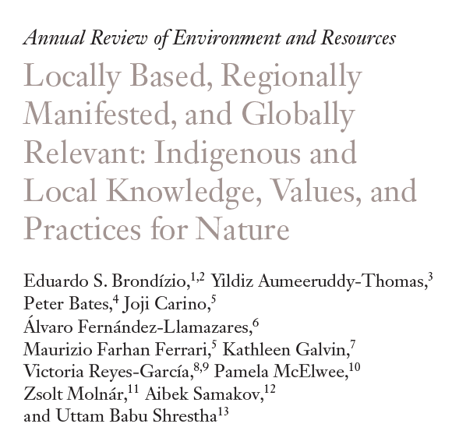
Contributions of Indigenous Peoples and local communities
to the protection and conservation of biodiversity
Domestication, adaptation
Creating new rich ecosytems
Protection
Concepts
Sustainable use, management and monitoring
IPBES (2019) Global Assessment: Summary for policymakers
Notes:
IP&LC contribute to the protection of BD in many and diverse ways.

Slide 11
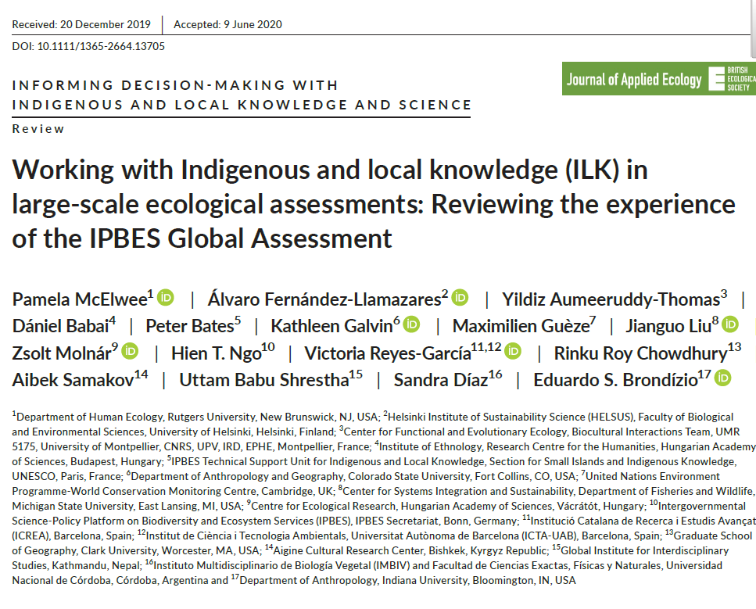
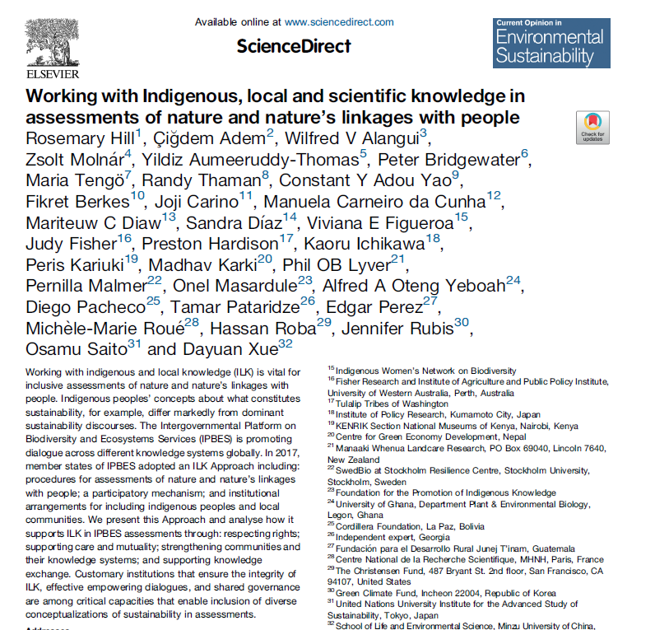
Tested methodologies
are available
Notes:
And we know, how we can collaborate with local knowledge holders, how we can do knowledge co-production!

Slide 12
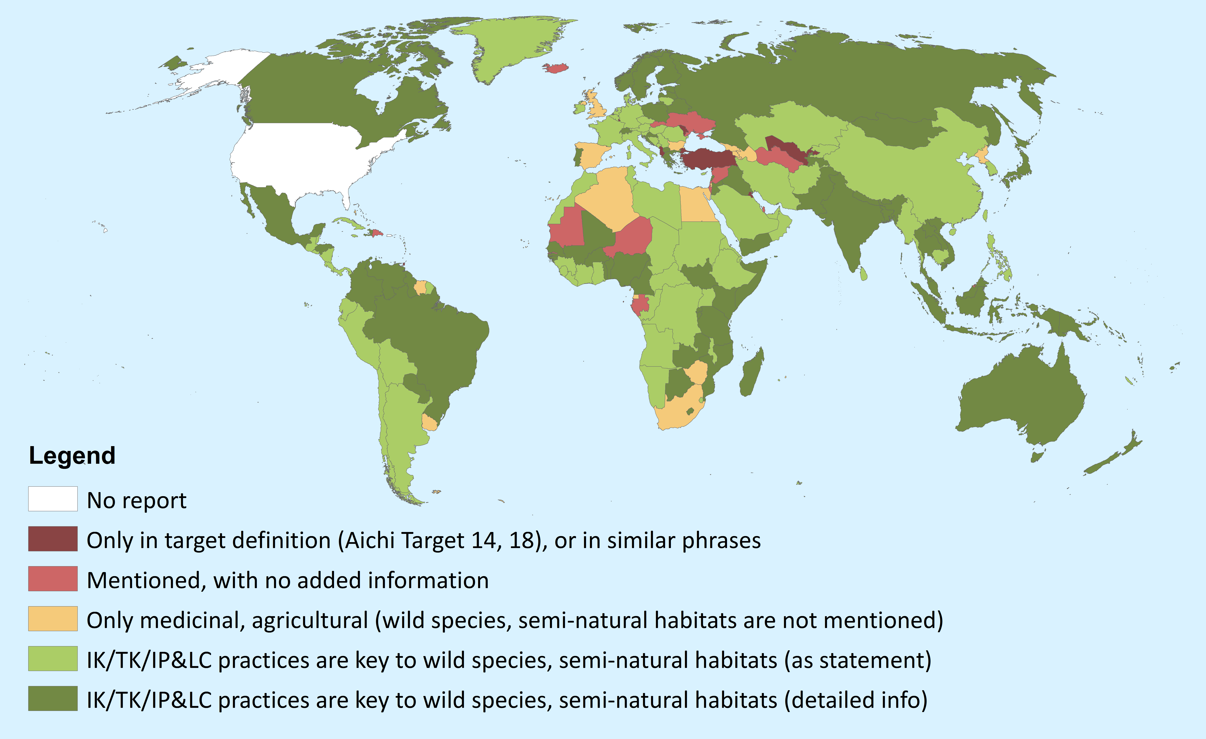
Inclusion of traditional/indigenous knowledge of Indigenous Peoples and local communites
in the Convention on Biological Diversity country reports
5th report
Öllerer et al. (in prep)
Notes:
Are we progressing? Yes, but slowly!

Slide 13
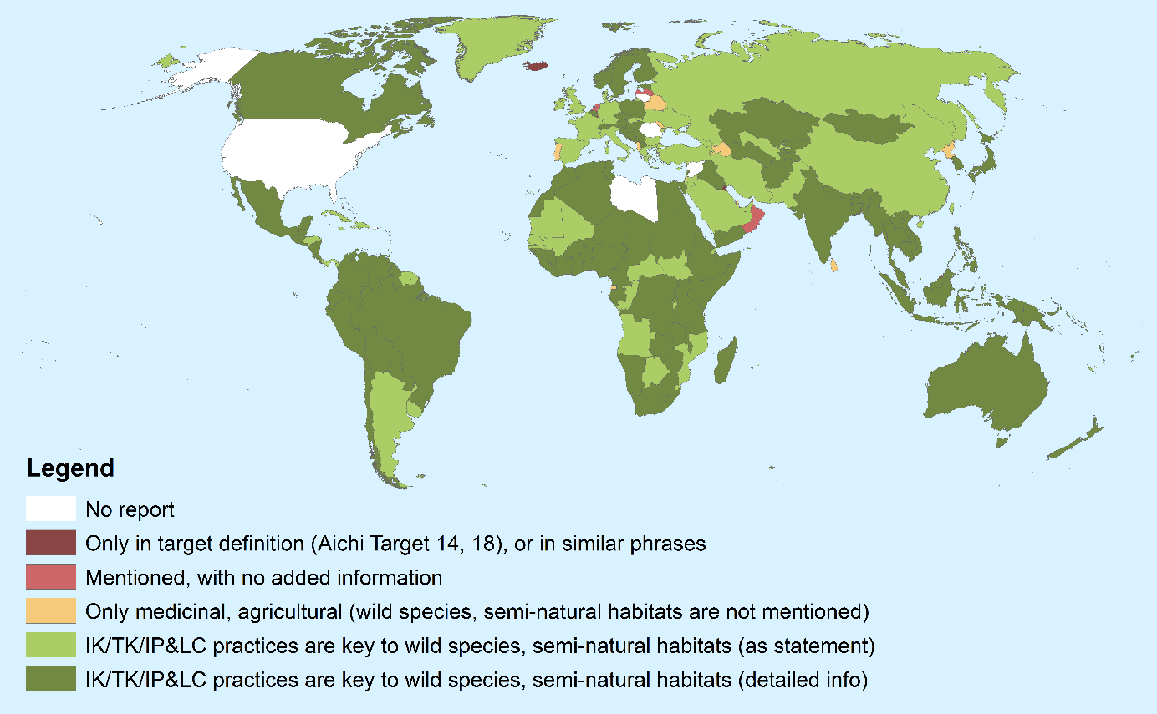
Inclusion of traditional/indigenous knowledge of Indigenous Peoples and local communites
in the Convention on Biological Diversity country reports
6th report
Öllerer et al. (in prep)
Notes:
More and more governments involve IPLC in their biodiversity policies. But there is much to be done.

Slide 14
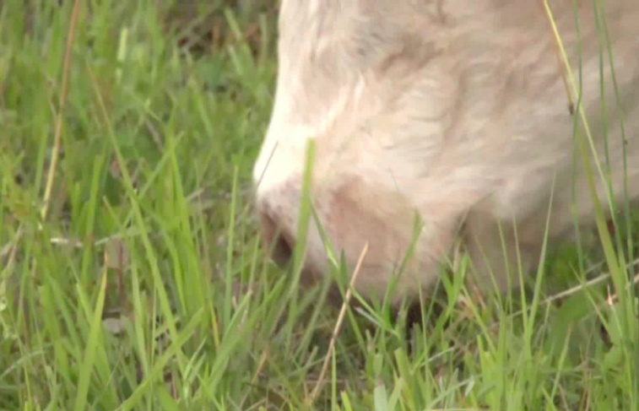
TAKE HOME MESSAGES
Science is not enough for transformative change
All knowledges are needed to manage the multi-crisis
’Western’ science + indigenous/traditional knowledge
Relevance of knowledge: global vs. local?
Added value of looking through different eyes
More complex holistic understanding of the world
More relevant messages for practitioners and decision makers
Notes:
So my key messages are:
science is not enough…,
it is good two see through two eyes…

