Slide 1
Tiago Braga
Director Ibict
Budapest, November, 2024

Slide 2
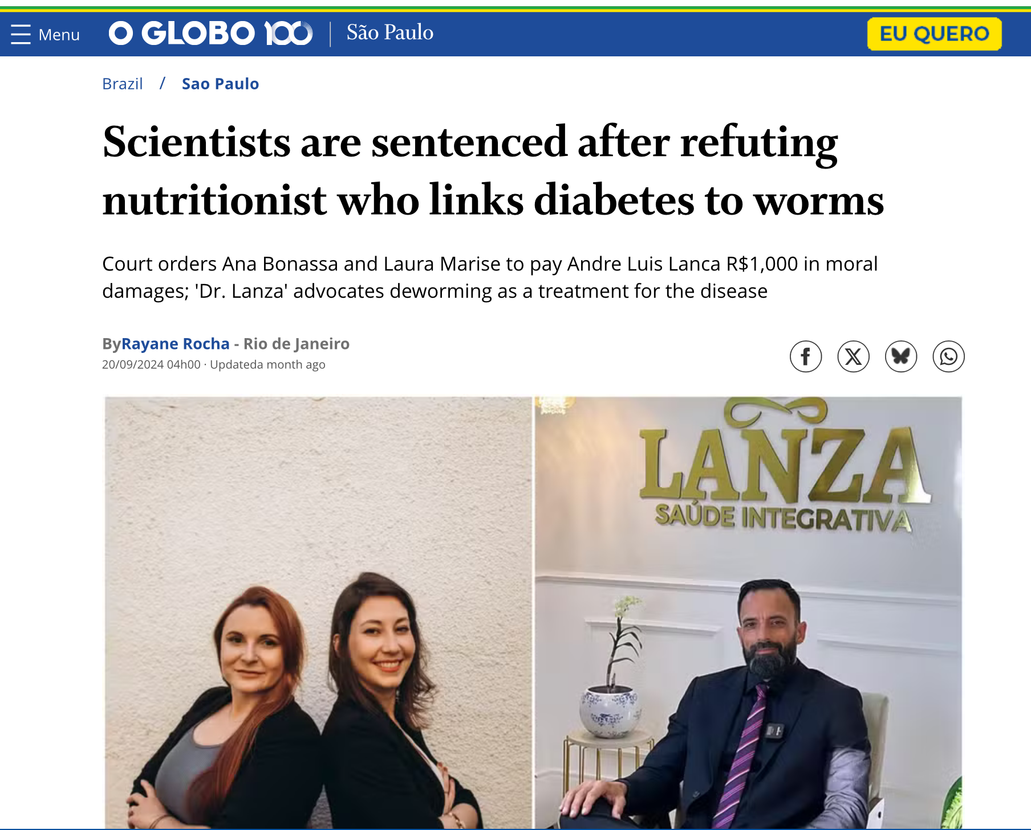

Slide 3
