Slide 1
Autonomy forces a
paradigmshift in R&D
World Science Forum 2024
RISK ASSESSMENT – Weighing Risk in Policymaking
Marina Rantanen Modéer
Head of Autonomy and Guidance, Navigation & Control
Saab Underwater Systems
Notes:
How can science provide and communicate evidence that speaks to both immediacy and complexity of risk, especially in cases where risks may compound?
Surging question:
How can scientists balance providing the best objective advice about the risks and benefits of different policy options with the need to be realistic about the political context in which decisions will be made? Please give examples from your own experience of what has worked or failed in the past and how things could be done better in future.
in the defense industry policy decisions often intertwine with national security imperatives, public perception, and ethical concerns.
stress the need for safeguards against unintended escalation while showing how adaptive technologies could minimize collateral damage

Slide 2
MEANINGFUL CONTEXT

Slide 3
WHAT IS AUTONOMY?
Source: https://capemaywhalewatch.com/blog/captain-flipper-dolphins-and-their-role-in-the-navy/
Notes:
Military Marine Mammals
Dolphins have been involved in a number of famous wars such as the Vietnam war defending Army ammunition (Milzarski, 2018) and clear mines from the Persian Gulf during the US invasion if Iraq (Bienaimé, 2015). Most tasks often given to bottlenose dolphins include locating mines; recovering objects (even humans) in a variety of environments; and guarding or surveying areas. There are potentially other reasons such as planting mines and even killing, but the U.S. Navy has denies that any of their dolphins are trained in killing

Slide 4
The capability and mandate to make meaningful decisions

Slide 5
Traceability model
URBAN/ RURAL
AERO-SPACE
DIGITAL
SPACE
OCEANIC
RESOURCES
SAFETY & SECURITY
DATA COLLECTION
SUPPLY CHAIN
MOBILITY
MANAGEMENT
Operational Domain
Joint Functions
Hierarchical Level
POLITICAL
ORGANISATIONAL
INDIVIDUAL
Technology
System
Platform
Capability
Task
Effect
ENVIRONMENT
END USERS
Level of autonomy?
INDUSTRY

Slide 6
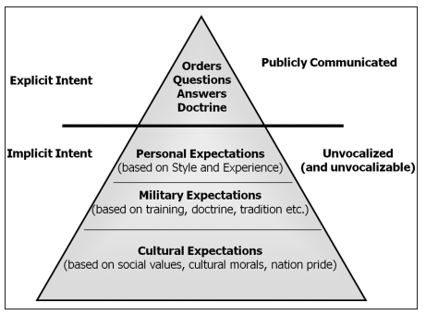
Two main categories – a multitude of technologies
Core platform automation
Efficiency
Reliability and Consistency
Scalability
Abstract problem-solving
Generalization
Innovation and creativity
Adaptability
Notes:
Generalization: Abstract problem-solving allows for identifying patterns, relationships, or principles that apply across various situations, leading to more versatile solutions.
Innovation: It encourages out-of-the-box thinking, as it requires looking at a problem from multiple perspectives, which can often yield novel approaches.
Adaptability: By abstracting details, one can address a category of problems rather than just a single instance, which is especially useful when dealing with unfamiliar situations.
Conceptual Thinking: Abstract problem-solving requires viewing a problem in terms of its underlying concepts rather than its specifics. For example, recognizing that a conflict between departments may be an issue of resource allocation rather than personal differences.
Pattern Recognition: Recognizing patterns or structures in problems, which can lead to insights about how they might be resolved. In math, for instance, identifying that different problems share the same underlying equation is a form of abstraction.
Hypothesis Formulation: In the absence of concrete details, abstract problem-solving often involves creating hypotheses or models that can be tested or refined with more information.

Slide 7
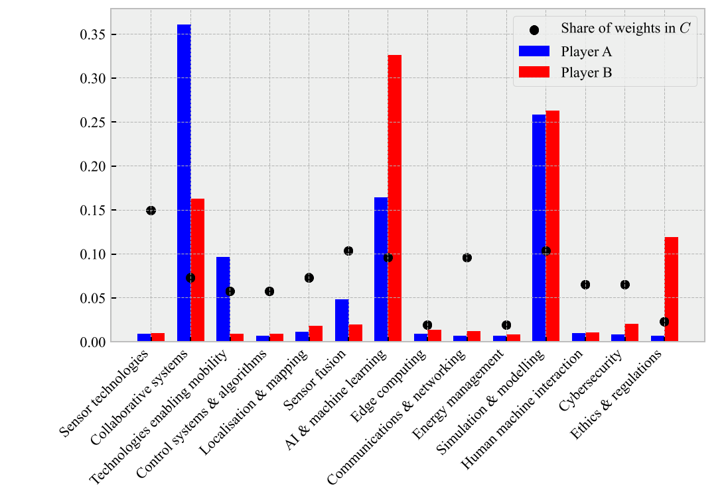
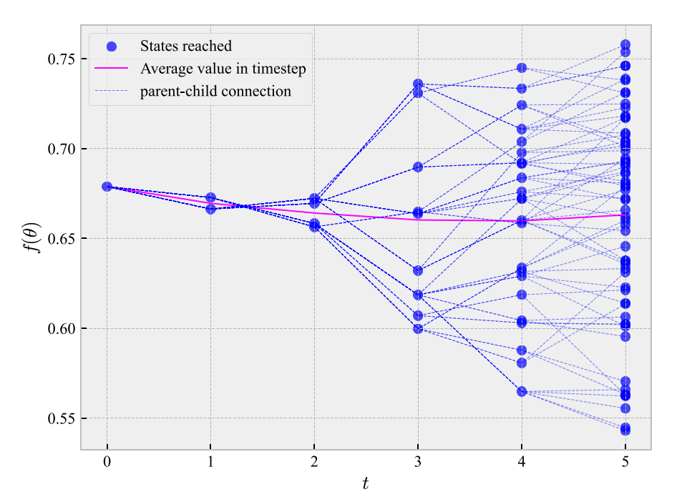
Technology forecasting for better investments
Quantitative

Slide 8
Way forward
Since autonomy is to decide for oneself:
1. …there is an urgent need for behavioural requirements (which will change the way industry develops technology)
2. …we will need quantitative methods for technology roadmapping such that we can leverage AI to have a robust plan for various evolutions
3. …we need to be aware that many different technologies make up that of autonomy – it is not a standalone science, eg:
Synthetic cognition
Teaming between sentient machines
Mission management that assumes independent behavior
4. …we must foster a scientific approach to realization of desired autonomy through effective R&D infrastuctures

Slide 9
In short:
Use robust approaches and leverage AI when investing in the techonolgies that make up autonomy

Slide 10
The capability and mandate to make meaningful decisions

