Slide 2
Scientific advice to address climate change’s (unequal) impacts on health
Dr Rosa Castro
EASAC Biosciences and Public Health Programme Director

Slide 3
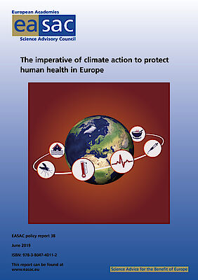
Climate change as a major health threat
The EASAC 2019 report: climate change a human health threat
Direct and indirect outcomes: increased mortality from heatwaves, spread of infectious diseases, respiratory issues due to air pollution, malnutrition and compromised food systems
2003 heatwave caused around 70,000 excess deaths across the continent; Southern and Eastern Europe vulnerable due to their warmer climates and varying levels of health infrastructure (see recent EASAC work on wildfires)

Slide 4
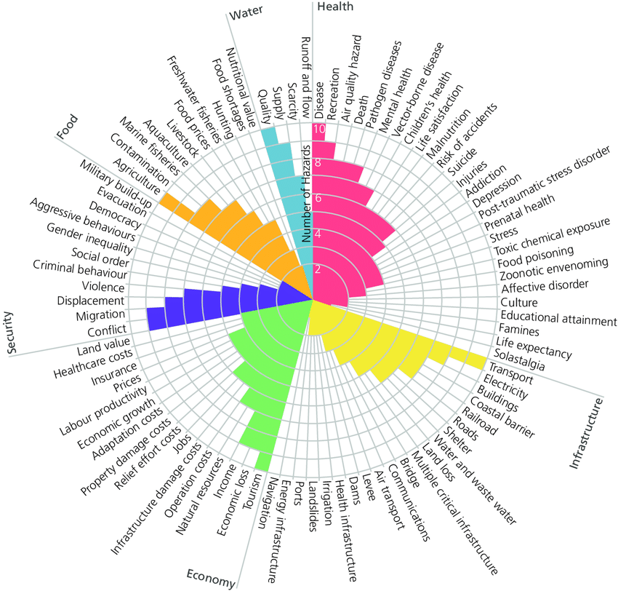
Source: Nature Climate Change, Broad threat to humanity from cumulative climate hazards intensified by greenhouse gas emissions, Mora et al., 2018.

Slide 5
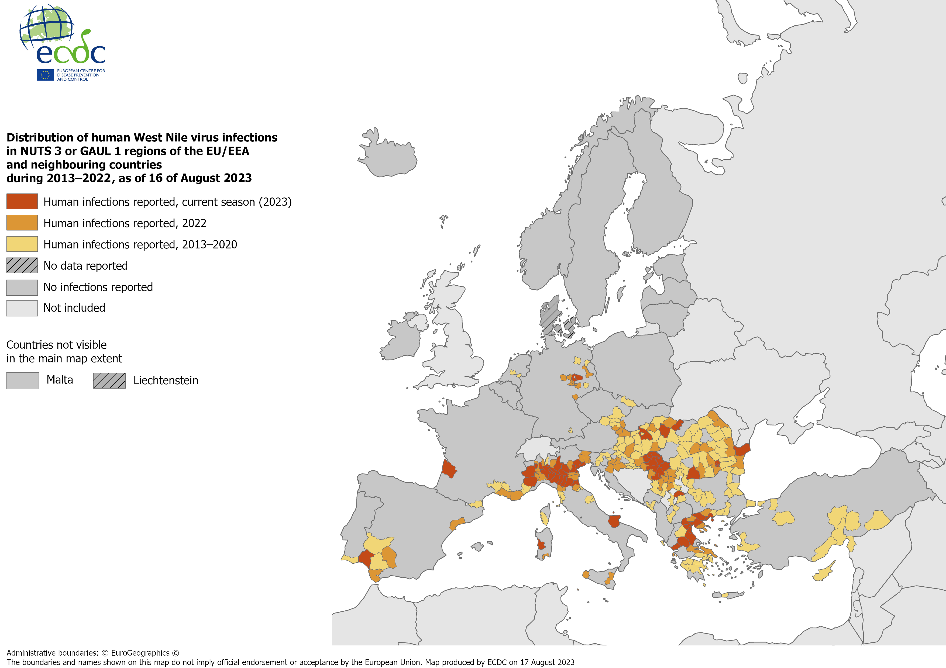
Source: ECDC, https://www.ecdc.europa.eu/en/publications-data/west-nile-virus-human-cases-compared-previous-seasons-16-august-2023

Slide 6
Inequities and vulnerable groups
Vulnerable populations (e.g., elderly, children, and low-income communities) at higher risk
Mediterranean regions’s increased risk of vector-borne diseases (e.g., dengue and West Nile virus) due to rising temperatures and changes in precipitation patterns (easier spread of disease-carrying mosquitoes)
Extreme heatwaves and flooding: disrupted services and increased hospital admissions and pressure to health systems

Slide 7
Data gaps and the need for evidence-based policy
EASAC report: insufficient data on how climate change impacts different European regions differently (e.g., areas with limited resources, higher risks, etc.)
More targeted research to better inform EU strategies
Ensuring that policies adequately account for regional health disparities

Slide 8
Role of Academies and scientific bodies
Scientific Guidance for Policymakers: EASAC provides independent, evidence-based advice
Key role in aligning research with policy to inform the EU and member states
Collaboration across sectors
Integrating other knowledge systems and engaging with stakeholders

Slide 9
Scientific advice to address climate change’s (unequal) impacts on health
Dr Rosa Castro
EASAC Biosciences and Public Health Programme Director

