Slide 1
Science, Technology and Innovation Diplomacy
The Case of Hungary

Slide 2
AGENDA
Strategic Priorities for Hungary’s STI
Key Stakeholders Driving STI Ecosystem
Policy Tools and Funding Schemes

Slide 3
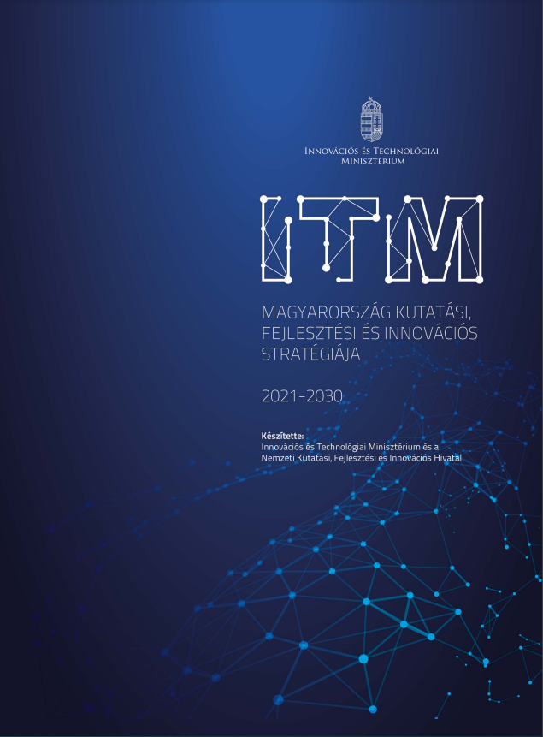
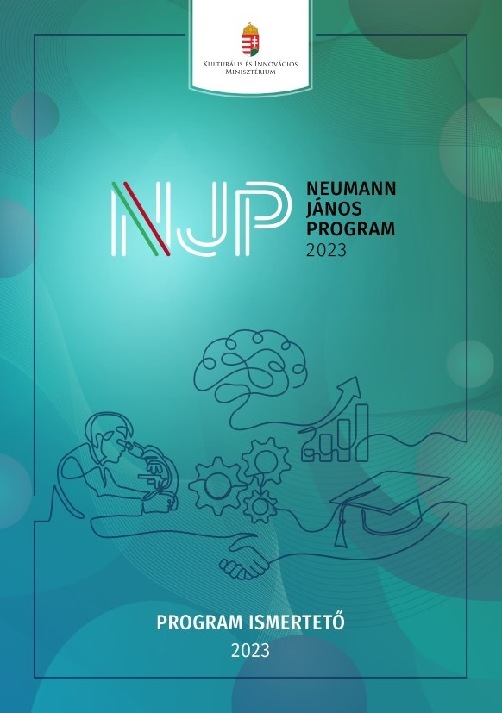
Strategic Framework for Hungarian ST & Innovation
The Research, Development and Innovation Strategy of Hungary (2021-2030)
Strengthening Hungary's position within the European innovation ecosystem, with a focus on Horizon Europe participation and international partnerships.
Facilitating bilateral and multilateral collaborations in research and development, particularly with strategically important countries.
Emphasizing the role of science diplomacy to promote Hungarian innovation on a global scale, fostering knowledge exchange and joint project generation.
John von Neumann Program (NJP)
Creating opportunities for international research collaborations, with specific focus on projects addressing global challenges like health, sustainability, and digital transformation.
Supporting mobility and partnerships between Hungarian and international academic and research institutions.
Hungary’s STI diplomacy objectives are embedded within broader national innovation frameworks such as The Research, Development and Innovation Strategy of Hungary (2021-2030) and John von Neumann Program (NJP).

Slide 4
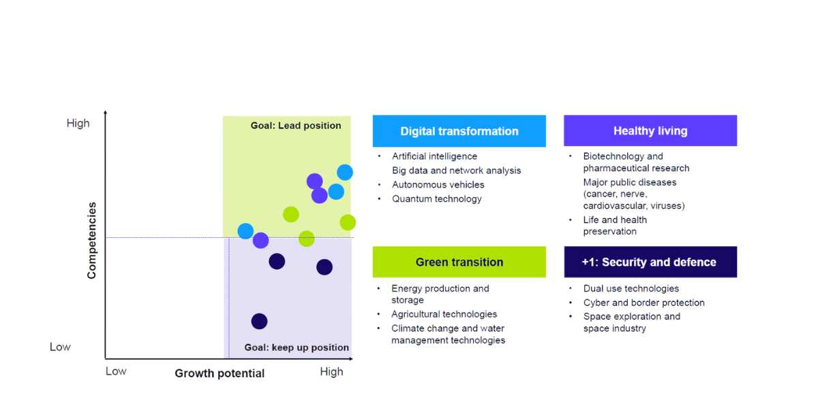
Focus areas defined for Hungarian science and innovation
Source: Ministry of Innovation and Culture

Slide 5
Multi-stakeholder ecosystem supports Hungary’s S&TD efforts
State Actors
Economy
Parliament
Ministry of Culture and Innovation
National Science Policy Council (NTT)
Ministry of Trade and Foreign Affairs
Hungarian Academy of Sciences
Research Excellence Council (KKT)
Hungarian Intellectual Property Office (SZTNH)
National Research, Development, and Innovation Office (NKFIH)
Hungarian Innovation Agency (NIÜ)
Tempus Public Foundation (TPF)
S&T Diplomat Network
HUN-REN
Higher Education Institutions (HEIs)
Startups
SMEs
Larges Enterprises
National Laboratories
Science Parks
National Incentives
EU Funds
Loans and Equity
Private Capital
Market Loans
Based on Ministry of Innovation and Culture (2024) with additions by the author.

Slide 6
„The smaller a country, the more active it must be diplomatically”
Bilateral S&T Cooperation
Bilateral S&T agreements with nearly 40 countries.
S&T Diplomat Network: 15 S&T attachés (Europe: 8, Asia: 4).
Bilateral collaborations (eg. joint projects) in STI with strategically important countries.
EU Membership
Boosting engagement in EU programs ( eg. Horizon Europe)
Representation in the strategic decision-making program committees; "supporting" grant schemes.
Participation in the legislative processes of EU R&D and innovation policymaking.
Multilateral RDI Cooperation and Programs
International large-scale research infrastructures (e.g., CERN, ESS, XFEL, EMBL).
Multilateral intergovernmental cooperation programs (e.g., EUREKA, COST).
Collaboration in policy-driven RDI initiatives (e.g., OECD, TAFTIE)

Slide 7
Funding Schemes: Strengthening Hungary’s International STI Presence
Participation in Horizon Europe
Bilateral Cooperation Programs
HU-rizon Program
Pannónia scholarship Program
Supports Hungarian researchers and companies in participating in the EU's most important research framework program.
Facilitates researcher mobility and joint innovation projects with more than 15 partner countries.
Introduces a new national initiative to launch international research projects led by Hungarian researchers.
Offers scholarships for Hungarian students, researchers and faculty to pursue academic or research opportunities abroad
Research Grant Hungary
Scientific Patronage Program
Stipendium Hungaricum Program
Provides funding to support the research of the most outstanding international researchers in Hungary.
Promotes the popularization of research results on the international stage.
Facilitates the internationalization of Hungarian higher education by providing scholarships to international students.

