Slide 1
GEODESY CASE
Investigated and published from March ’23 to February ‘24
Dora Kršul

Slide 2
GEODESY EXCLUSIVE
corruption and crime in higher education, science and politics
misuse of EU and national funds designated for scientific research and reconstruction after series of earthquakes hit Croatia in 2020.
3 KEY SEGMENTS
CARS - EU project for geodesy researches aimed to reduce the risk of natural disasters in Croatia
A YACHT - EU project for hidrography researches aimed for the mapping of marine habitats and the knowledge of sea biodiversity
MINISTRY OF CULTURE - 3D scanning of cultural heritage buildings after massive earthquakes hit Croatia

Slide 3
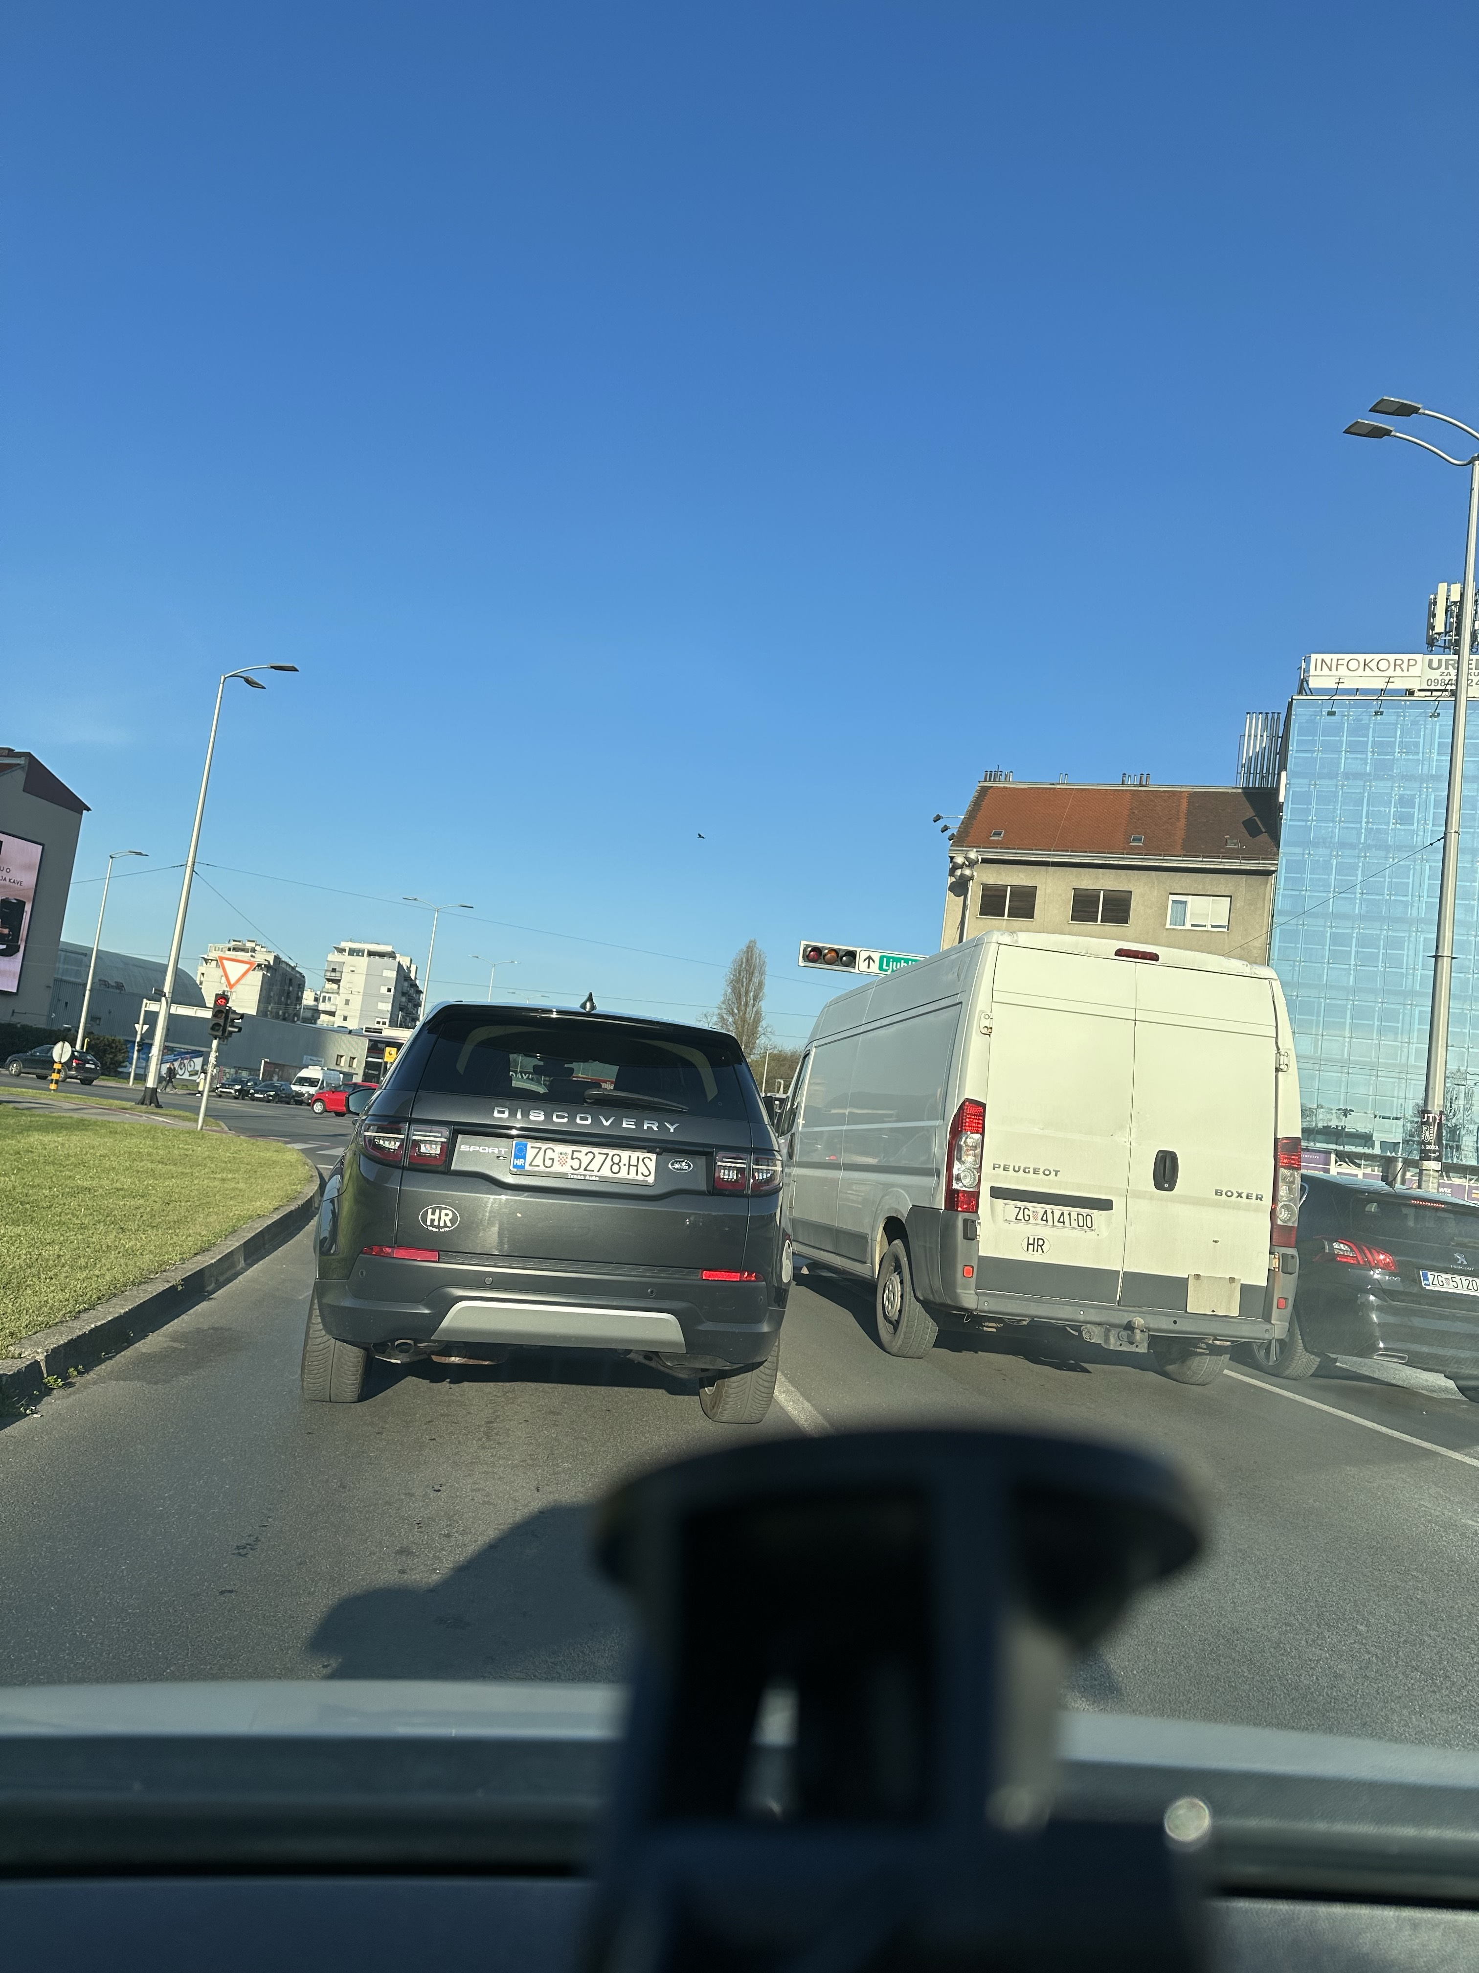
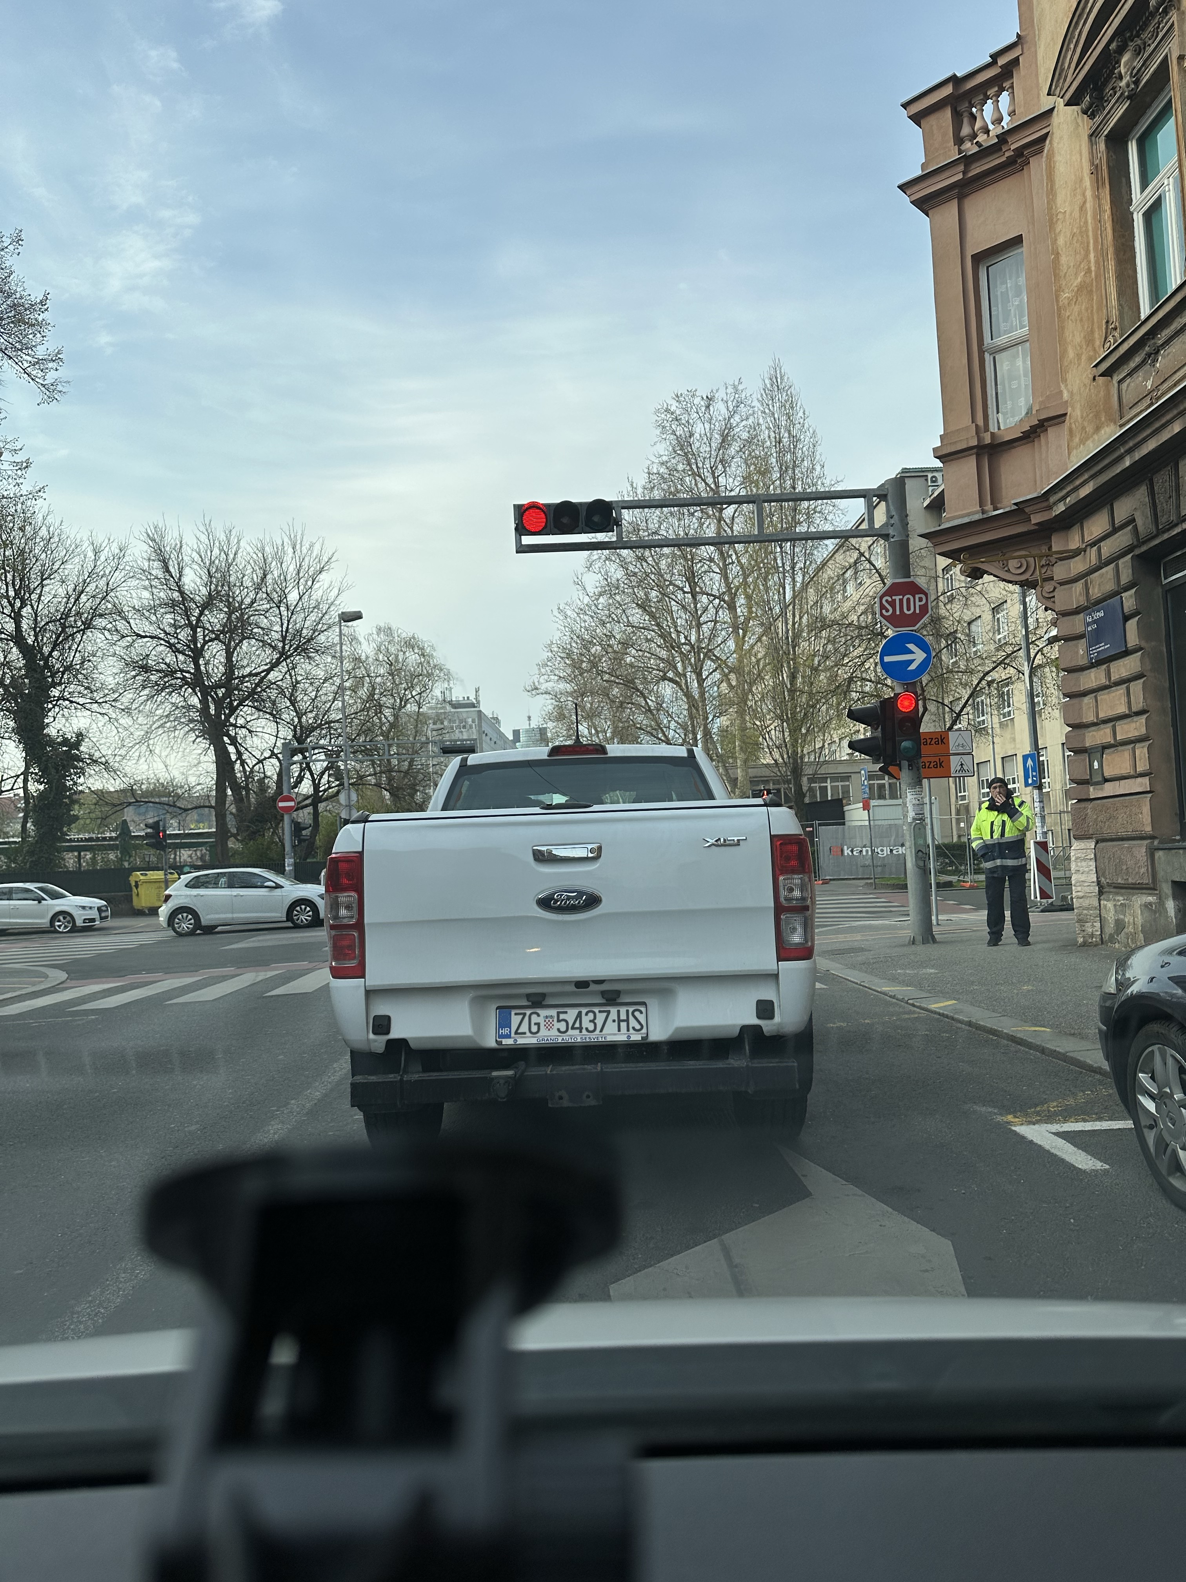
How it all started…

Slide 5
How it developed…

Slide 7
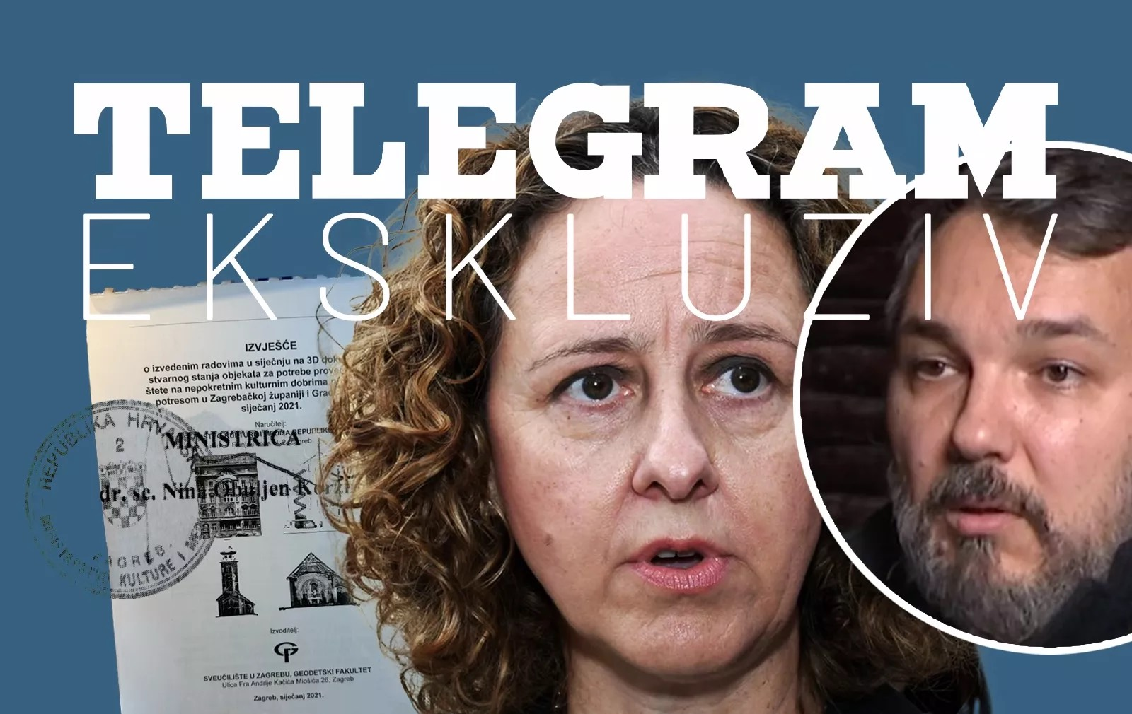
And how it came to the Minister of Culture

Slide 8
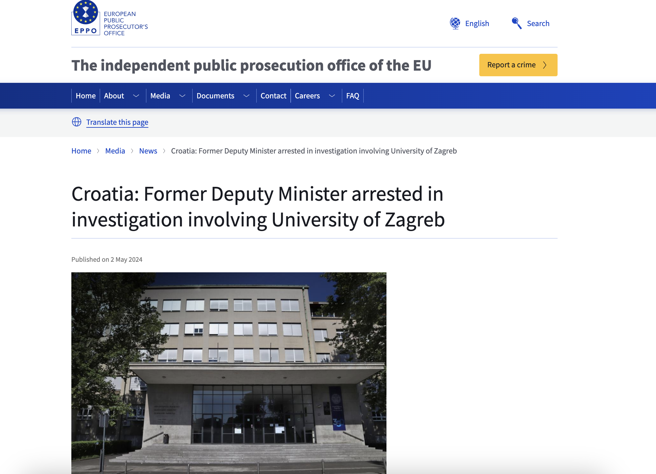
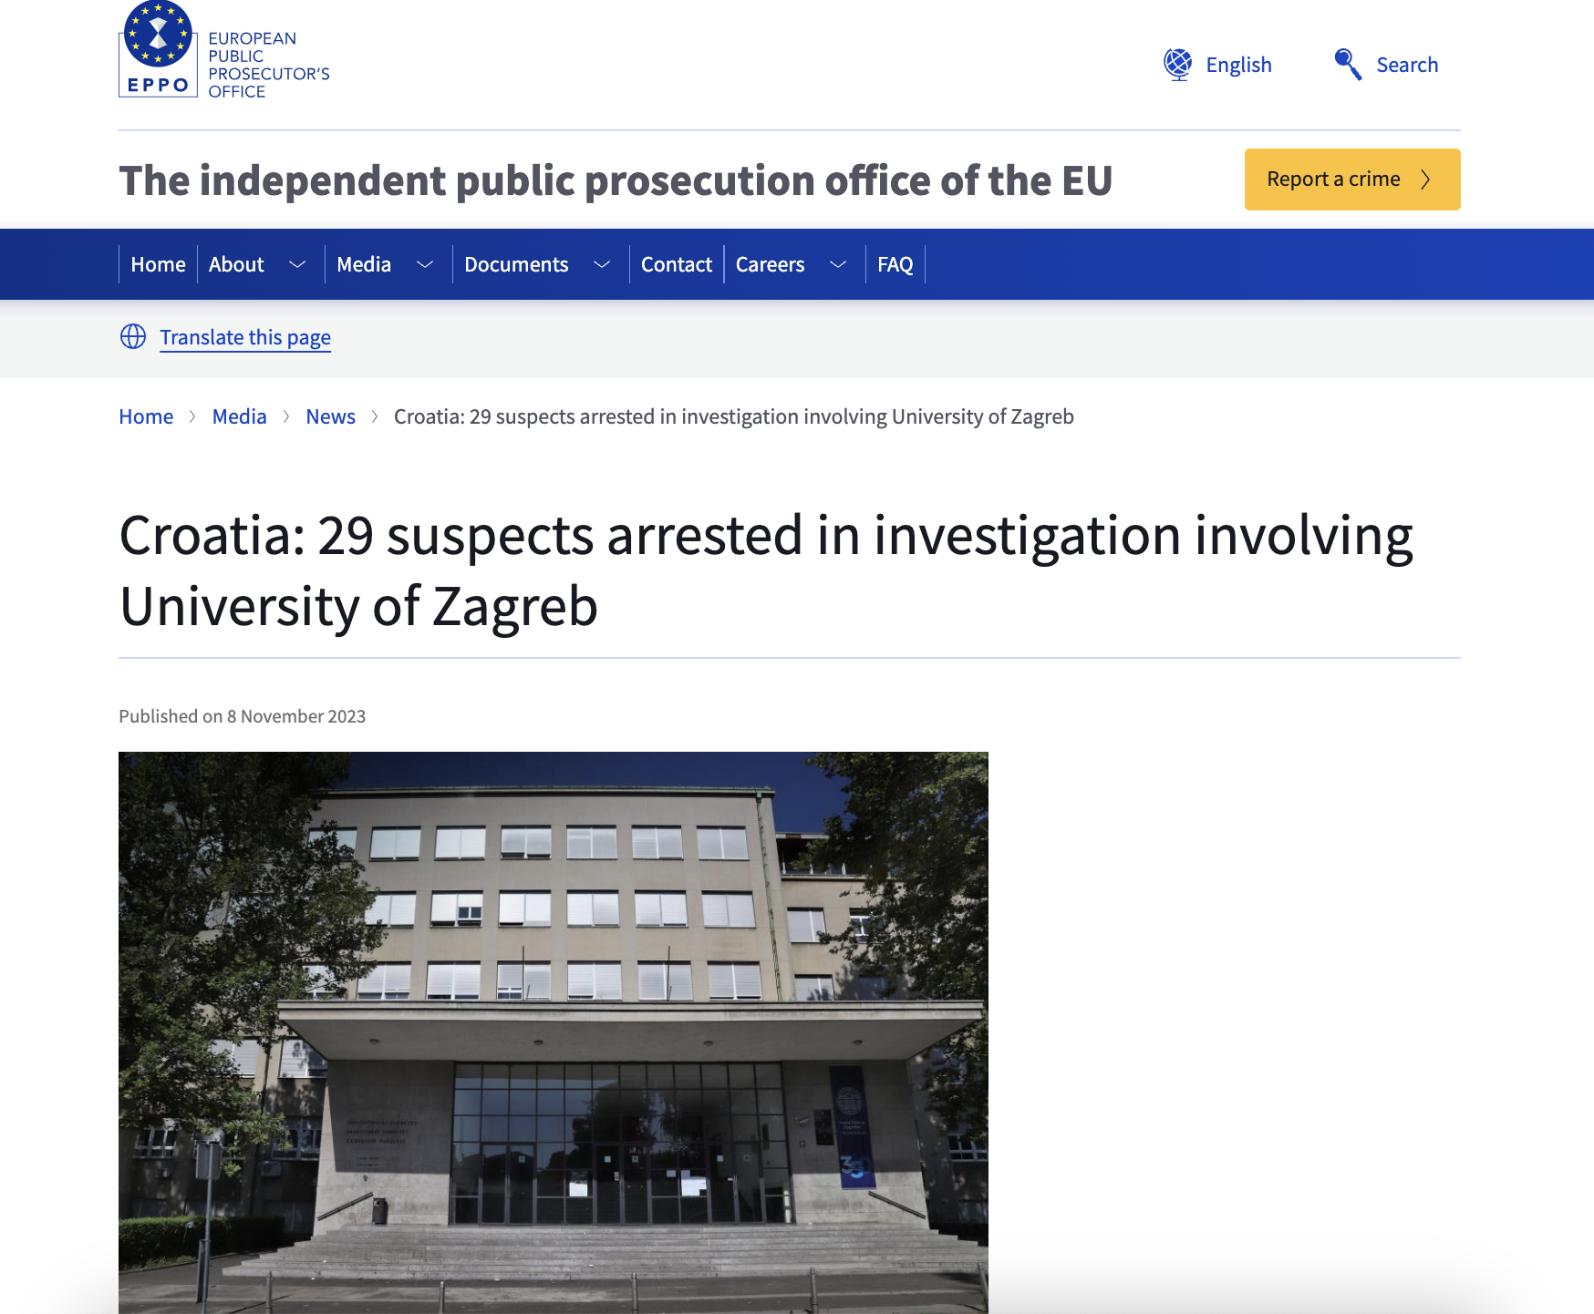
What happened after our stories?

Slide 9
And for now…
Faculty had to return all the money - 526.000 euros - from the EU project on which they bought the yacht
there hasn’t been any consequences regarding the EU project with cars
the part of the exclusive regarding the 3D scanning of cultural heritage buildings ended in political scandal involving the Prime Minister, Minister of Culture and their vocal efforts to undermine the work of Telegram and the European Public Prosecutor’s Office (EPPO) in Zagreb
dispute between the Government and the EPPO is ongoing
indictment is expected sometime soon for the total of 30 suspects

Slide 10
Regarding the academia and the University of Zagreb
there hasn’t been any serious (academic) discussion about corruption and crime in academia,
there wasn’t any specific measures installed at the University to prevent cases like this one,
there wasn’t even any hard judgement of the crime on The Faculty of Geodesy and their criminal misuse of funds designated for scientific research
Croatian academia is burdened and blocked with negative selection, while perspective individuals usually stay silent or leave the country

Slide 11
Thank you for your time!
dora@telegram.hr
P.S. The Minister of Culture is still on her duty, fully supported by the Prime minister
P.P.S. Croatian Government is heavily perceived as corrupted

