Slide 1
Scientific freedom, responsibility and protection of scientists Responsible science activists in a planetary emergency Dr Tracey Elliott World Science Forum 2024

Slide 2
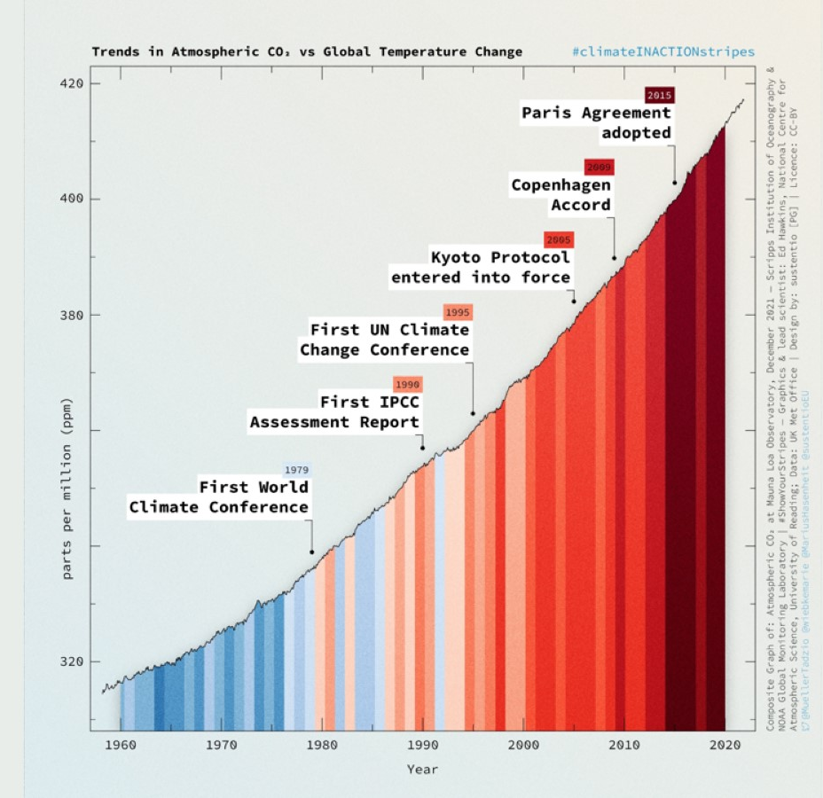
Our political system
is failing us, domestically and internationally

Slide 3
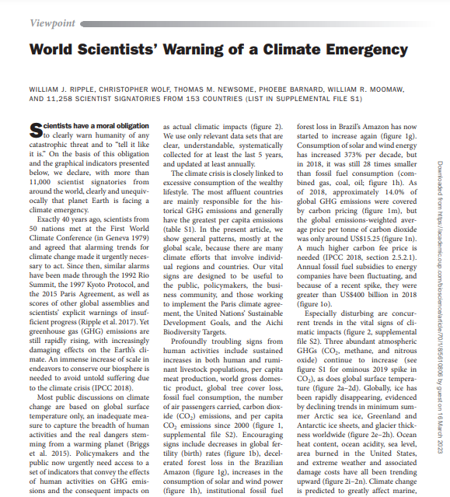
“We declare, with more than 11,000 scientist signatories from around the world, clearly and unequivocally that planet Earth is facing a climate emergency”
2019

Slide 4
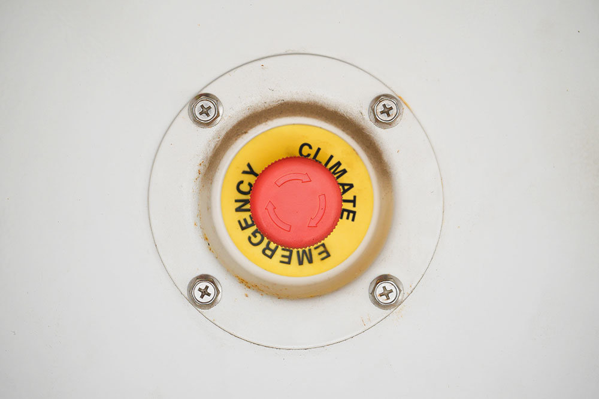
Emergency
times…
…call for
emergency
measures

Slide 5
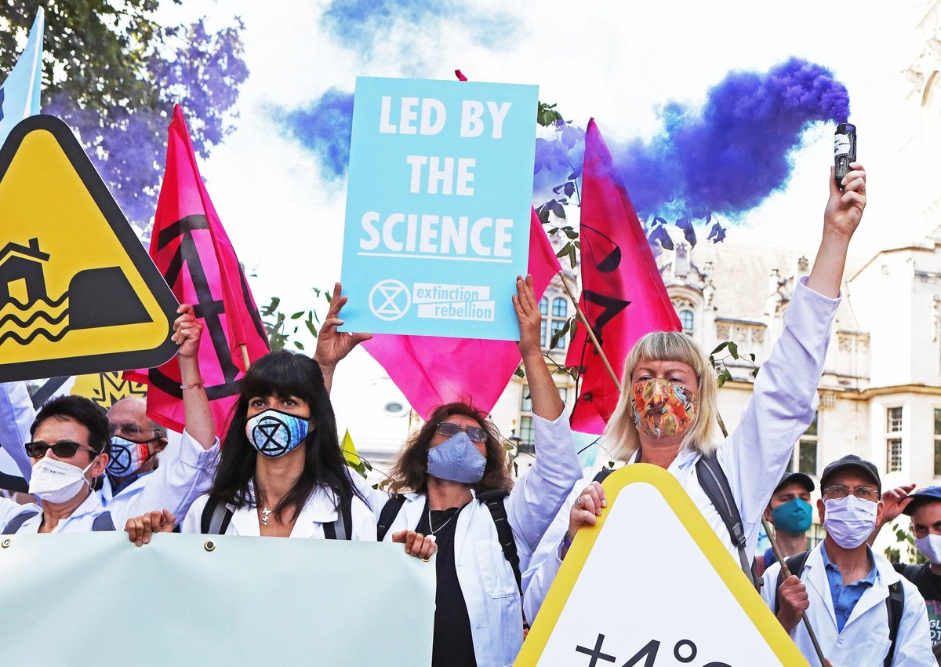
From Publications to Public Actions
There is an imperative for responsible scientific activism
in a planetary emergency

Slide 6
Proliferation of social movements…..
….that are making a difference

Slide 7
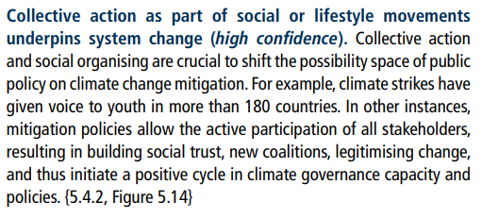

Slide 8
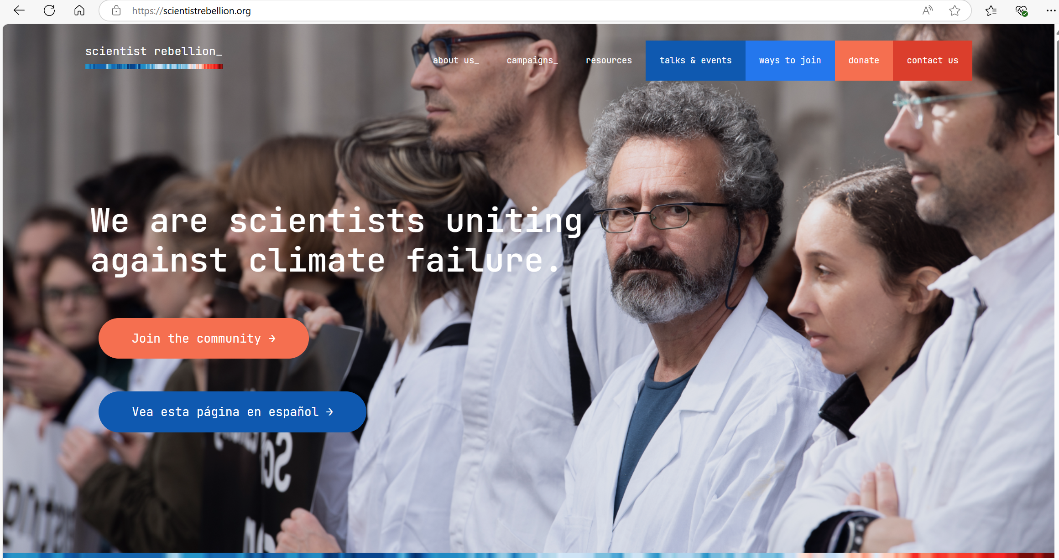

Slide 9
Scientist Rebellion – 32 countries
AFRICA | AMERICAS | ASIA PACIFIC | EUROPE
DRC Malawi Nigeria Rwanda Sierra Leone Tanzania Uganda Zimbabwe | Argentina Chile Colombia Ecuador Mexico Panama Peru US/Canada | Australia India | Belgium Denmark France Finland Germany Greece Italy Netherlands Norway Portugal Spain Sweden Switzerland UK
National group contacts at
https://scientistrebellion.org/contact-us

Slide 10
Notes:
.

Slide 11
Targeted interventions – government, insurance, law, museums

Slide 15
What can WSF participants do?
AS AN INSTITUTIONAL LEADER
AS A MEMBER OF THE GLOBAL RESEARCH COMMUNITY
Protect the safety and freedom of scientists who choose to be activists – “have their backs”
Run/host initiatives on science activism and social movements to raise profile amongst members
Provide training, evidence and fact-checking support to social movements
Defend the right of academics to protest
Build science activism into research evaluation frameworks
Instigate research programmes on science activism and its efficacy
Provide free meeting space to social movements
Divest from oil and gas industry funding and sponsorship
Adopt green, sustainable institutional practices – minimise travel, use and waste; use green-flagged third parties; prepare public annual accounts
Lead / participate in (research/advocacy) initiatives on science activism
Write OpEds, editorials etc on science activism
Provide behind-the-scenes support e.g. fact-checking, training
Support colleagues and students who choose to be activists
Publicly support science activism and social movement campaigns
Go on marches, join demonstrations
Be kind,
supportive,
protective,
proactive
=> Recognise peaceful, disruptive science activism as a necessary and legitimate part of the global science community’s toolkit for communicating science and influencing policy

Slide 16
Conclusion-
As Albert Einstein is said to have remarked:

