Slide 1
Systems Analysis to Measure and Project Sustainable Wellbeing Dr. Sibel Eker
22 November 2024, World Science Forum

Slide 2
IIASA is…
An international research institute that conducts multidisciplinary/ transdisciplinary research to help policymakers find long-term solutions to global and universal challenges facing countries

Slide 3
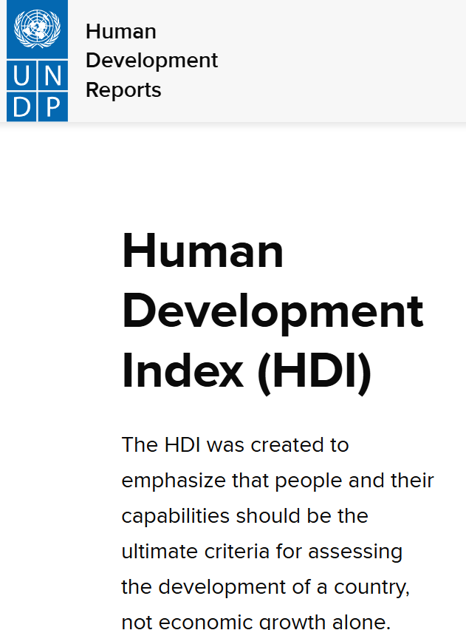
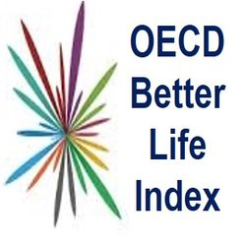
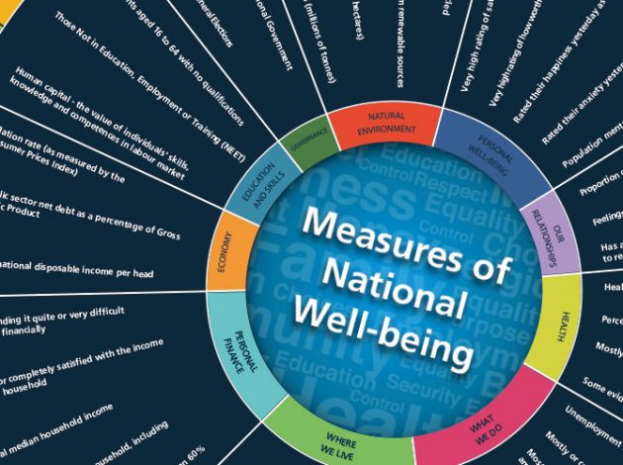
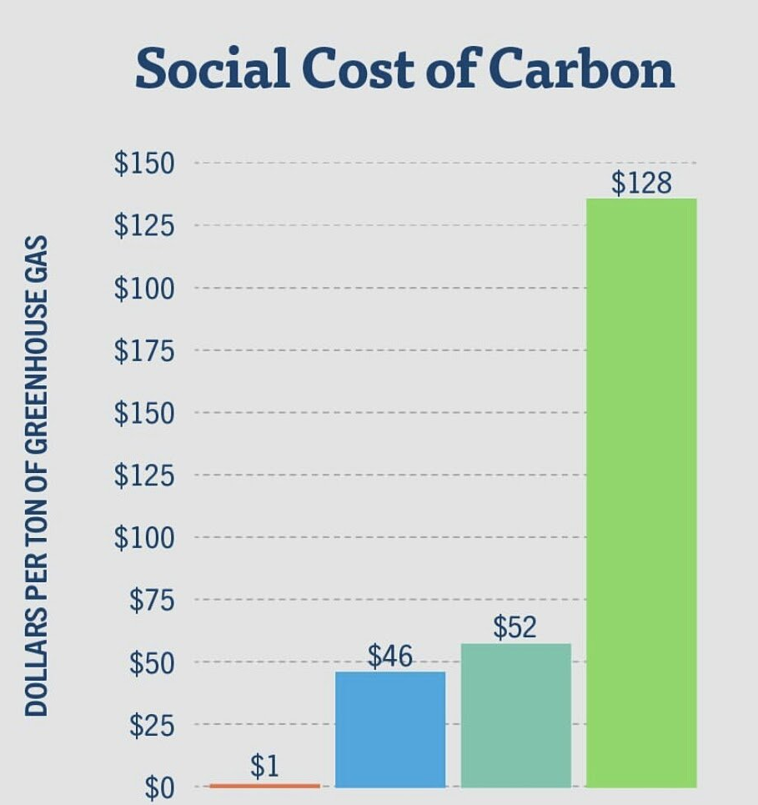
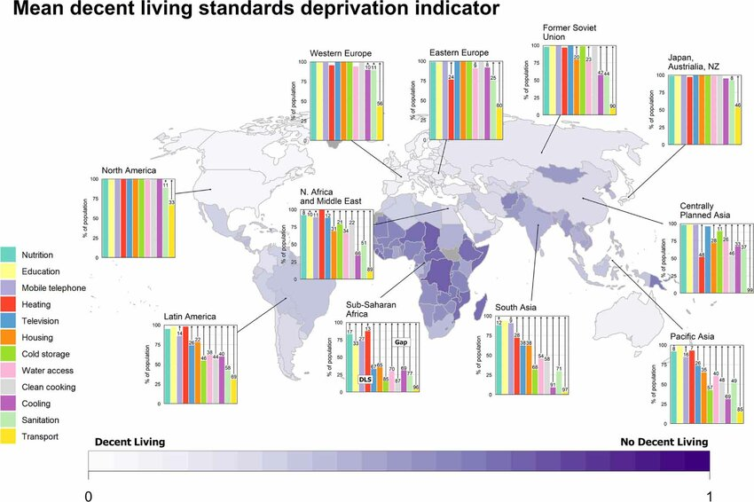
Human wellbeing
Kikstra et al. (2021)

Slide 4
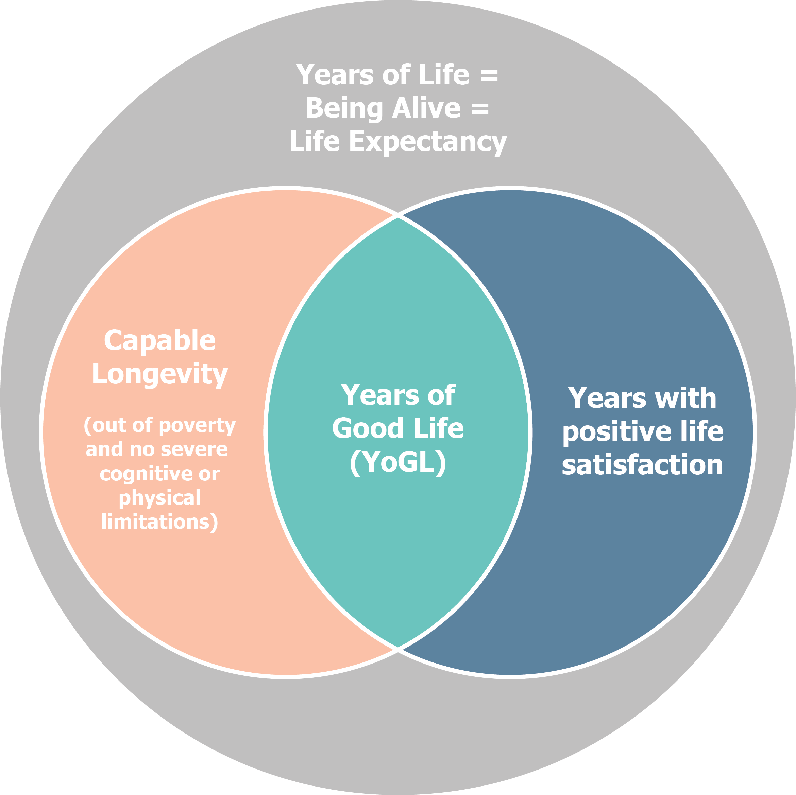
Years of Good Life (YoGL)
Life Expectancy
Being out of absolute poverty
Having no severe activity limitation (health)
Being cognitively able to function (education)
Having positive life satisfaction
Source: Lutz et al. (2021) Proceedings of the National Academy of Sciences

Slide 5
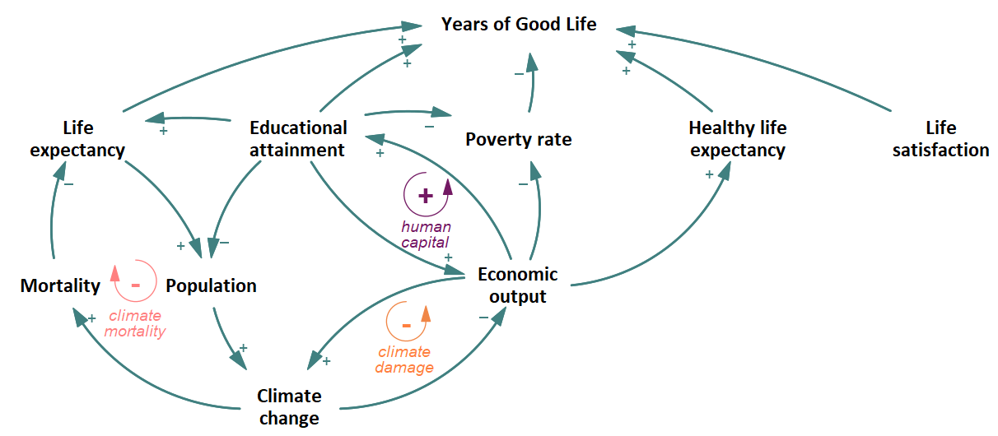
Feedbacks underlying Years of Good Life (YoGL)

Slide 6
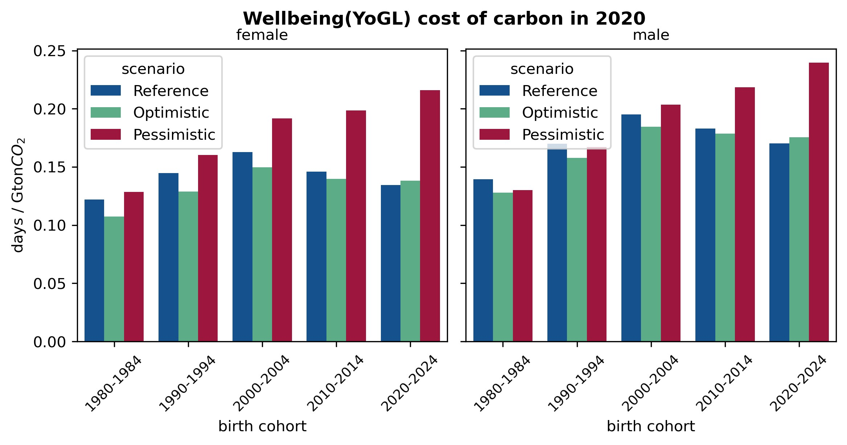
Projecting human wellbeing

Slide 7
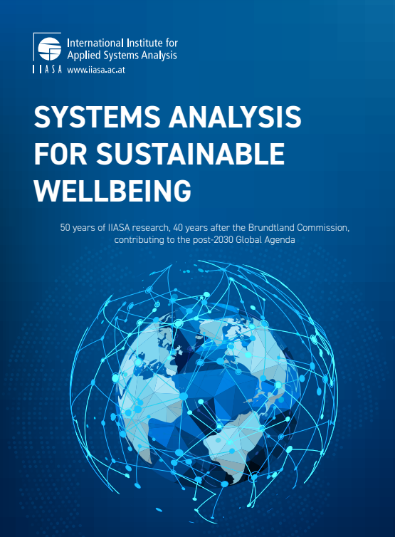
Sustainable wellbeing
Compound metrics of multidimensional concepts (wellbeing, sustainability) are dangerously limited but useful.
Wellbeing metrics such as YoGL can help move beyond GDP.
Integrated systems view helps understand, measure and project wellbeing.

Slide 8
Thank you.

