Slide 1
Food production and food security in a changing climate
Thomas Elmqvist
Program Director, EASAC
Professor, Stockholm Resilience Centre

Slide 2
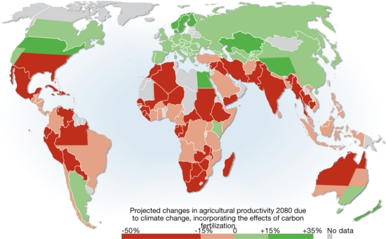
Impact of climate change on food production
Source: IPCC

Slide 3
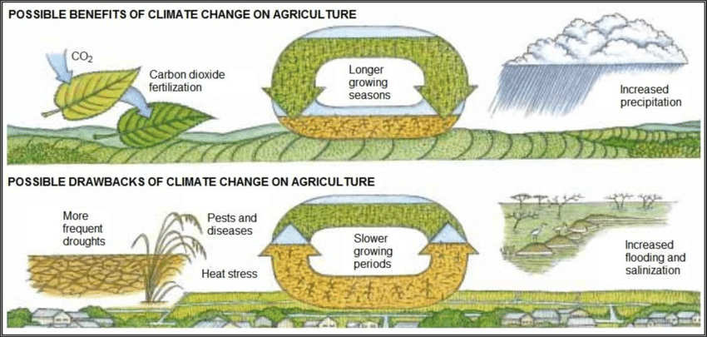

Slide 4
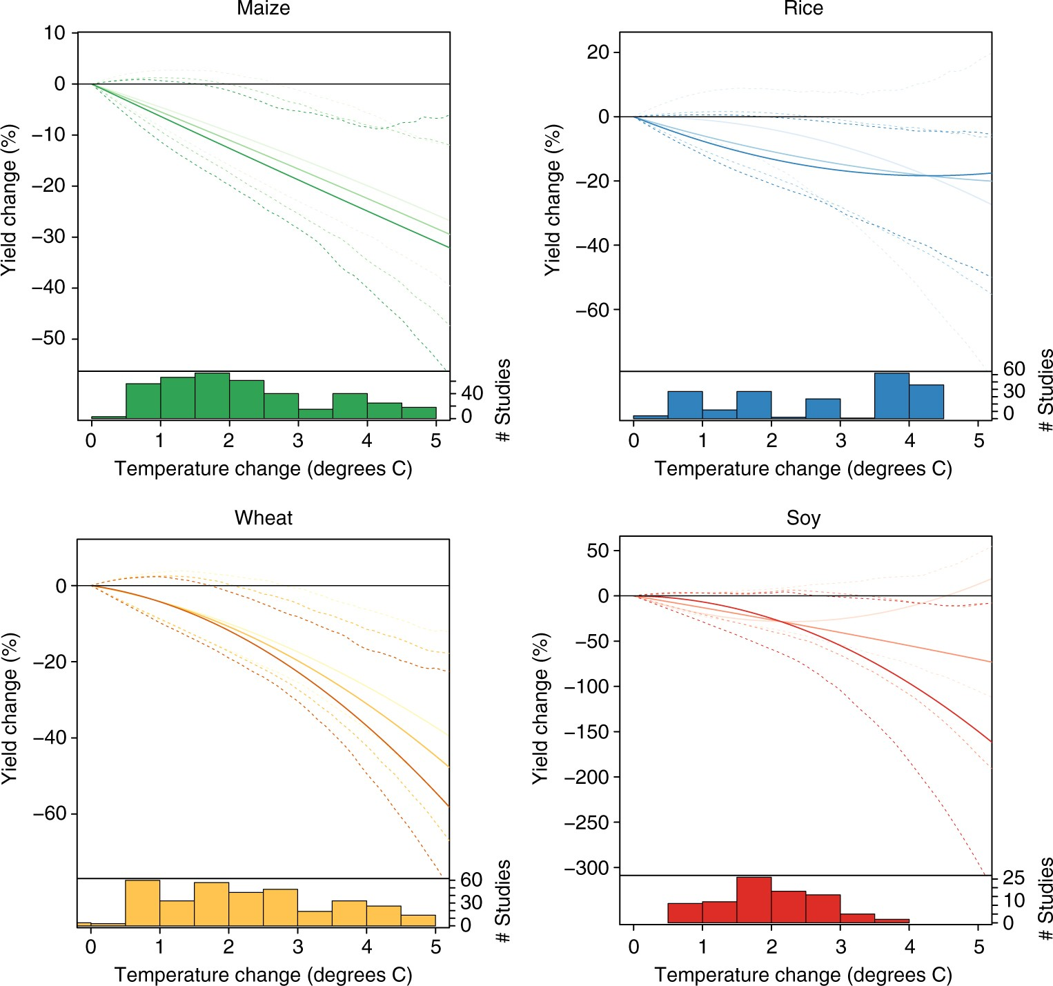
Effects of climate change on yield of specific crops
Moore, F.C., Baldos, U., Hertel, T. et al. New science of climate change impacts on agriculture implies higher social cost of carbon. Nat Commun 8, 1607 (2017). https://doi.org/10.1038/s41467-017-01792-x
Notes:
Impacts of temperature change on yields of four major crops. Based on a meta-analysis of 1010 point-estimates from 56 studies (see Methods section). Darkest, middle, and lightest lines show responses at the 75th, 50th, and 25th quantiles of baseline growing-season temperature, respectively. Dashed lines show the 95% confidence interval based on 750 block bootstraps, blocking at the study level. Plotted response curves are for temperature only and do not include CO₂ fertilization or adaptation. Temperature changes are relative to a local 1995–2005 baseline. The histograms show the number of observations by crop and level of warming used to estimate the response functions. In subsequent analyses, yield losses >100% are set to losses of 99%

Slide 5
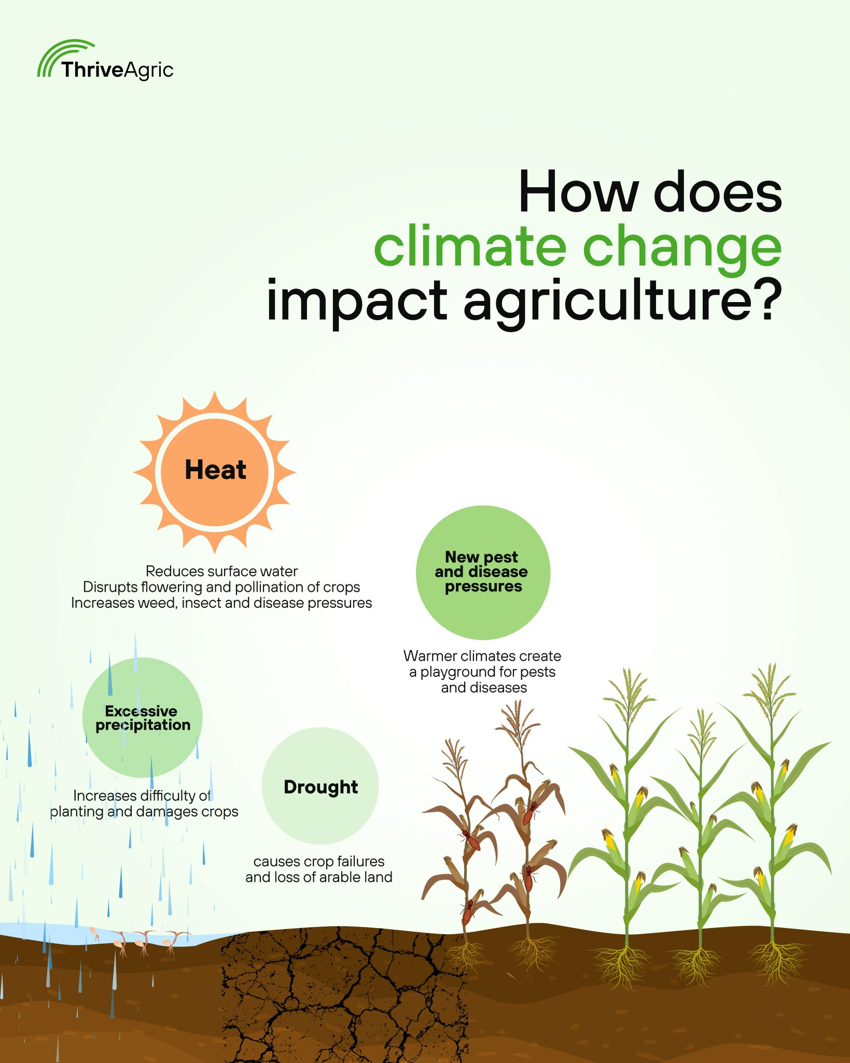

Slide 6
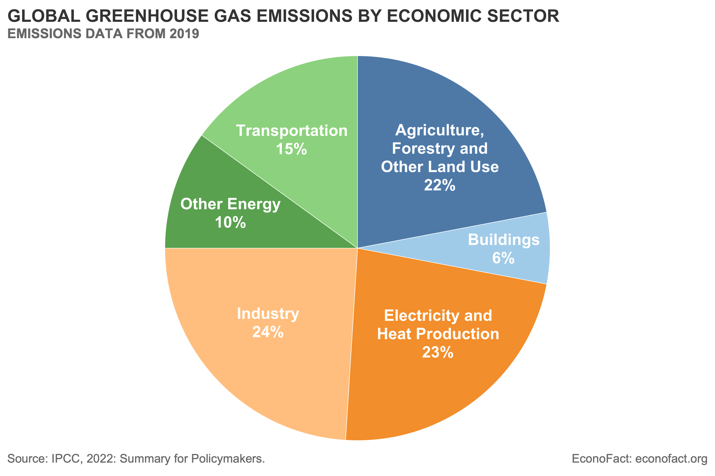

Slide 7
IPCC April 2022

Slide 8
Carbon dynamics in the agricultural landscape

Slide 9
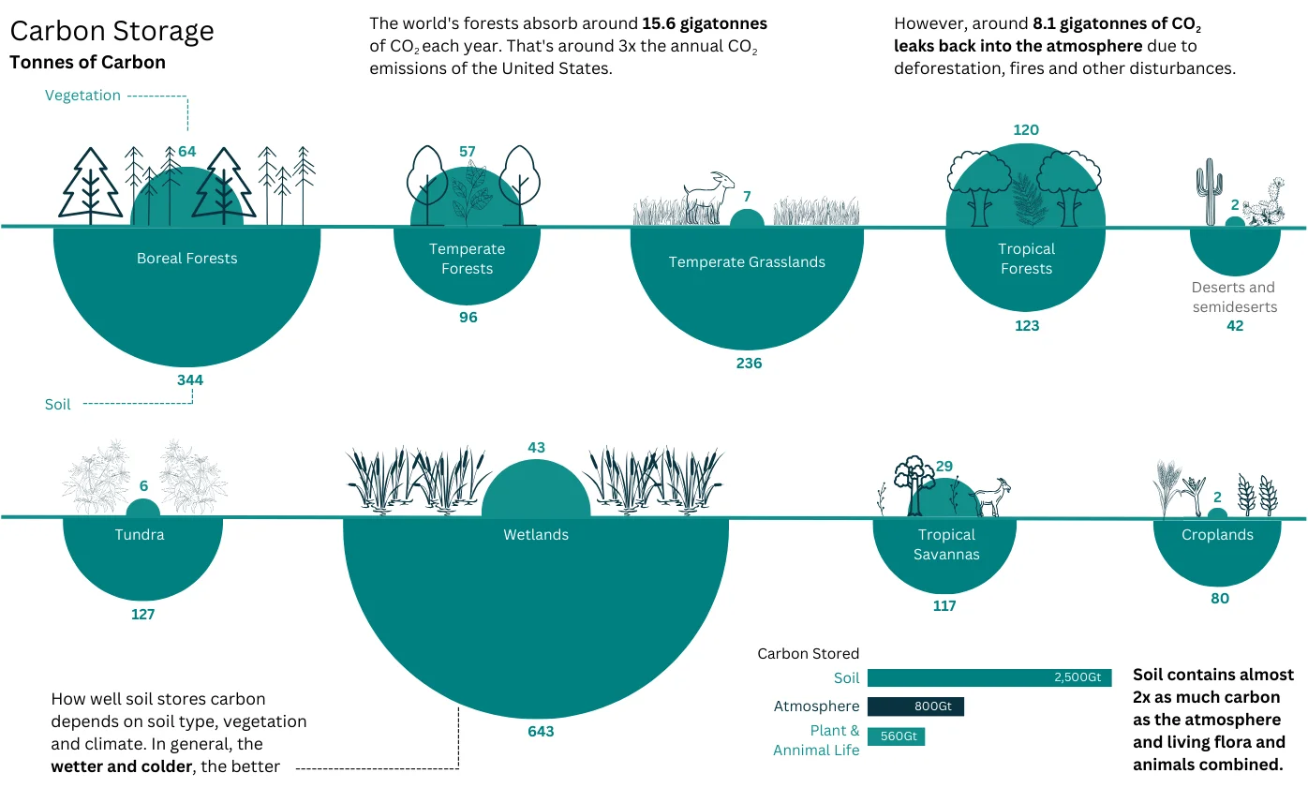

Slide 11
e.g.

Slide 12
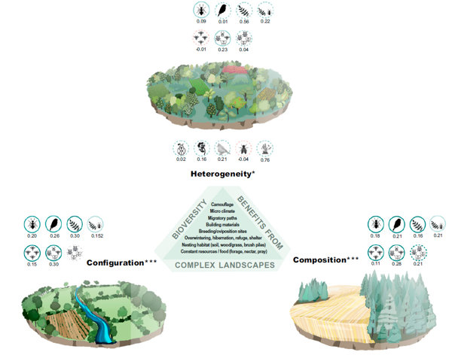
The Importance of the Landscape Scale
Diversifying cropland
Maintaining and restoring non-crop habitats
Reducing field sizes
Source: Estrada-Carmona et al. 2023 PNAS

Slide 13
Food system

Slide 14
Thank You!

