Slide 1
Rethinking Research Assessment to Shape Innovative, Inclusive, and Impactful Science in EuropE
The early and mid-career researcher perspective
Katalin Solymosi, Ph.D.,
Outgoing Chair, YAE
Young Academy of Europe

Slide 2
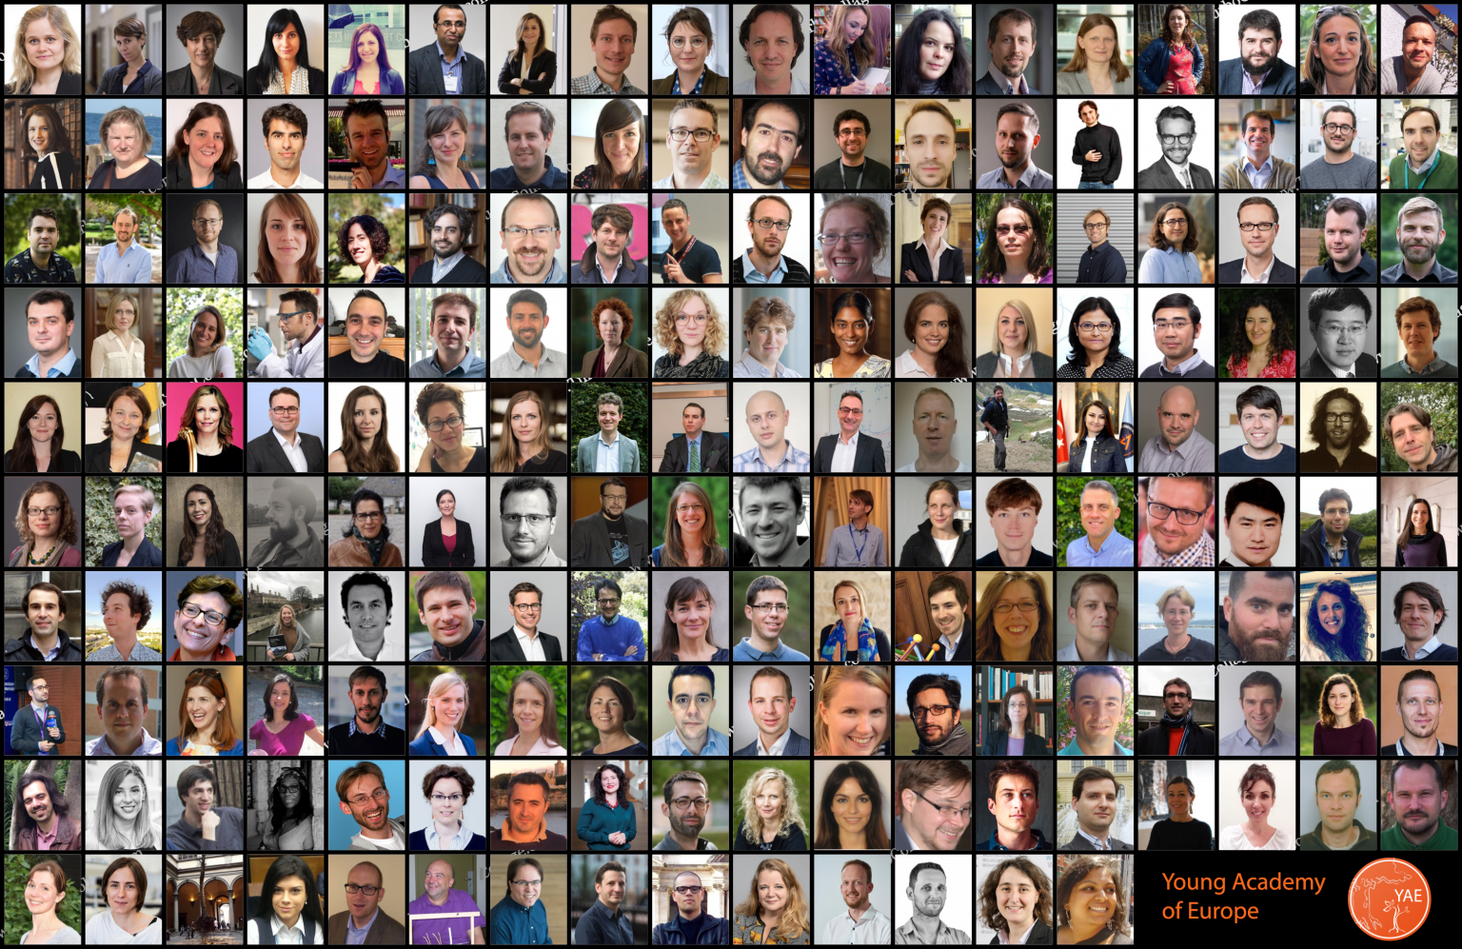
The Young Academy of Europe
Pan-European bottom-up initiative of outstanding early and mid-career researchers for networking, scientific exchange, promotion of equity, diversity and inclusion, science policy and evidence-based policy
YAE fellows demonstrate leadership (young principal investigators), their research is recognised at national and international levels, and have an interest in science policy
160 members and 180 alumni

Slide 3
The Young Academy of Europe and CoARA
Part of the 20 stakeholders of the Core Group preparing CoARA
Among the first signatories of CoARA in July 2022
Member of the following working groups:
- Reforming Academic Career Assessment – co-chaired by Moniek Tromp previous YAE Chair
- Improving practices in the assessment of research proposals (Mona Simion)
- TIER – Towards an Inclusive Evaluation of Research (Marc Yeste)
- Early-and-mid-career researchers (EMCRs) – Assessment and Research Culture
Young Academy of Europe
Notes:
European Commission invited us as stakeholder of the core group

Slide 4
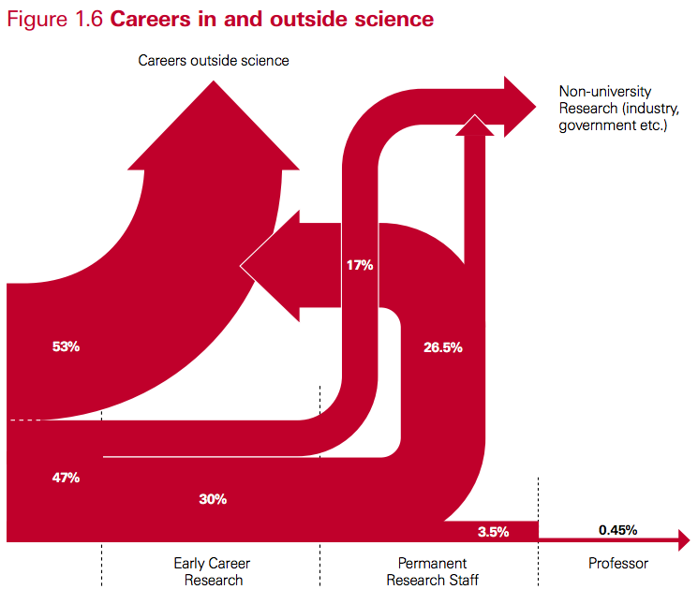
Specific challenges
Leaving the linear academic path or academia is quite general, but
most early-to-mid-career researchers (EMCRs) are not prepared for careers outside science
due to this and their precarious situation, there is hypercompetition
frustration and feeling of failure (affecting women more) - mental health
Source: 2010 Royal Society policy report entitled “The Scientific Century: securing our future prosperity”

Slide 5
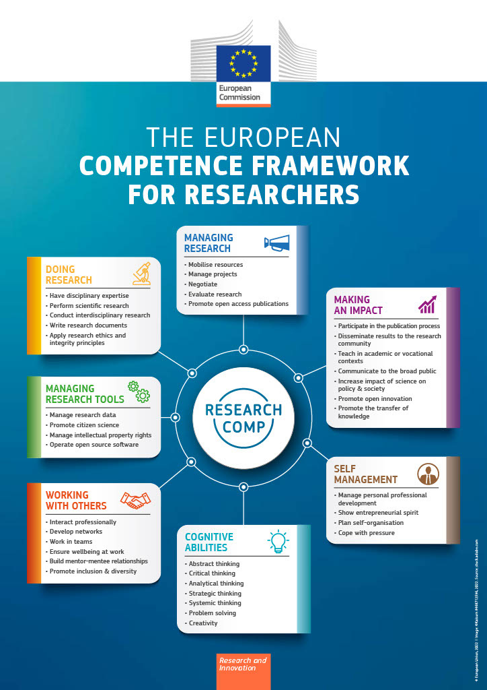
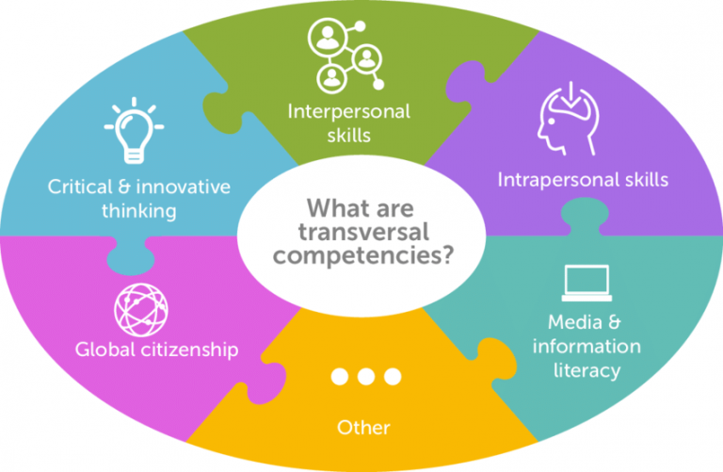
Specific challenges
need to improve doctoral training to meet needs of developing transversal skills and a diverse set of research competencies
this takes time (become a good lecturer, mentor, science communicator, innovator) and it is uncertain which competencies will be needed, recognized and rewarded later

Slide 6
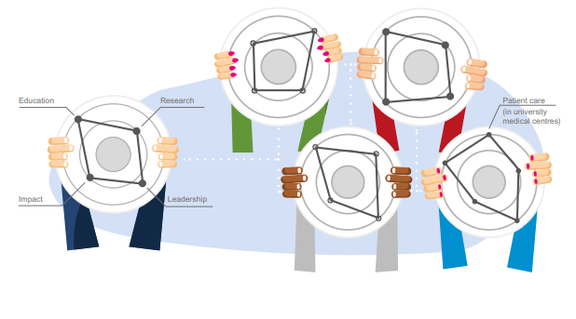
Specific challenges
“If you want to go fast, go alone. If you want to go far, go together.”
Teamwork – complementarity in competencies, large societal/research challenges often require inter- and transdisciplinary research teams
We need to recognize and reward the importance of various researcher competencies
https://recognitionrewards.nl/wp-content/uploads/2023/04/Room-for-everyones-talent-in-practice-Road-map-Recognition-Rewards.pdf
Achieving balance between the individuals and the collective
It is hard to tell apart the excellence of the researcher from that of the supervisor/group leader/group/institution at an early career stage

Slide 7
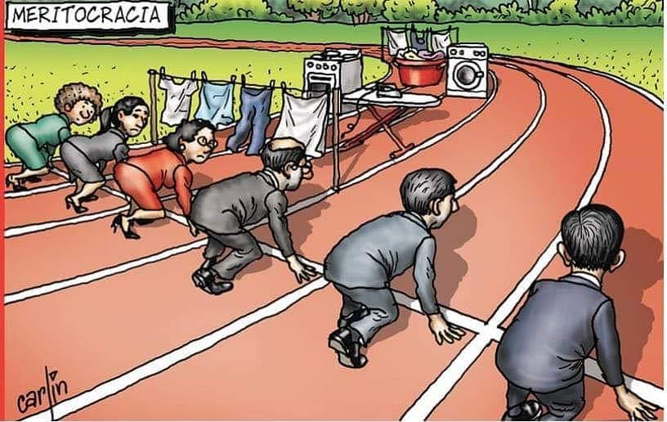
Specific challenges
“If you want to go fast, go alone. If you want to go far, go together.”
“Academia is a marathon, not a sprint.”
but how can you compare and assess people based on the first 100 m when this is a marathon?
gender, parental leave, teaching, science policy related activities are all “handicaps”
Matthew effect strengthens inequalities
uncertainty in evaluation criteria is also challenging (poor mental
health)

Slide 8
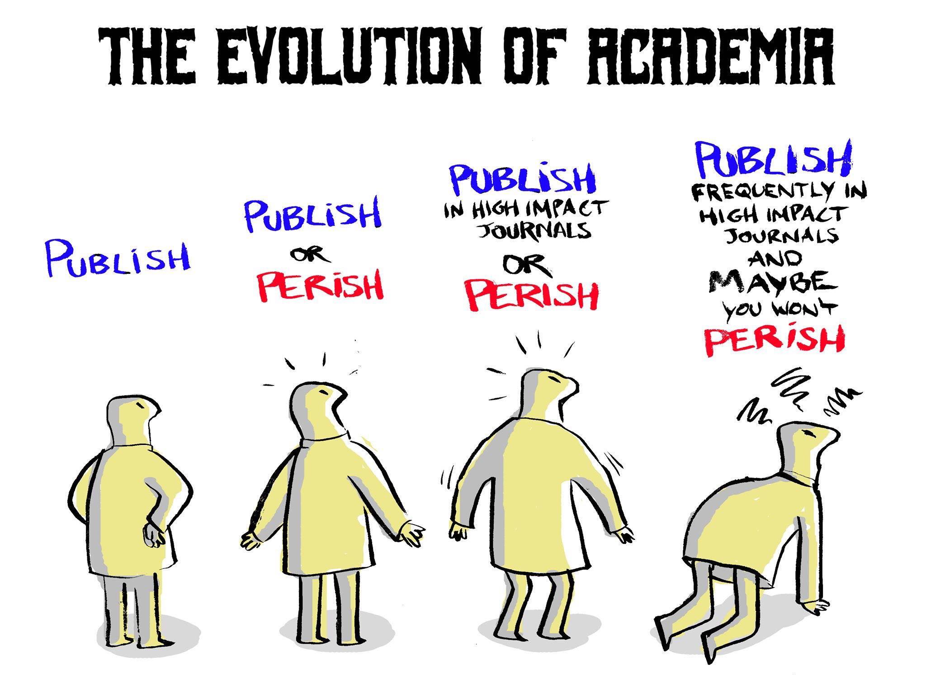
Solutions
Change in research culture
advocating for improved recognition and rewarding of various researcher competencies – not only of EMCRs but also their supervisors (quality/excellence of supervision/teaching/mentoring/doctoral training)
providing credit for parental leave, unconventional career paths (industry), teaching, mentoring, etc.
narrative CVs may help (peer mentoring platform by MCAA, YAE and 6 funders): https://pep-cv.mariecuriealumni.eu/
Pedronomics from Cheeky Scientist

Slide 9
Solutions
Change in research culture
stable, transparent, meritocratic, and predictable evaluation criteria
internationally compatible (to allow global mobility)
collection of data, discussions and sharing of best practices on
1) doctoral work/candidate assessment (by universities, doctoral schools)
2) (transparent) postdoctoral grant assessment (by funders)
3) habilitation evaluation procedures across Europe (by universities/authorities)
JOIN OUR TASK FORCE FOR EARLY-TO-MID-CAREER RESEARCHERS!
Young Academy of Europe

Slide 10
ThANK YOU!
chair@yacadeuro.org / katalin.solymosi@ttk.elte.hu
@yacadeuro / @KatalinSolymosi

