Slide 1
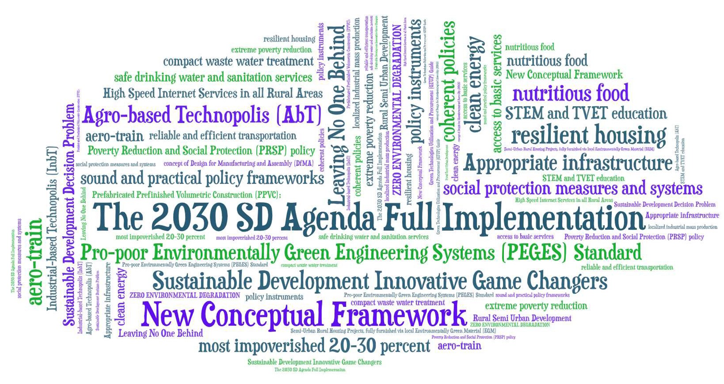
Utilizing the IDSSD as an Effective Vehicle Towards Accelerated Sustainable Development in DCs
Facilitating the Practical & Accelerated Implementation of the 2030 SD Agenda in Developing Countries
Nazar M. Hassan, PhD. IEOR Head of the Natural Sciences Section – UNESCO Beirut Office
The information presented herein does not necessarily represent the opinion of UNESCO
Notes:
We chose to approach the 2030 SD agenda as a multi-attribute multi-objective optimization problem, using the Industrial Engineering and Operations research field, for mathematically modelling such a complex problem, to identify its feasible region of solutions and finding the optimal possible solutions using a smart algorithm.
There were several important contributions, best of which is the development of the pro-poor environmentally Green Engineering system (PEGES) as a standard on which DCs can build their robust steps towards rural SD in the most cost effective and affordable modalities.

Slide 2
Problem Environment (Developing Countries)
Climate disruption is growing, as droughts, floods, storms and other weather-related hazards become more frequent and more severe.
More generally, production and consumption models are unsustainable.
Chemical, synthetic and electronic waste are globally in abundance.
The masses of unemployed college graduates should be part of a nation-wide program for achieving sustainable development in the impoverished rural areas.
Recent reports indicated that continuing population growth and urbanization globally are projected to add another 2.5 billion people to the world's urban population by 2050, with nearly 90% of the increase expected in Asia and Africa.
2
Notes:
So in investigating what needs to be done in terms of major actions to ensure achieving SD in these targeted countries, we found out that Global reports have identified four major actions for national governments and the international community to focus on. These are:
First, access to the poor to basic services such as clean energy, safe drinking water, health care, nutirious food, quality education, etc.;
Second, need to develop the appropriate infrastructure such as resilient housing, good drainage and sewage systems, transportation systems, all-weather roads; bridges, etc.;
Thirdly It is important to implement social protection measures and systems against exploitation and marginalization ; and
Fourth we need the right set of sound and practical policy frameworks to allow to implement and operate the new system.
So the main question we then answered was: how can we reduce the 169 targets problem into a tractible problem that can be solved

Slide 3
Strategic Dynamic Fit between the IDSSD and the Efforts of SD in DCs
Education
Agriculture
Communications
Technologies
Food
Industry
Electric
Power
Generation
Health
Care
Basic Services (Safe Drinking Water, Nutritious Food, Sanitation, etc.)
Textile
Industry
Resilient & Safe Housing
Small Industries
Transportation
17 Sustainable Development Goals as ONE PACKAGE
Notes:
The main challenge is the scarce resource allocation particularly if one chooses not to trade-off between the different objectives as in our case here, trying to address all the 17 SDGs as one package.
The second main challenge is the need to use high level engineering expertise in identifying the integrated solutions that will successfully address as many SDGs as possible in one action or in as few actions as possible for rural development, using proven green technologies as you will see in the proposed solution.

Slide 4
Strategic Dynamic Fit between the IDSSD and the Efforts of SD in DCs
Objectives of the IDSSD:
Objective 1: To advance scientific knowledge by enhancing scientific endeavour to deepen our understanding of nature and humanity, as well as the intricate interplay between them, and to generate, use and leverage scientific knowledge to accelerate progress towards the Sustainable Development Goals (SDGs) and beyond.
Objective 2: To build a robust science culture in which everyone has the right to participate in science and enjoy the benefits of scientific progress and its applications in accordance with the Universal Declaration of Human Rights.
4
Notes:
So identifying the interaction between the IDSSD and the SDGs implementation pathways, we can focus our actions around generating, using and leveraging scientific knowledge to accelerate progress towards the Sustainable Development Goals (SDGs) and beyond as indicated in IDSSD objective ONE
To focus on building a robust science culture amongst the targeted population and enjoy the benefits of scientific progress and its applications as indicated in IDSSD Objective TWO

Slide 5
Strategic Dynamic Fit between the IDSSD and the Efforts of SD in DCs
Expected Outcomes of the Decade
Outcome 1: The global community is empowered through scientific literacy.
Outcome 2: Actionable scientific knowledge is produced and used to accelerate progress towards the SDGs, in alignment with human rights.
Outcome 3: Basic sciences are advanced through global collaborative research initiatives.
Outcome 4: Open science is widely and equitably used to democratize scientific processes and access to scientific knowledge.
Outcome 5: National innovation systems are transformed, in order to respond better to the needs of science and society.
5
Notes:
This will allow us to focus on Outcome TWO and Five of the Decade:
Outcome 2: Actionable scientific knowledge is produced and used to accelerate progress towards the SDGs
Outcome 5: National innovation systems are transformed, in order to respond better to the needs of science and society.

Slide 6
Actionable Scientific Knowledge & Technologies Required
Global reports have recently called on DCs to focus on four specific actions towards SD, and which happen to be the main four targets of SDG 1, in order to phase lift the poor enacting the principle of ”Leaving No One Behind” .
These actions can be summarized as follows:
1. Formulate sound and practical policy frameworks based on pro-poor development and gender-sensitive approaches and mobilize adequate resources in an innovative manner to a common pool, in order to boost investment towards poverty eradication.
6
Notes:
So even in setting a plan to implement the four identified actions, the principle of LEAVING NO ONE BEHIND is to be embedded in the integrated solution.
And this could be easily enacted by:
by implementing a well-designed Poverty Reduction and Social Protection (PRSP) policy revolving around the implementation of Aristotle’s call for increasing the middle class for a better stable and just society, and enacting the principle of ”Leaving No One Behind” by focusing on the well-being and development of the most vulnerable and most impoverished 20-30 percent of each region’s population (with incomes of $1.25 USD or less).
Taking these targeted groups out of poverty will indeed impact the social and economic development of these communities and their countries, as was the case in Brazil between 2003 – 2011.

Slide 7
Actionable Scientific Knowledge & Technologies Required
2. Implement the appropriate social protection measures and systems against exploitation and unfair treatment;
3. Ensure easily access of the poor to basic services of safe drinking water; clean energy; adequate health services; new technology systems and dire-needed financial services and most importantly high-speed Internet;
4. Appropriate infrastructure such as all-weather roads; bridges; good drainage and sewage systems and dams in identified areas are all in order to reduce the magnitude of natural disasters, and adding recreational parks, while improving resilience against climate change adverse effects;
7
Notes:
It might hence be worthwhile to contemplate designing and adopting a replicable infrastructure development standard/ practice, which can help us benefit from easy accessibility to the relevant scientific knowledge and practical technologies in order to achieve sustainable resilience, and successfully apply full green procurement in transforming most of the poor villages and small towns into a number of agricultural/industrial Technopolis i.e. new societies with a concentration of technology-based businesses (both digital and non-digital) green technologies, depending on the natural resources of each specific region.

Slide 8
Actionable Scientific Knowledge & Technologies Required
Achieving sustainable development in impoverished rural areas essentially calls for substantial investments in mega infrastructure projects, which are instrumental in meeting the SDGs in developing countries. This is true since:
By creating jobs and economic activity, infrastructure enables development;
Provides the services that underpin the ability of people to be economically productive, for example via transport;
Building the right type of infrastructure in rural areas, you not only have a positive impact on the environment and the ability to meet the climate change goals, but you also contribute to reducing inequality within societies.
8
Notes:
Another mandate of the proposed infrastructure development standard is to pay close attention to the pre-design conditions dictated by the standard. This is to make sure to design all necessary and relevant infrastructure specifications such that it easily fits and suits the requirements of the different preselected green technologies that are to be introduced in these infrastructure units.

Slide 9
Actionable Scientific Knowledge & Technologies Required
Hence it is the necessary replicable infrastructure development standard that can help us benefit from scientific knowledge and technologies to achieve sustainable resilience and successfully apply full green procurement in transforming most of the poor villages and small towns into a number of Agricultural/Industrial Technopolis i.e. new societies with a concentration of technology-based businesses (emphasis on both digital and non-digital green technologies), depending on the natural resources of each specific region.
Another mandate of the proposed standard is to make sure to design all necessary and relevant infrastructure to suit the requirements of the different preselected green technologies that are to be introduced in these units.
9

Slide 10
Actionable Scientific Knowledge & Technologies Required
Main specifications and technological provisions towards the sought accelerated SCP patterns:
Selection of a set of pre-selected innovative but well-proven green technologies as technological standards for replication in the targeted regions to ensure the development of a strong sub-regional supply chain and industrial base. This aims towards the creation of the required demand for the production of these technological applications in a modality that would promote regional and/or sub-regional integration;
Utilization of the concept of Value Engineering to seek schemes that mandate both efficient designs i.e. optimal resources allocation, reduced waste, land and space management, renewable energy utilization, and cost effectiveness as well as shorter construction lead time when compared to conventional systems and alternatives;
Utilization of the concept of Value chain to support the promotion of local manufacturing and production for the majority of the spare parts of the newly proposed engineering systems. This aims to create new markets and SMEs for the selected new products and their associated services in these targeted regions;
Mandates that any natural resource you do not have you do not use, unless its use is critical and there is no other innovative substitution for it;
10

Slide 11
Actionable Scientific Knowledge & Technologies Required
Main specifications and technological provisions towards the sought accelerated SCP patterns:
Mandates that all new and innovative systems are to be designed or re-designed using the Integrated Whole System Design (IWSD) Approach, with the required level of cost effectiveness through minimal resources utilization and optimal waste management;
Mandates that all newly built rural urban centers including the agricultural-based Technopolis (AgbT) and/or the industrial-based Technopolis (IndbT) will refrain from utilizing fossil fuel products for all forms of energy consumption;
Mandates that all newly built rural urban centers including the AgbTs and/or the IndbTs will refrain from utilizing products of energy-intensive production nature such as Ammonia, Paper and Fertilizers, etc. Cement and steel can only be used and only allowed in construction;
Mandates that all newly built rural urban centers including the AgbTs will refrain from using material that negatively affects biodiversity such as wood for furniture. Instead, the use of granite stone and cast concrete/bricks to be promoted for furniture manufacturing;
Mandates the design and/or re-design of any system with fewer moving elements, where most of the wear and tear take place.
11

Slide 12
Actionable Scientific Knowledge & Technology Required
The suggested sought actionable knowledge and technologies are envisioned as:
a database containing a set of pre-selected technologies and technology applications of the infrastructure standard that when implemented would transform the marginalized rural areas into a fully green economy detached from environmental degradation.
The database is essentially a Green Technologies Utilization and Procurement (GTUP) e-guide that teaches the required technical know-how (TVET) in providing all technological applications to make available all the basic services including resilient green housing, safe drinking water, brackish water desalination, water efficient gadgets, RE energy generation, affordable and reliable transportation and designed compact wastewater and sanitation facilities in every rural semi-urban center/residential complex that is replacing the poor villages.
12

Slide 13
Actionable Scientific Knowledge & Technology Required
A series of regional Sustainable Development Green Technologies Education and Utilization (SDG-TEU) hubs/centers of excellence are developed to mainly focus on building a regional online platform to develop and implement Training of Trainers (ToTs) in developing countries in many important educational areas such as:
a) Functional and digital literacy skills: Functional literacy refers to the capacity of a person to engage in all those activities in which literacy is required for effective function of one’s group and community and also for enabling him or her to continue to use reading, writing and calculation for his or her own as well as the community’s development.
b) Entrepreneurship: Entrepreneurship education has been defined as “a collection of formalized teachings that informs, trains, and educates anyone interested in participating in socioeconomic development through a project to promote entrepreneurship awareness, business creation, or small business development”.
13

Slide 14
Actionable Scientific Knowledge & Technology Required
c) Global citizenship Education: aiming to empower learners of all ages to assume active roles, both locally and globally, in building more peaceful, tolerant, inclusive and secure societies.
d) Technical and vocational education and training (TVET) TVET, is referred to here to includes work-based learning and continued training and professional development. Our module in TVET shall target most of the required technical education and knowledge for sustainable development in all economic sectors including resilient housing construction, water desalination, renewable energy systems, sanitation, sustainable transportation, environmentally green small and medium industries, sustainable agriculture, nutritious foods production, etc.
These will be intimately related to the technologies and services identified in the Green Technologies Utilization and Procurement (GTUP) e-guide facilitating all the basic services preselected for the development of the proposed rural semi-urban communities;
14

Slide 15
Actionable Scientific Knowledge & Technology Required
The set of Trained Trainers shall be part of a robust nationwide training programs that are intended to propagate their knowledge further at the national level to train the critical mass of technical force and practitioners that are required to support achieving the SDGs in these communities.
The technology universities and academies of Sciences around the world and some technology manufacturers shall also be called upon to support the development of the different digital TVET modules. Some of e-modules could even be gathered from existing sources such as the “…101 for dummies” and the “Do It Yourself” series.
15
Notes:
Unlike the quality courses produced by the SDG Academy affiliated with the Sustainable Development Solutions Network (SDSN) of Jeffrey Sachs, the plan here is to train all unemployed college graduates in the targeted countries to specialize in a set of pre-selected green technological solutions within the main economic sectors to be implemented in the rural areas.

Slide 16
Examples for Actional Knowledge and Technological Applications
Standard rural semi-urban complex: (Observe for the possible industrial facilities to develop through the application of the pre-design requirements)
Each residential unit (3 buildings of 1000 sq.m. and 75 floors each) can take up to 1000 families (4500 persons) hence supplying a whole village or a # of merged villages with all their basic needs in ONE STEP (10-12+ SDGs achieved)! With the following characteristics:
- Ability to produce 250 – 300kW of electricity either through large vertical wind turbines installed before the roof floor or using the concept of a solar chimney as illustrated;
- Ability to produce sufficient drinking water to tenants through Brackish Water desalination processes;
- Uses an aqua phonic system on the tower roof to produce nutritious food for tenants including fish, poultry and fresh vegetables;
Notes:
Extensive research in well proven engineering approaches such as using the IWSD approach and the Design For Manufacturing & Assembly, etc. was undertaken and which led to the Possible Development of Semi-Urban Rural Housing Projects, fully furnished via local Environmentally Green Material (EGM)
Please Observe for the possible industrial facilities that are to develop through the application of these pre-design requirements
Read from slide

Slide 17
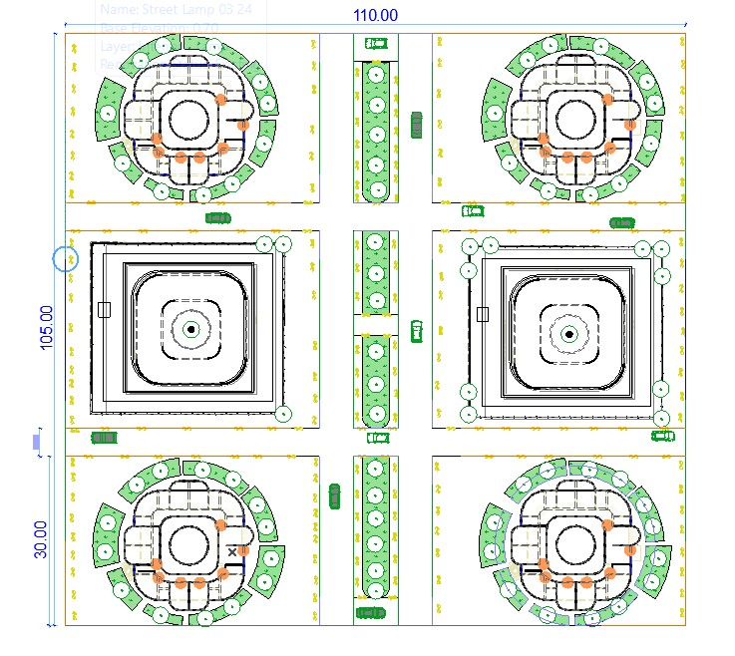
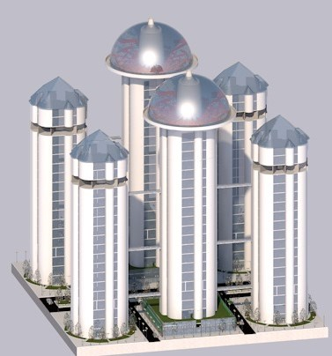
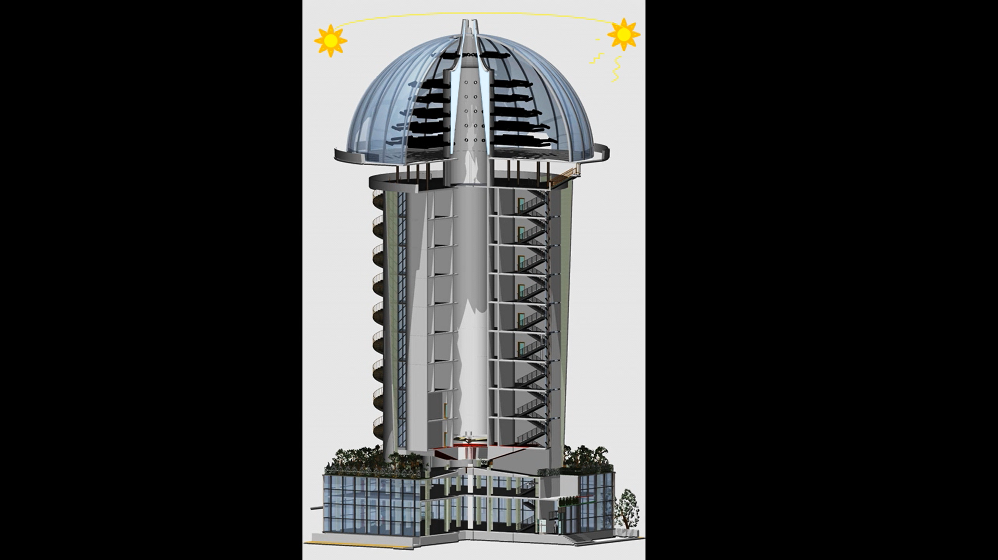
(a) Semi-Urban Rural Housing Projects (Poor Villages Transformed)
Notes:
Notice here for the three concepts as part of this engineering design:
The improved solar chimney concept (patented)
Vertical wind turbine installation within the design of the buildings
Green houses and Aqua phonics systems installed on the rooftops
Note that these systems in total will cost less than 2% of the total buildings cost

Slide 18
Examples for Actional Knowledge and Technological Applications
- All furniture for the living Qtrs are made of granite stone, PVC or cement pre-cast; (possibly locally manufactured!!!)
- All doors and windows are made of PVC; All plumbing parts are made of PVC; (possibly locally manufactured!!!)
- Buildings are fitted with water efficient gadgets;
- Buildings are equipped with sanitation and compact wastewater treatment systems underneath each tower;
- Buildings use LED savings lamps; (locally manufactured!!!)
- New innovated specially-designed super efficient central ventilation and AC system;
- All tenants will therefore have clearly marked and identified fixed addresses, a requirement to secure bank loans and other financial services.
Notes:
Extensive research in well proven engineering approaches such as using the IWSD approach and the Design For Manufacturing & Assembly, etc. was undertaken and which led to the Possible Development of Semi-Urban Rural Housing Projects, fully furnished via local Environmentally Green Material (EGM)
- All tenants will therefore have clearly marked and identified fixed addresses, a requirement to secure bank loans and other financial services.
Read from slide

Slide 19
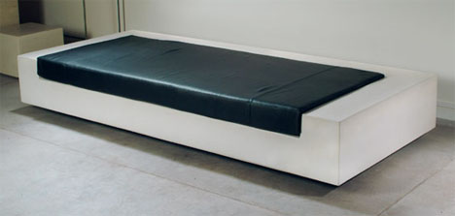
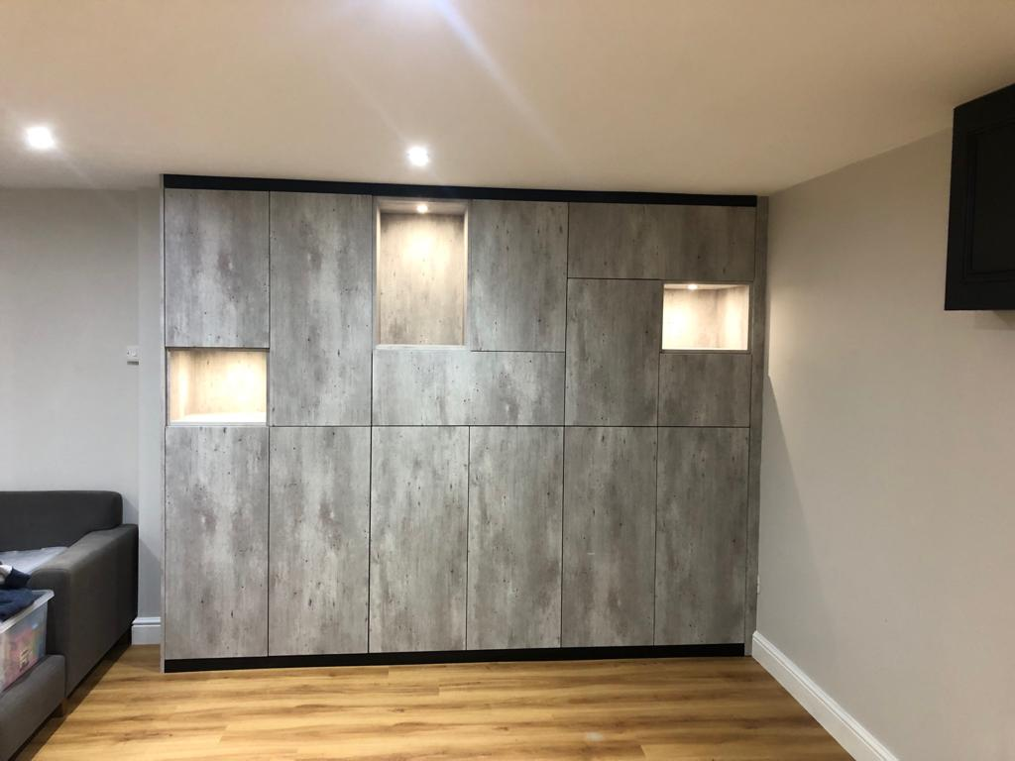
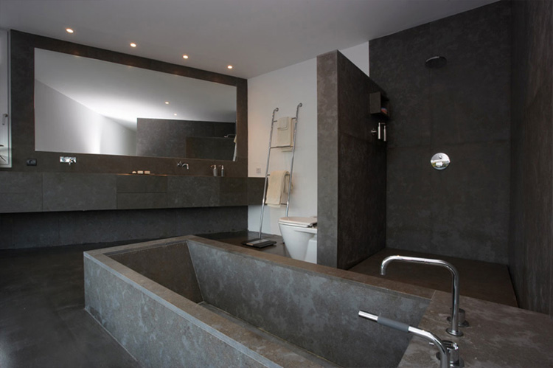
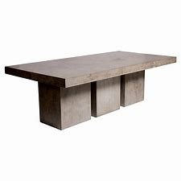
Fully furnished via local Environmentally Green Material (EGM) Granite, PVC or fabricated cast concrete (if need be)
Notes:
The project provides for fully furnished spacious apartments allowing for furniture production facilities in these rural areas. This is something that currently exists and just need to be exploited.

Slide 20
Examples for Actional Knowledge and Technological Applications
Buildings constructed using Prefabricated Prefinished Volumetric Construction (PPVC), which reduces wastage both on-site and off-site with better control of the production processes and improve construction productivity by up to 40 per cent in terms of manpower and time savings
Around 80 per cent of each housing module will be built off-site, with waterproofing, tiling, painting, glazing, cabinetry, plumbing and electrics completed before being delivered to be "stacked and joined together on-site".
"To raise construction productivity, the industry is encouraged to embrace the concept of Design for Manufacturing and Assembly (DfMA), where construction is designed and detailed for a substantial portion of work to be done off-site in a controlled manufacturing environment,".
Chinese infrastructure company BROAD Group managed to build a 10-storey apartment building in just 28 hours and 45 minutes. (can you imagine!!!)
According to the company, the special steel plates it has developed for the structural support of the units have a much lower production cost than those used traditionally. In addition, it is 10 times lighter and 100 times stronger, so it can withstand earthquakes and hurricanes.
Notes:
The well proven engineering approaches used allows for:
1. Around 80 per cent of each housing module will be built off-site in a controlled manufacturing environment
2. improve construction productivity by up to 40 per cent in terms of manpower and time savings and more than 60% savings on waste building materials

Slide 21
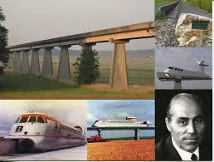
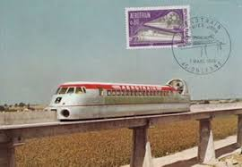
(b) Agro-based Technopolis (AbT) aero-train systems
(b) Development of AbT and/or InbT efficient and cost-effective transportation system
Description
Transportation within the network of the AbTs and InbTs will be Relatively cheap railways of concrete infrastructure with no steel rails or rail wheels;
Historic 1960s aero-trains are been recommended where there is no need for steel railways or steel wheels infrastructure. It easily glides over an air cushion like a guided hovercraft. Early in the 1960s, the aero-train has been proven to attain speeds up to 400+ mph operated by an electric motor, and hence This will reduce both energy consumption and travel time between the different semi urban centers; (best situated for countries with poor long distances road or rail transportation networks)
Applying the proposed Standard has also led to:
- Higher train speeds with low propulsion power;
- PV powered segways and motorbikes (new designs);
Notes:
The developed Standard recommends transportation within the network of the new semi-urban centers that is relatively very cheap, fast and effective.
First: With no steel railways or steel wheel infrastructure, the Historic 1960s aero-train glides over an air cushion like a guided hovercraft with speeds up to 400+ mph operated by an electric motor, reducing both energy consumption and travel time between the different Technopolis & urban areas; (best situated for countries with long distances poor road or poor rail transportation networks)
- PV powered segways and electric motorbikes for inner cities individual transportation (new);

Slide 22
Proposed Plan of Action to Implement IDSSD Outcome 2
Main Objective: To Provide the different population groups in developing countries with readily applicable scientific knowledge and technologies to address the complex challenges associated with the achievement of the 17 Sustainable Development Goals (SDGs), and in alignment with the Universal Declaration on Human Rights.
To raise awareness of developing countries that they should seize the rapid urbanization movement that is globally creating significant opportunities for social and economic development and more sustainable living, and foster semi-urban communities in their rural areas, using a well-defined cost effective and optimal resources management fashion. Of course, urban sustainability is to be guided by an evidence-based and inclusive planning process that balances economic, social and environmental resource consideration;
22
Notes:
So to recap, we review the main and specific objectives of this white paper and see whether the proposed solution was able to achieve any of these objectives

Slide 23
Proposed Plan of Action to Implement IDSSD Outcome 2
To set up a possible standard for semi-urban rural development to ensure reaping the benefits of sustainable resilience in these targeted countries. Sustainable resilience is a proactive, holistic approach that creates a work culture of excellence sustained by a wide range of systemic factors such as well-developed standards. Standard-setting allows for the development of a rational framework of rules, norms, values, and accepted measures of compliance, such as LEED in the case of rural semi urban development. It is also worth noting that standard-setting transcends government and includes regulatory requirements for both public agencies and private corporations and investors. More importantly, standard-setting transcends policy and advocacy as it combines public acceptance, expectation, compliance, and legal enforcement—all in a single, powerful strategy.
23

Slide 24
Proposed Plan of Action to Implement IDSSD Outcome 2
Once the standard for rural infrastructure development is created, the project will aim to develop an online platform with an interactive database containing a set of mandatory courses signifying all pre-selected technologies and technology applications of the infrastructure development standard and/or practice, which when implemented would transform the marginalized rural areas into fully green economies detached from environmental degradation.
1) Intrinsic skills development in the construction field;
2) Modern Techniques in towers construction using SMART Prefabricated Prefinished Volumetric Construction (PPVC);
3) Modern Techniques in towers construction utilizing the concept of Design for Manufacturing and Assembly (DfMA);
4) Newly designed special steel plates for the structural support of the towers for better earthquakes and hurricanes overloads;
5) Modern Giant Machinery for efficient construction of high towers;
6) Innovative SMART plumbing techniques in erecting and maintaining towers;
7) Innovative SMART electrification techniques in high towers;
8) Vertical Wind turbines in towers: construction and maintenance;
9) Sustainable and efficient transportation for semi-urban rural Technopolis;
10) Innovative SMART Brackish water desalination techniques for standalone towers;
11) Environmentally green materials for furniture development for towers;
12) Efficient SMART Space management for towers dwellers: wellbeing and livelihoods;
13) Skills for the implementation of SMART e-governance in developing countries;
14) Design and maintenance of SMART Aquaponics for sustainable nutrition; and
15) SMART techniques in high-rise building management using AI.
24
Notes:
1) Intrinsic skills development in the construction field;
2) Modern Techniques in towers construction using SMART Prefabricated Prefinished Volumetric Construction (PPVC);
3) Modern Techniques in towers construction utilizing the concept of Design for Manufacturing and Assembly (DfMA);
4) Newly designed special steel plates for the structural support of the towers for better earthquakes and hurricanes overloads;
5) Modern Giant Machinery for efficient construction of high towers;
6) Innovative SMART plumbing techniques in erecting and maintaining towers;
7) Innovative SMART electrification techniques in high towers;
8) Vertical Wind turbines in towers: construction and maintenance;
9) Sustainable and efficient transportation for semi-urban rural Technopolis;
10) Innovative SMART Brackish water desalination techniques for standalone towers;
11) Environmentally green materials for furniture development for towers;
12) Efficient SMART Space management for towers dwellers: wellbeing and livelihoods;
13) Skills for the implementation of SMART e-governance in developing countries;
14) Design and maintenance of SMART Aquaponics for sustainable nutrition; and
15) SMART techniques in high-rise building management using AI.

Slide 25
Proposed Plan of Action to Implement IDSSD Outcome 2
The experts will give their opinions in trying to answer the following questions:
Is the proposed solution highly likely to accelerate the achievement of sustainable development in targeted regions?
What are the pros and cons of the proposed solution?
Has the Integrated Whole System Design (IWSD) approach been successfully implemented in the proposed solution? Explain
Standards are meant to facilitate sustainable resilience, why has not the global community utilized standards to achieve SD in developing countries so far?
Does the proposed standard solution meet Leadership in Energy and Environmental Design (LEED) requirements? Explain
Is the outcome 2 of the IDSSD likely to be implemented using the proposed solution?
Will the development of the online platform support the buildup if the scientific tempo in developing countries?
If financing the proposed solution is the obstacle, how can the global community at least implement a demo for the project and properly evaluate its effectiveness?
25
Notes:
Let us now see what the panel have to say in terms of the proposed solution using their expertise
We will give each expert 5 minutes to make a general statement regarding how they view the solution and then we will work through a set of questions to clarify more

Slide 26
ALL QUESTIONS AND/OR COMMENTS ARE WELCOME
For collaboration in the implementation of the herewith proposal
For comments and questions regarding the research work please contact the author at n.hassan@unesco.org
شكراً لإصغائكم

